Slide 1
Problem No. 10 TESLA VALVE
Reporter
David Wittek & Jakub Domes
Mendelovo Gymnázium, Opava

Slide 2
task
„A Tesla valve is a fixed-geometry, passive, one-direction valve. A Tesla valve offers a resistance to flow that is much greater in one direction compared to the other. Create such a Tesla valve and investigate its relevant parameters. “

Slide 3
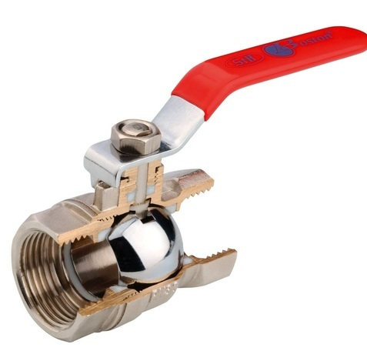
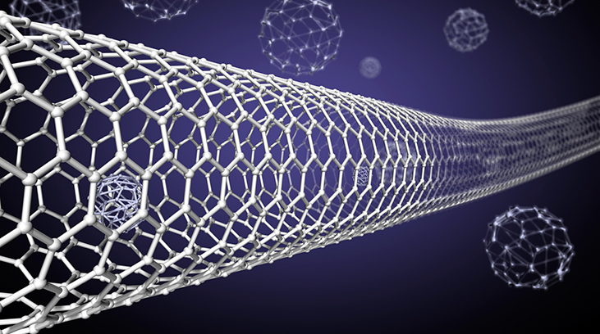
PROBLEMATICS WITH construction of valve
BEGINNING OF 20. CENTURY
NOWADAYS – nanotechnologies, microfluids
high degradability of moving components
construction of moving components of valves with sizes about ${10}^{−7}$ m
ball valve
[1]
[2]

Slide 4
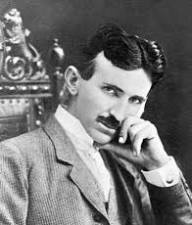
Valvular Conduit
Patended in 1920 in USA by Nicola Tesla
„Tesla valve“
[3]
„The interior of the conduit offering virtually no resistance to the passage of the fluid in one direction, other than surface friction, constitute an almost impassable barrier to its flow in the opposite direction“
Nicola Tesla, 1920 [3]
[3] "Patent #: US001329559". United States Patent and Trademark Office. Office of the Chief Communications Officer. Retrieved 2 January 2017

Slide 5
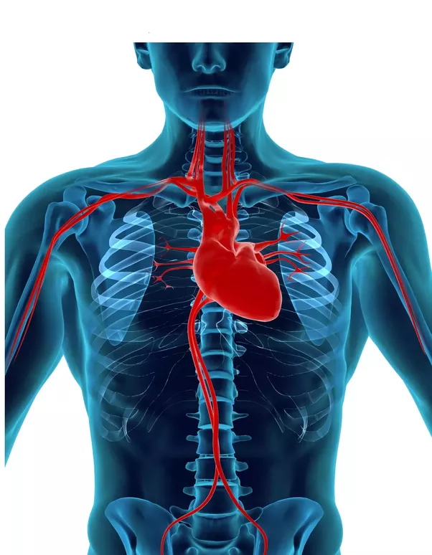
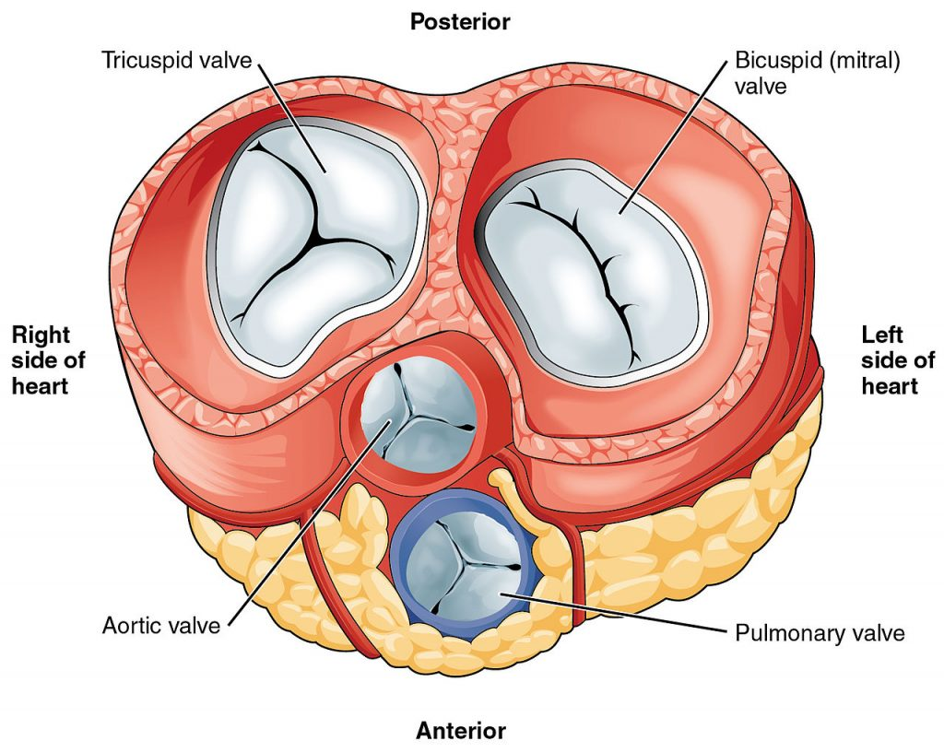
future
model of Aortic valve
artificial heart valve
diseases like regurgitation

Slide 6
Valvular Conduit
Patended in 1920 in USA by Nicola Tesla
„Tesla valve“
[3]
„The interior of the conduit offering virtually no resistance to the passage of the fluid in one direction, other than surface friction, constitute an almost impassable barrier to its flow in the opposite direction“
Nicola Tesla, 1920 [3]
[3] "Patent #: US001329559". United States Patent and Trademark Office. Office of the Chief Communications Officer. Retrieved 2 January 2017

Slide 7
Tesla‘s device
[3] "Patent #: US001329559".
b
11 segments
$$\frac{a}{b}≈\frac{5}{3}$$
a
$$α≈23.5°$$
$$α$$
likely heuristic design
pressure ratio to 200

Slide 8
our Tesla Valve geometry
$$l_{1}$$
$$r_{1}$$
C
we change parameters independently:
a
C
D
C
$$l_{2}$$
$$β$$
$$α$$
angle $α$
$$l_{1}$$
ratio $\frac{a}{b}$
b
our contribution
number of segments
application of scientific method
Defining parametres:
$r_{1}$= 0.7 cm
$β$ = 140 °
$l_{1}$=0.6 cm
$l_{2}$=1.5 cm
D= 1.36 cm

Slide 9
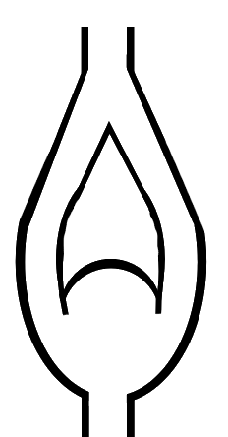
our fixed geometry valve
our own unique model of one direction passive valve
reversed
forward
1-4 SEGMENTS
$≈$1.36 cm
better properties than Tesla model
1-38 kPa

Slide 10
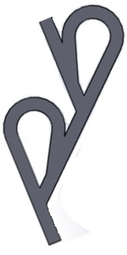
tesla valve relationship
reversed direction
PRESSURE DROP $p_{D−(R F)}$
$$p_{D}=INLET PRESSURE −OUTLET PRESSURE$$
DIODICITY ${DI}_{Q}$
$${DI}_{Q}=\frac{PRESSURE DROP IN FORWARD DIRECTION}{PRESSURE DROP IN REVERSED DIRECTION}$$
forward direction
CONSTANT FLOW RATE

Slide 11
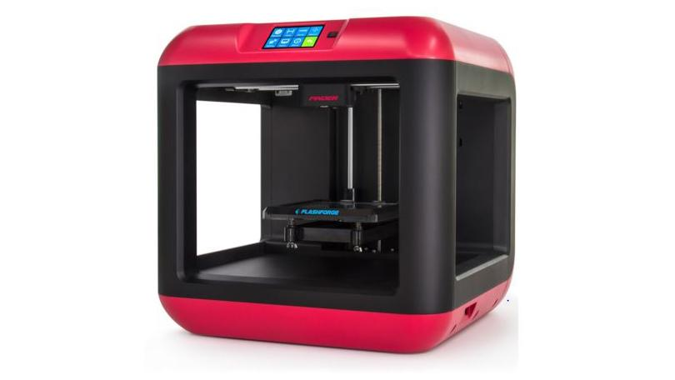
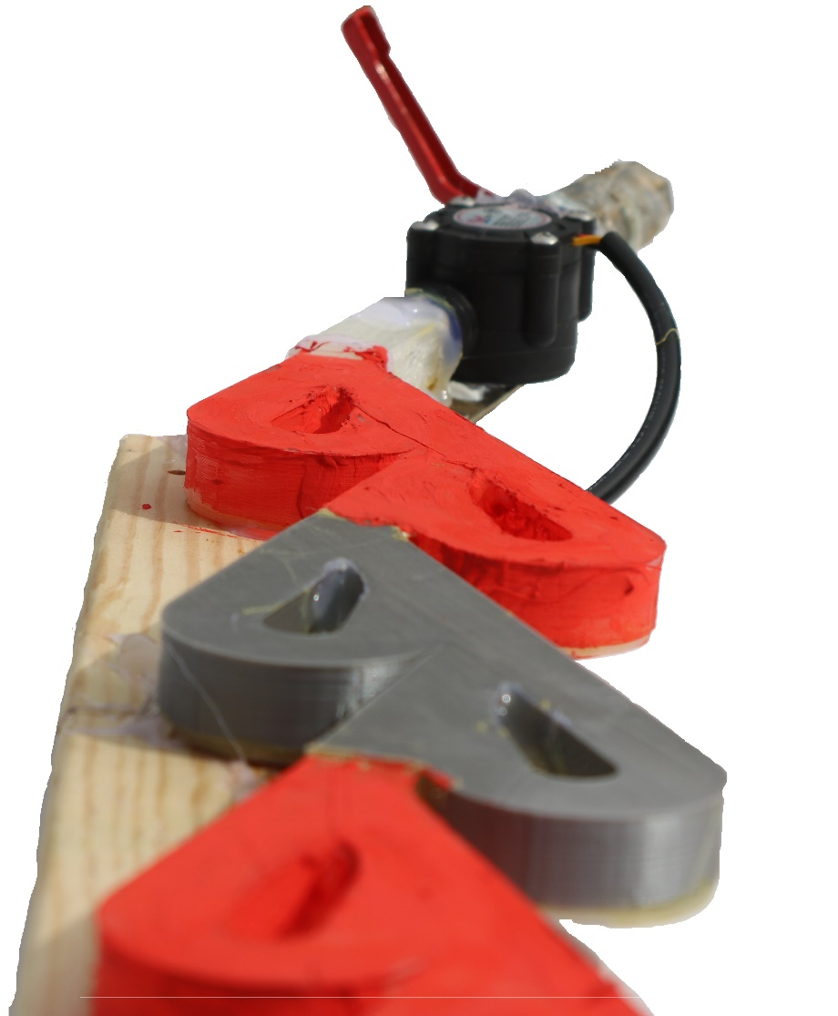
our setup
own geometrical model
more than 90 segments with different properties
3D print
$$D$$
$$D$$

Slide 12
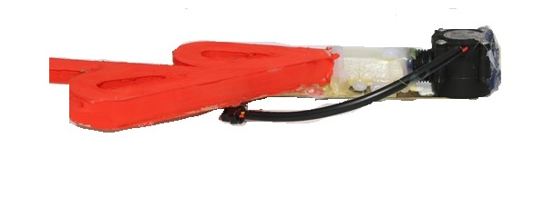
EXPERIMENTAL METHOD
behavior of the valve for liquids
outlet pressure
hydrostatic pressure
flow rate
INLET PRESSURE
$p_{OUT}=\frac{d^{2}}{4∙H∙ρ∙g}$ - $\frac{1}{2}{\left(\frac{Q}{S}\right)}^{2}$
surr. press.
atm
Arduino flow rate sensor
H
d
pressure drop = inlet pressure - outlet pressure

Slide 13
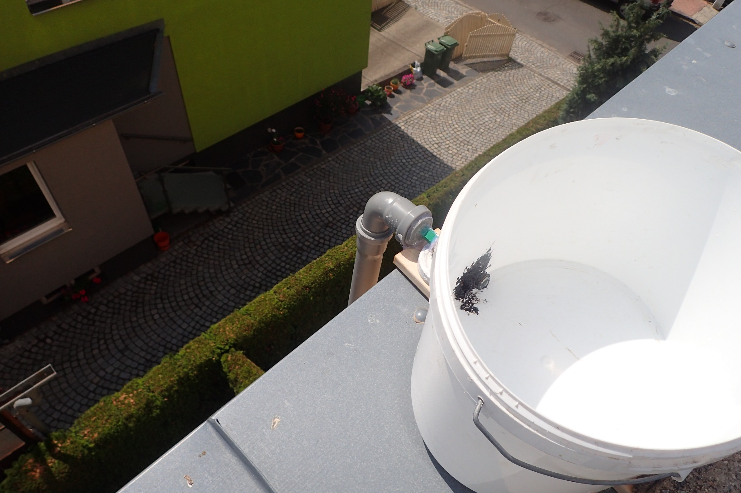
Initial conditions
is of great importance to results & reproducibility
height water column
(to 5.5 m)
large water surface
$≈$const. water level in time
good reproducibility 7.4 % !
BEFORE experiment:
DURING experiment:
const. initial pressure in whole valve
result from stationary state (T$≫10 s$)

Slide 14
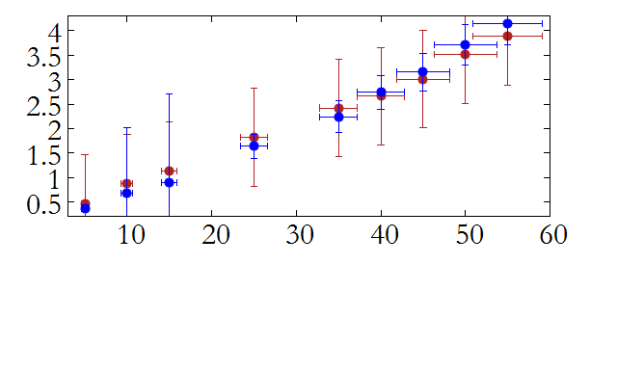
Pressure drop - forward
$≈$1.36 cm
Press. drop= INLET press. – OUTLET press.
14 segments
$≈$1.36 cm
$$45°$$
Pressure drop [kPa]
11 segments
forward
Inlet pressure [kPa]

Slide 15
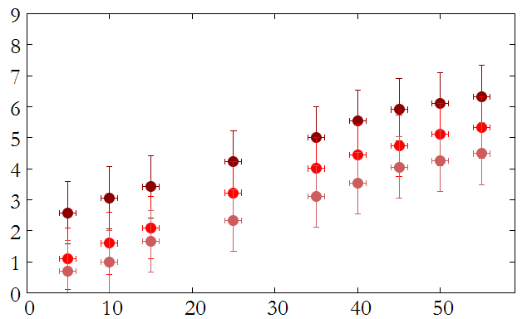
Pressure drop - forward
L
Darcy - Weisbach equation
14 segments
Pressure drop [kPa]
$$\frac{∆p}{L}=f_{D}∙\frac{ρ}{2}∙\frac{v^{2}}{D}$$
velocity experimentaly determined
11 segments
14 segments
Inlet pressure [kPa]
for turbulent flow
Flow rate [m/s]
$$\frac{1}{\sqrt{f_{D}}}=1.93∙\log{\frac{1.9}{Re∙\sqrt{f_{D}}}}$$
11 segments
numerical solution
Inlet pressure [kPa]

Slide 16
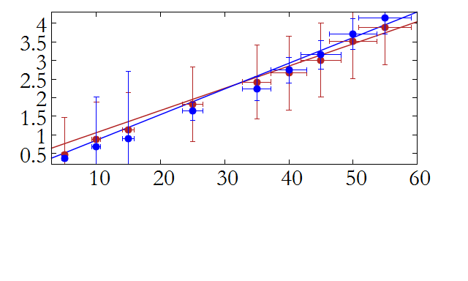
Pressure drop - forward
$≈$1.36 cm
$≈$1.36 cm
$$45°$$
Press. drop= inlet press. – outlet press.
forward
Darcy - Weisbach equation
14 segments
Pressure drop [kPa]
$$\frac{∆p}{L}=f_{D}∙\frac{ρ}{2}∙\frac{v^{2}}{D}$$
11 segments
for turbulent flow
$$\frac{1}{\sqrt{f_{D}}}=1.93∙\log{\frac{1.9}{Re∙\sqrt{f_{D}}}}$$
good agreement for higher pressures
Inlet pressure [kPa]
L

Slide 17
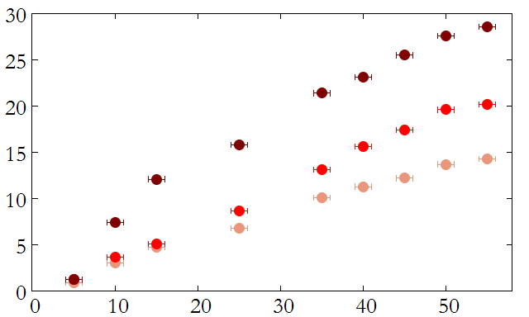
Pressure drop - reversed
$≈$1.36 cm
$$45°$$
Press. drop= inlet press. – outlet press.
reversed
14 segments
Pressure drop [kPa]
11 segments
losses due to interaction of turbulent streamlines
8 segments
$$\frac{∆p}{L}=f_{D}∙\frac{ρ}{2}∙\frac{v^{2}}{D}$$
Darcy - Weisbach equation
Inlet pressure [kPa]

Slide 18
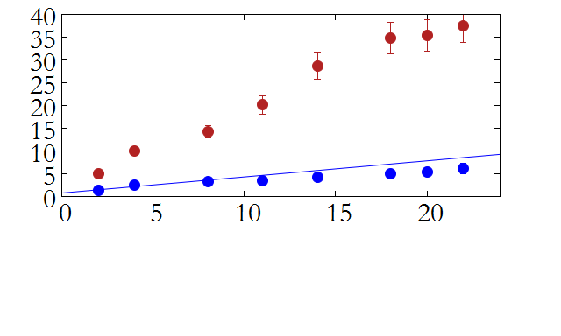
Pressure drop – number of segments
$$p_{0}=\left(55±1\right)kPa$$
$≈$1.36 cm
reversed direction
$$45°$$
Pressure drop [kPa]
reversed
forward
forward direction
Darcy - Weisbach equation
$$\frac{∆p}{L}=f_{D}∙\frac{ρ}{2}∙\frac{v^{2}}{D}$$
for turbulent flow
Number of segments

Slide 19
FORWARD dir. REVERSED dir.
Di =12.7 ± 0.4
same flow rate
press. drop in reversed dir.
Di =
press. drop in forward dir.

Slide 20
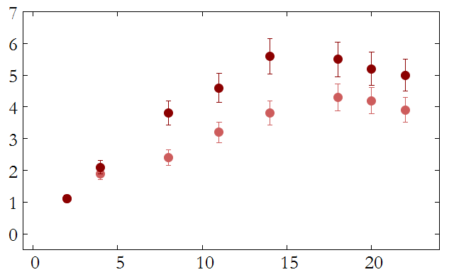
DIODICITY – number of segments
$p_{IN−r}=$(50$±1$) kPa
$$p_{IN−r}$$
Diodicity
$p_{IN−r}=$(20$±$1) kPa
inlet pressure in reversed direction
$≈$1.36 cm
press. drop in reversed dir.
Di =
$$45°$$
press. drop in forward dir.
reversed
number of segments

Slide 21
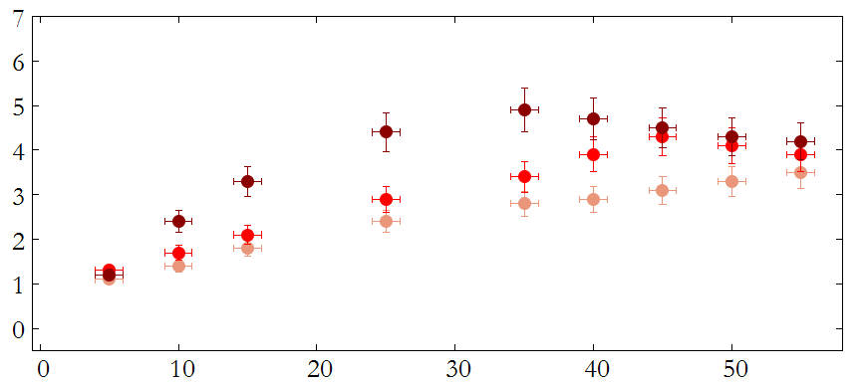
diodicity – inlet pressure
$≈$1.36 cm
$$45°$$
14 segments
Tesla original design
11 segments
Diodicity
Diodicity
11 segments
8 segments
inlet pressure in reversed direction [kPa]

Slide 22
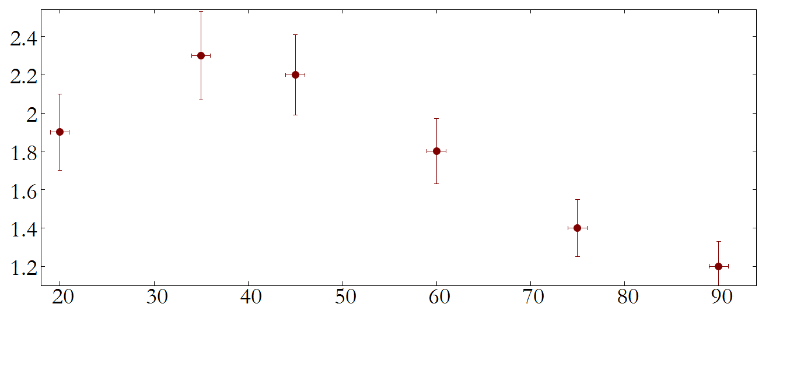
Diodicity- angle dependecy
$p_{IN−r}=$(20$±$1) kPa
$≈$1.36 cm
$$α$$
diodicity
optimal angle
$$α=(35.0±7.5)°$$
Tesla‘s device
angle $α$[$°$]

Slide 23
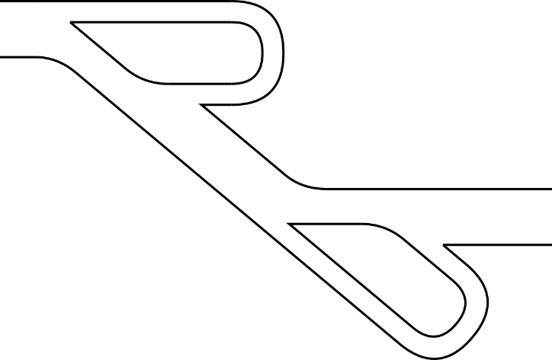
diodicity – side ratio $\frac{a}{b}$
$p_{IN−r}=$(20$±$1) kPa
b
optimal ratio $\frac{a}{b}$
a
diodicity
$\frac{a}{b}$=(1.25$±0.20)$
slightly larger diameter a
Tesla‘s device
ratio $\frac{a}{b}$

Slide 24
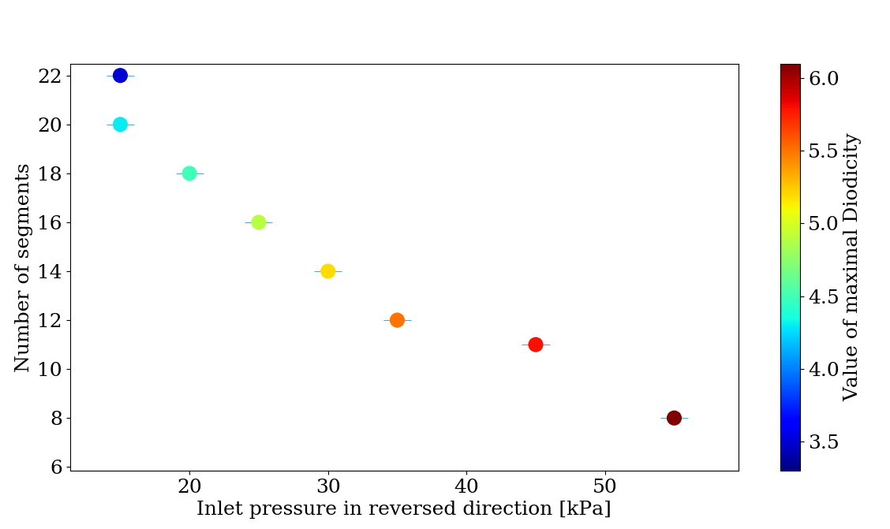
optimal diodicity
optimal number of segments for variable inlet pressure
maximal observed diodicity 6.3
press. drop in reversed dir.
Di =
press. drop in forward dir.

Slide 25
our fixed geometry valve
our own unique model of one direction passive valve
reversed
forward
1-4 SEGMENTS
$≈$1.36 cm
better properties than Tesla model
1-38 kPa

Slide 26
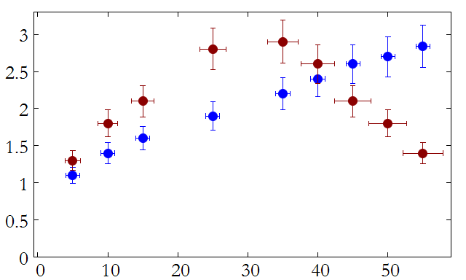
OWN GEOMETRY
our own model of one direction passive valve
Diodicity
Tesla valve
4 segments ($α=45°)$
our model better properties
inlet pressure in reversed direction [kPa]

Slide 27
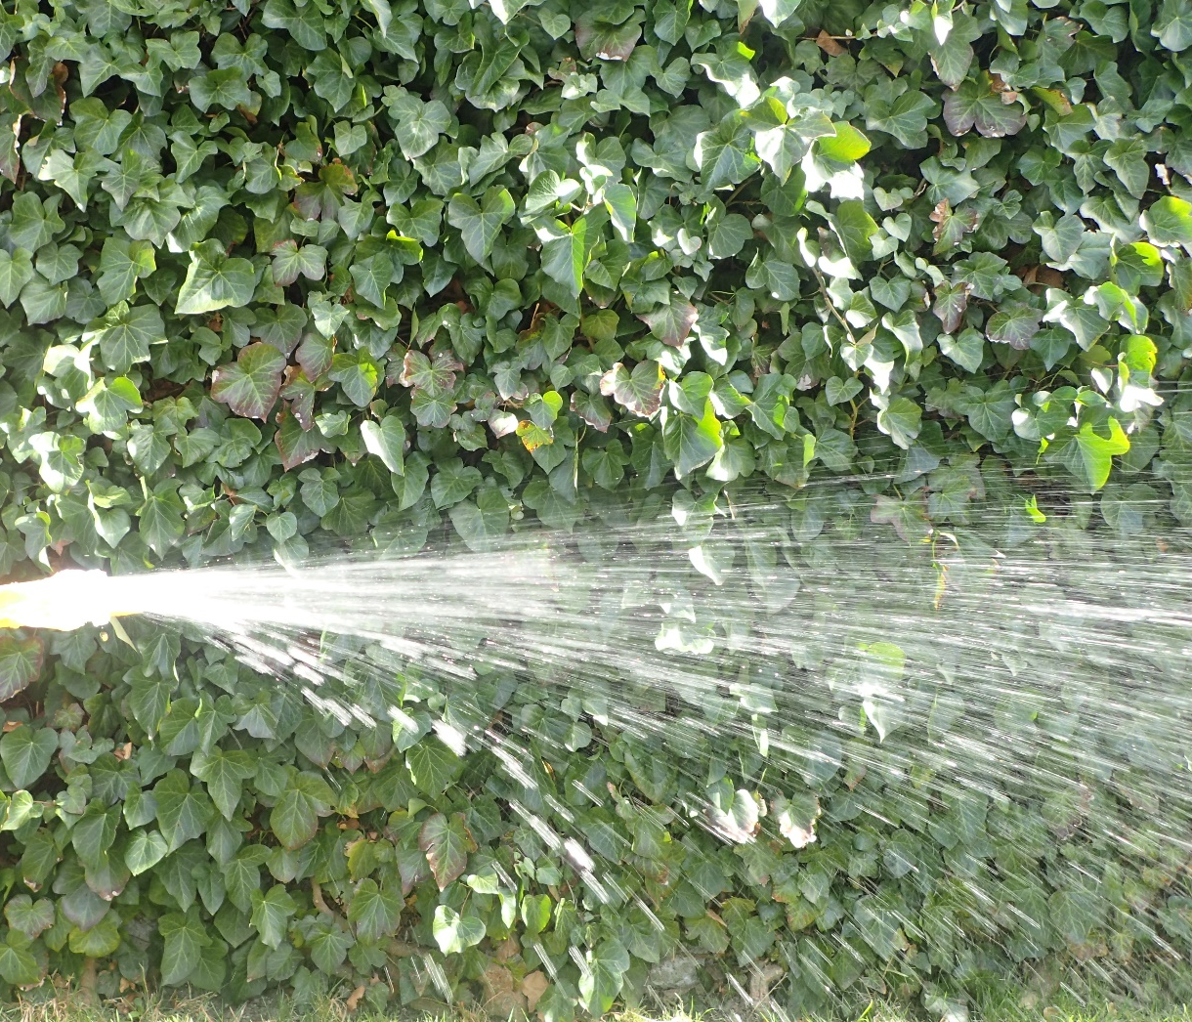
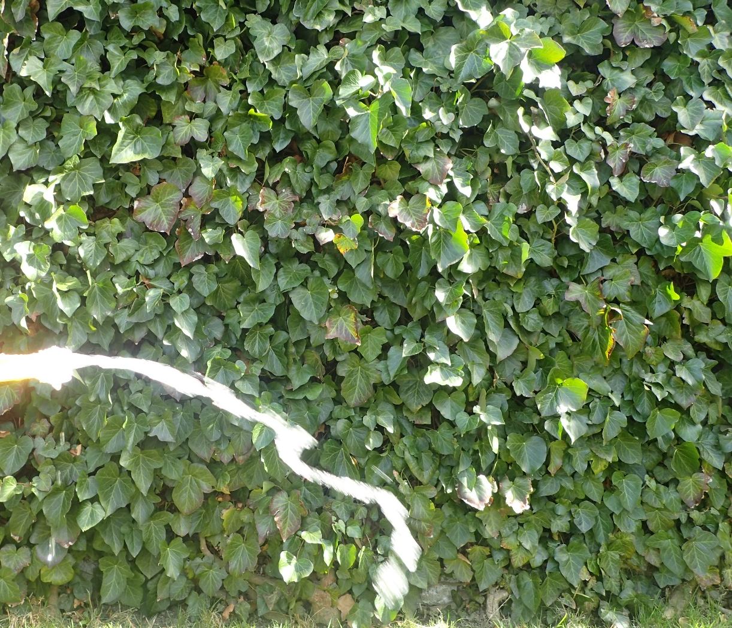
Conclusion I.
$p_{in}$ = 15 MPa
own functional model designed & constructed
two segments
forward direction
reversed direction

Slide 28
CONCLUSION
own geometrical model of Tesla Valve with independet parameters
own geometric model with better properties than geometry of Tesla*
pressure drops
Darcy-Weisenbach equation (forward direction)
angle $α$, ratio of sides $\frac{a}{b}$, number of segment experimentally investigated
optimal number of segment for maximal Di

Slide 29
REFERENCE
[1] The Life and Times of Nikola Tesla; Biography of a Genius.
[2] "Patent #: US001329559". United States Patent and Trademark Office. Office of the Chief Communications Officer. Retrieved 2 January 2017
[3] Fundamental Mechanics of Fluids, Currie I. G.
[4]

Slide 30
APENDIX

Slide 31
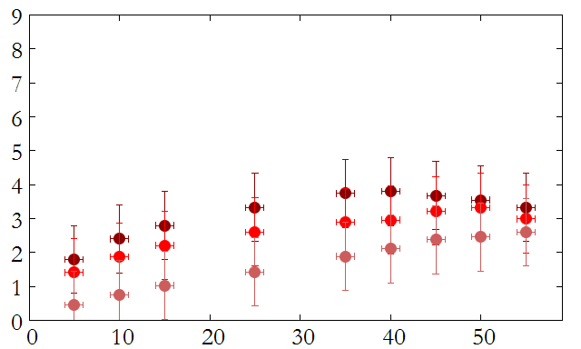
Flow characteristics
Arduino flow rate sensor
14 segments
14 segments
39.8 kPa
11 segments
11 segments
8 segments
50.7 kPa
Flow rate [m/s]
8 segments
Flow rate [m/s]
not monotonic fce
Inlet pressure [kPa]
Inlet pressure [kPa]

Slide 32
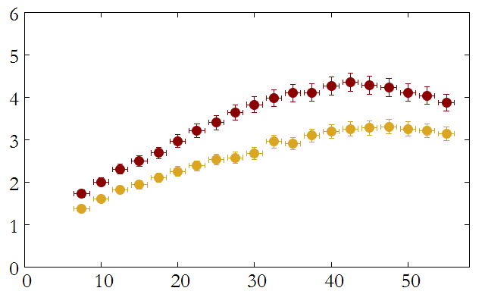
Preliminary experiment
one curve = one experiment
different $\dot{p}$
different results
$$\dot{p}≈500 Pa∙s^{−1}$$
$$\dot{p}≈250 Pa∙s^{−1}$$
fluent descent of inlet pressure
Pressure drop [kPa]
$≈$1.36 cm
current behavior dependence also on previous behavior
ONLY reversed dir.
great importance on initial condition (pressure)
$$p$$
$$45°$$
4 segments
Inlet pressure [kPa]

