Slide 1
Measurement of elliptic flow of $D^{0}$meson in d+Au collisions at 200 GeV with the STAR experiment
Workshop EJČF 2019
bílý potok
14.1.2019
Zuzana Moravcová
supervisor: Jaroslav bielčík
consultant: Lukáš Kramárik

Slide 2
Outline
Quark-gluon plasma
Collectivity in small systems
Anisotropic transverse flow
Multiparticle correlations method
STAR experiment
$D^{0}$ reconstruction in d+Au collisions

Slide 3
Quark-gluon plasma
...as seen in 5 previous STAR talks...
hot and dense nuclear matter of deconfined quarks and gluons
two types of phase transitions
early universe, studied in AA collisions
short lifetime

Slide 4
Open charm hadrons
STAR CTU: $D^{0}$ - Lukáš, Tomáš
$D^{±}$ - Robert, Jan
$Λ_{c}$ - Miro
all of them – “Mišel Kokan“
heavy-quarks are produced at the initial stages of heavy-ion collisions
experience the whole evolution of the medium
probe of QGP
nuclear modification factor (modification of particle production by nuclear matter, ratio of yields in pA/pp, AA/pp)
collectivity (flow) → A guide to understand collectivity in small systems (for dummies) by K. Křížková Gajdošová, Friday 10:40
jet quenching
quarkonium suppression
QGP produced in AA…. why pA?
control environment
initial state effects, also known as cold nuclear matter effects

Slide 5
Collectivity in small systems
significant flow of light hadrons compared with $D^{0}$ and $J/ψ$
common shape of elliptic flow
weaker collective behavior of heavy flavor quarks?
collectivity in AA collisions is NOT caused only by QGP
our goal: elliptic flow of $D^{0}$ in d+Au with STAR
A MOMENT TO THINK…..
Does everyone here know what these terms mean???

Slide 6
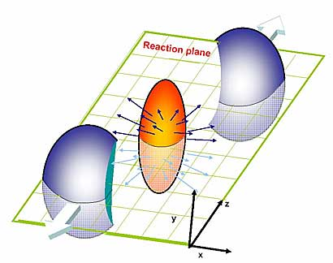
What is between initial and final state?
Reaction plane is defined by beam axis and impact parameter vector
Nearly perfect liquid behavior
Overlap of colliding nuclei is anisotropic (in non-central collisions)

Slide 7
“I can go with the flow”
initial geometry and event-by-event fluctuations cause azimuthal anisotropy (with respect to common symmetry plane)
pressure gradients are dependent on direction
spatial anisotropy converted into momentum-space anisotropy – MEASURABLE!
different forms of collective flow:
longitudinal flow
radial transverse flow
anisotropic transverse flow
$v_{1}$ - directed flow
$v_{2}$ - elliptic flow
$v_{3}$ - triangular flow
“Quantitatively, anisotropic flow is characterized by the coefficients in the Fourier expansion of the azimuthal dependence of the invariant yield of particles relative to the reaction plane:”
$v_{n}= <\cos\left[n\left(φ−Ψ_{RP}\right)\right]>$
are $p_{T}$ and $y$ dependent (differential flow)

Slide 8
Event plane method
Phys. Rev. Let. C58, 1671 (1998)
event plane = estimated reaction plane
correction needed (we don’t know the real reaction plane)
event plane resolution dependent on event multiplicity
EP method uses the anisotropic flow itself to determine the event plane
EP can be determined independently for each harmonic of the anisotropic flow
EP reconstruction by calculating Q vector for each event (recentering eg. run by run, STAR $D^{0}$ Au+Au at 200 GeV)
$Q_{x}=Σ$ ( $q_{x}− <q_{x}>$ )
$Q_{y}=Σ$ ( $q_{y}− <q_{y}>$ )
$$q_{x}=p_{T}\cos\left(2φ\right)$$
$$q_{y}=p_{T} sin⁡(2φ)$$
$$Ψ=atan⁡({\frac{Q_{x}}{Q_{y}}}/2)$$

Slide 9
Multiparticle correlation method
arXiv: 1010.0233
motivation: reduction of non-flow effects
2-particle azimuthal correlations: $<\cos\left(n\left(φ_{1}−φ_{2}\right)\right)> =(e^{in\left(φ_{1}−φ_{2}\right)}> = <v_{n}^{2}> + δ_{n}$
MC method is based on multiparticle cumulants
MC method can subtract non-flow effects order by order
single pass over the data (huge advantage)
cumulants expressed in terms of moments of the magnitude of the corresponding flow vector $Q_{n}$
$Q_{n}=\sum_{i=1}^{M}{e_{i}^{inφ_{i}}}$, M number of particles
single-event average 2-particle azimuthal correlations
$<2> = <e^{in\left(φ_{1}−φ_{2}\right)}> = \frac{1}{P_{M,2} }\sum_{i,j}{′ }e^{in\left(φ_{i}−φ_{j}\right)}$ $P_{n,m}= {n!}/{\left(n−m\right)!}$, $\sum_{i,j}{′ }$ … $i ≠j$
averaging over all events:
$≪2≫ = ≪e^{in\left(φ_{1}−φ_{2}\right)}≫$ $≪4≫ = ≪e^{in\left(φ_{1}+φ_{2}−φ_{3}−φ_{4}\right)}≫$

Slide 10
Multiparticle correlation method
n-particle cumulants:
n = 2: $c_{n}\left\{2\right\}= ≪2≫$
n = 4: $c_{n}\left\{4\right\}= ≪4≫$ - 2$⋅ ≪2≫$
non-uniform detector acceptance
$$c_{n}\left\{2\right\}= ≪2≫−[≪\cos\left(nφ_{1}\right)≫^{2}+ ≪\sin\left(nφ_{1}\right)≫^{2}]$$
reference harmonic:
$v_{n}\{2\}=\sqrt{c_{n}\{2\}}$
$v_{n}\{4\}=\sqrt[4]{−c_{n}\{4\}}$
$$≪2≫ = ≪e^{in\left(φ_{1}−φ_{2}\right)}≫$$
$$<2> = \frac{1}{P_{M,2} }\sum_{i,j}{′ }e^{in\left(φ_{i}−φ_{j}\right)}$$

Slide 11
Multiparticle correlation method
2nd order cumulant:
${\left|Q_{n}\right|}^{2}=M+ \sum_{i,j}{′ }e^{in\left(φ_{i}−φ_{j}\right)}$
$<2> = \frac{{\left|Q_{n}\right|}^{2}−M}{M(M−1)}$
how to avoid autocorrelation? use $η$ gap!
$<2> = \frac{\sum_{B}{\cos\left(nφ\right) ⋅}\sum_{F}{\cos\left(nφ\right) + \sum_{B}{\sin\left(nφ\right) ⋅}\sum_{F}{\sin\left(nφ\right)}}}{\#F ⋅ \#B}$
technical hint: ROOT’s TProfile – average over events
F
$η$ gap
B

Slide 12
Reference flow - RECAP
$$c_{n}\left\{2\right\}= ≪2≫−[≪\cos\left(nφ_{1}\right)≫^{2}+ ≪\sin\left(nφ_{1}\right)≫^{2}]$$
$$<2> = \frac{\sum_{B}{\cos\left(nφ\right) ∗} \sum_{F}{\cos\left(nφ\right) + \sum_{B}{\sin\left(nφ\right) ∗} \sum_{F}{\sin\left(nφ\right)}}}{\#F ∗ \#B}$$
$$<\cos\left(2φ\right)> = \frac{\sum_{B}{\cos\left(nφ\right)}}{\#B}$$
Reference is important, but it’s only a reference…

Slide 13
Flow analysis
what do we need?
reference flow particle (RFP), eg. all charged hadrons
particle of interest (POI)
what will we do? (“kuchařka”)
step 1: estimation of the reference flow by using only the RFPs
step 2: estimation of the differential flow of POIs with the respect to the reference flow of the RFPs (step 1)

Slide 14
Differential flow
reduced single-event average 2-particle azimuthal correlation:
$<2^{′}> = <e^{in\left(ψ_{1}−φ_{2}\right)}>$
in practice (POI from B): $<2^{′}> = \frac{\cos\left(nφ_{D}\right) ∗ \sum_{F}{\cos\left(nφ\right) +\sin\left(nφ_{D}\right) ∗ \sum_{F}{\sin\left(nφ\right)}}}{\#POI ∗ \#F}$ (in our analysis: POI by POI, not event by event)
differential 2nd order cumulant:
$d_{n}\left\{2\right\}= ≪2^{′}≫$
${ d}_{n}\left\{2\right\}= ≪2≫−[≪\cos\left(nφ_{D}\right)≫∗≪\cos\left(nφ_{1}\right)≫+ ≪\sin\left(nφ_{D}\right)≫∗≪\sin\left(nφ_{1}\right)≫]$
${ d}_{n}\left\{2\right\}$ might be (should be?) a function of a variable ($p_{T},$ centrality, …)

Slide 15
Fourier coefficients
$$v_{n}\left(p_{T}\right)= \frac{d_{2}\left\{2\right\} (p_{T})}{√c_{2}\{2\}}$$
$v_{1}$ - directed flow
$v_{2}$ - elliptic flow
$v_{3}$ - triangular flow
WATCH OUT – obtained $v_{n}$ contains background
$v_{n}= \frac{N_{sig}}{N_{tot}}⋅v_{n}^{sig}+ \frac{N_{bkg}}{N_{tot}}⋅v_{n}^{bkg}$

Slide 16
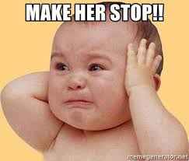
Too many formulas?

Slide 17
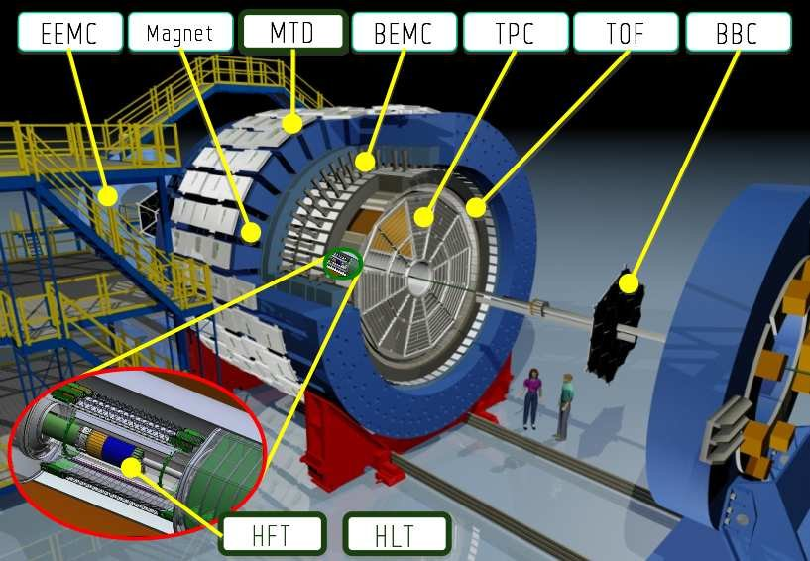
STAR experiment

Slide 18
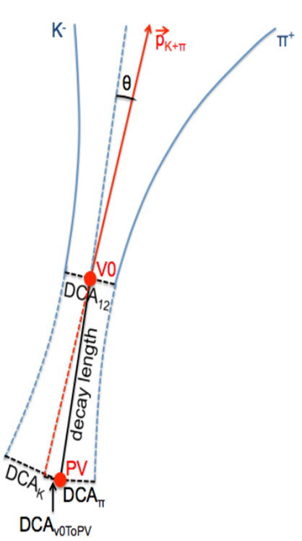
$D^{0}$ meson
open charm meson ($D^{0}=c\overline{u}$)
$m=(1864.84±0\text{.05)}$ MeV/$c^{2}$
$cτ=122.9 μm$
hadronic channel: $D^{0}→K^{∓}π^{±},$ BR =$\left(3.89±0.04\right)\%$
6 variables:
decay length of D meson candidate
daughters DCA to primary vertex (kaon, pion)
DCA between daughter particles
pointing angle θ between reconstructed D momentum and decay length vector
reconstructed D candidate DCA to primary vertex

Slide 19
$D^{0}$ meson
TMVA (Toolkit for Multivariate Data Analysis) optimized cuts for 3 different $p_{T}$ bins
1 – 2 GeV/c
2 – 3 GeV/c
3 – 5 GeV/c
TMVA rectangular cuts optimization
random different cut combination
the best combination is the one with the biggest background rejection
background – wrong (like) sign combination K$π$ pairs

Slide 20
$D^{0}$ meson with BDT – strict TOF
BDT (Boosted Decision Trees)
machine learning method using TMVA package
just seen in Robert’s talk
L. Kramárik

Slide 21
$D^{0}$ meson with BDT – hybrid TOF
bigger yields are crucial for elliptic flow analysis
L. Kramárik

Slide 22
$D^{0}$ meson yields
summary table:
rectangular cuts method with hybrid TOF – in progress

Slide 23
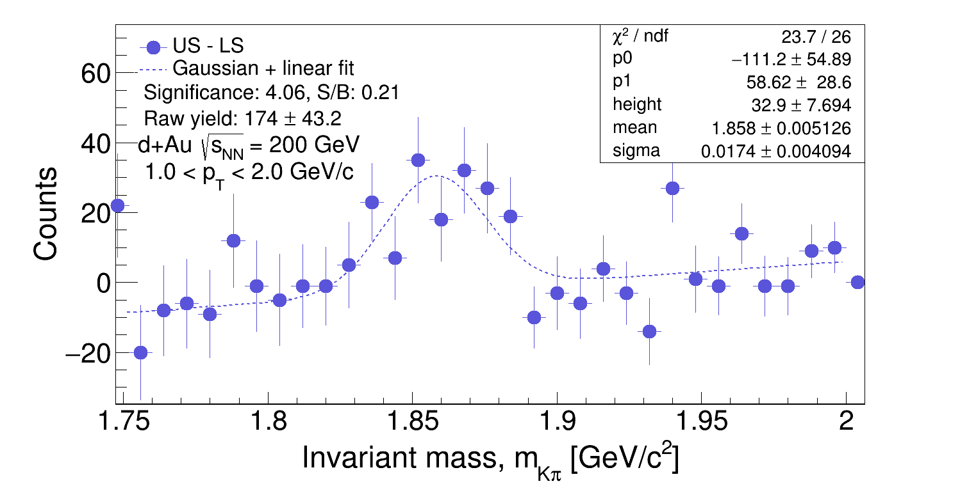
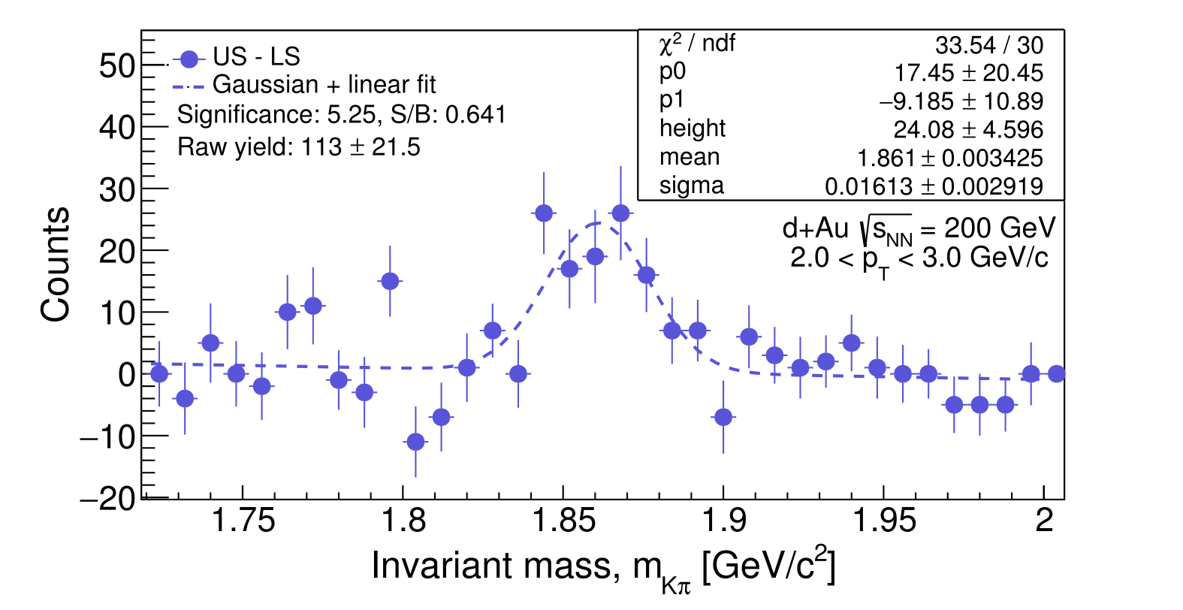
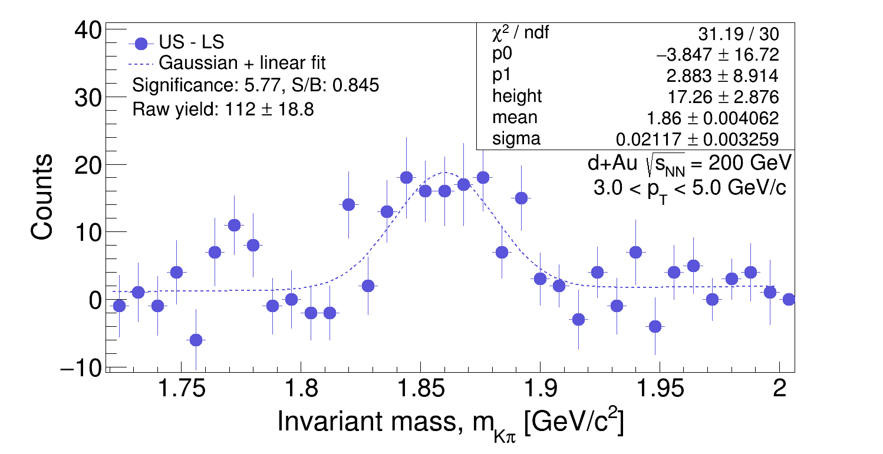
$D^{0}$ meson – hybrid TOF *NEW*
significance is small, but – no optimization of cuts so far!
high probability to obtain bigger yield – good to know before $v_{2}$ analysis
results consistent with previous ones

Slide 24
Elliptic flow of $D^{0}$ meson in Au+Au
mass ordering ($p_{T}<2$)
PRL 118 212301 (2017)
baryon/meson grouping ($p_{T}>2$)

Slide 25
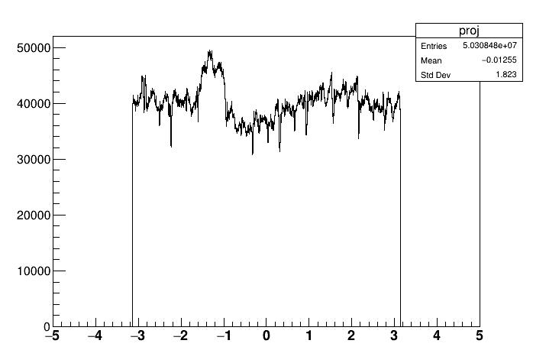
Elliptic flow of $D^{0}$ meson in d+Au
work in progress (collaboration with Lukáš)
importance of correction (non-uniform distribution of $φ$) – equations from the theory
d+Au @200 GeV
Au+Au @200 GeV
Hadron $ϕ$

Slide 26
Elliptic flow of $D^{0}$ meson in Au+Au

Slide 27
Conclusion
study of collectivity in small systems is a hot topic!
${ D}^{0}$ meson was successfully reconstructed in the hadronic decay channel in d+Au at 200 GeV at the STAR experiment
TO DO:
analysis with new data (looser Vz-Vpd cut)
hybrid TOF rectangular cuts
corrections on $D^{0}$ raw yields
elliptic flow of $D^{0}$ meson in d+Au (multiparticle correlation method)
correction (non-uniform acceptance)
write and defense master thesis ☺

Slide 28
Before I leave….

Slide 29
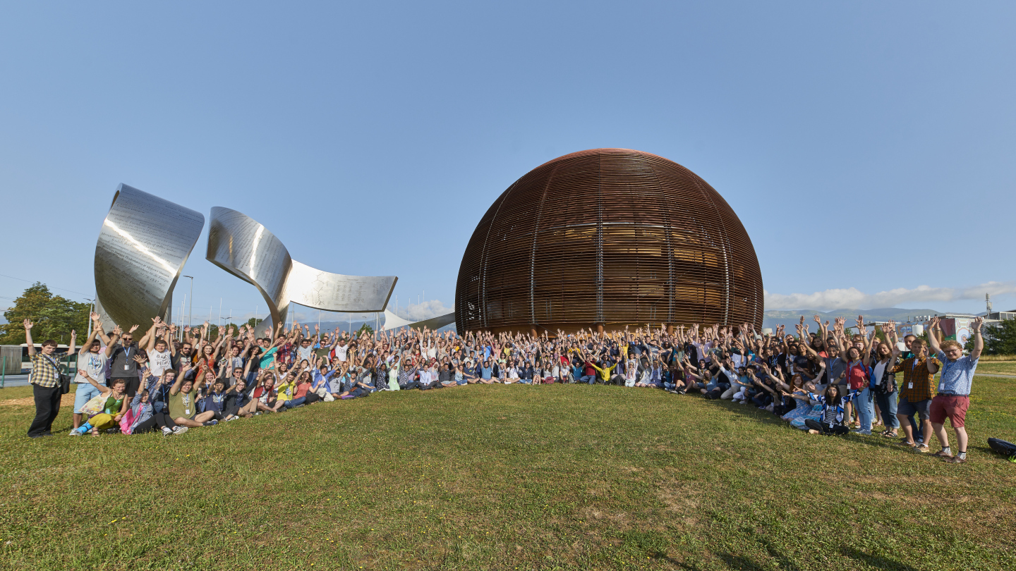
CERN Summer Student Programme
application deadline - 31 January 2019
last summer: 3 students from FNSPE CTU
Tomáš – PS Booster, Wire Scanner optimization, 13 weeks
Dáša – LHCb, jet tagging using machine learning methods, 9 weeks
me ☺ - ALICE, calibration of TOF detector with cosmic muons, 10 weeks

Slide 30
Thank you for your attention!

Slide 31
Back up

Slide 32
Boosted Decision Trees
method in TMVA
rectangular cuts - chosen just one hypercube from the whole phase space
BDT - phase space divided to hypercubes, each is signal-like or background-like
boosting – using a lot of shallow trees, the final BDT response is their weighted average
training:
signal from simulation
background from data (wrong sign combination)

Slide 33
Cold nuclear matter effects
present in Au+Au collisions, difficult to distinguish experimentally from effects caused by QGP
motivation to study pA collisions
initial state effects
modifications of the parton distribution functions in the nucleus (shadowing at lox Bjorken-x)
different dynamics of partons within free protons with respect to those in nucleons
multiple scattering of partons in the nucleus
energy loss (radiative/collisional)
transverse momentum broadening (Cronin effect)
final state inelastic interaction
nuclear absorption of quarkonium bound states when passing through nucleus

