Slide 1
Soil Air Radon Concentration in Bintan Island, Indonesia (M.M. Nirwono, A.C. Syuryavin, S.J. Park, S.H. Lee)
Muttaqin Margo Nirwono
Kyungpook National University
Indonesia Nuclear Energy Regulatory Agency (BAPETEN)
Prague, 2019-09-10

Slide 2
Contents
Introduction
Measurements and Methods
Results and Discussion
Conclusion

Slide 3
Introduction

Slide 4
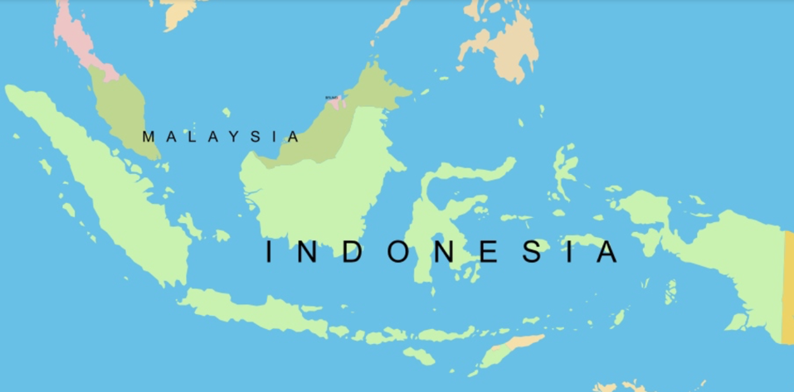
Indonesia Map
Bintan island
Jakarta

Slide 5
Introduction
Indonesia has 17,508 islands that lie across the Equator. As a country in the equatorial zone, large deposits of bauxite are located in some islands of Indonesia.
Bintan island had the first area of bauxite mining in Indonesia. It was located in Kijang and discovered since Dutch colonialization of 1924, mined and exported since 1935, and closed in 2013 because of the exhausted deposit.
Rohmana et al. (2007) reported that in Bintan island, there was 10,450 ha of bauxite potential area and 209 million cubic meters of reserved resources.

Slide 6
Bauxite and TENORM
Bauxite is one of concern about Technologically Enhanced Naturally Occurring Radioactive Material (TENORM) issues that releases radon gas. Because radon gas is carcinogenic that triggers second lethal of lung cancer.
Bauxite may consist Al₂O₃, SiO₂, and FeO₃ which have radiological concern in their refinery process.
Naturally occurring radioactivity in bauxite ores is concentrated during the refining process, creating some side products or residues categorized as TENORM.
The most frequently radionuclides found in the residues are uranium, thorium, radium and their decay products. As we know, radon is included in radium and thorium decay chains.

Slide 7
Purpose of Study
Considering the possibility of TENORM and their decay products existence, this research is carried out to identify soil gas radon concentration in bauxite area of Bintan and for further purpose can be used as part of radon profile in Indonesia.
The level of radon in the sampling area is also analyzed based on depth parameter to reveal the possibility of the existence of high radon exposure in some sampling areas. The information on high radon area will be very important to be used as a safety consideration for public and environment.

Slide 8
Measurements and Methods

Slide 9
Location of Sampling
Bintan Island is administratively under Riau Islands province, Indonesia.
The location of the research was in
bauxite mining areas in Teluk Bintan District, Bintan Regency, and
residence areas and an office area, Tanjung Pinang City.
Owen (1949) reported that in Tembeling area, bauxite ore contained
56.2% of Al₂O₃
27% of SiO₂
9.8% of FeO₃, and
0.7% of TiO₂.

Slide 10
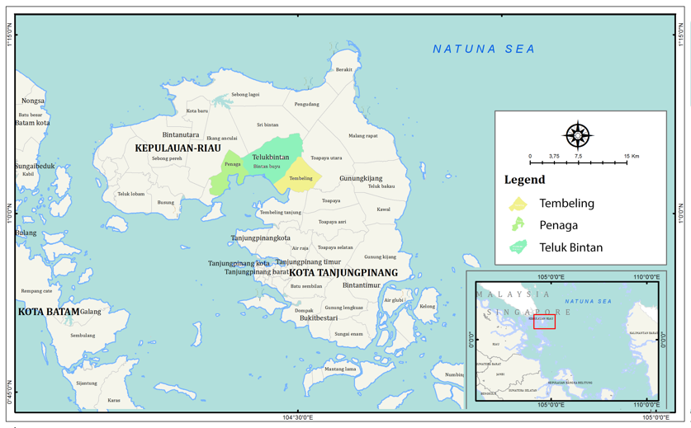
Map of Bintan Island

Slide 11
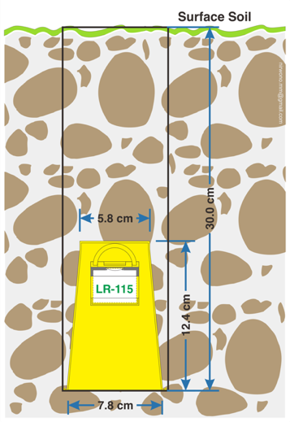
Methods
Choosing detector and procedure
Period of measurement
Sending detectors to lab
3 week in mining areas
2 week in resident & office areas
Getting the result
Passive can technique of LR-115 at 30 cm depth.
24 detectors

Slide 12
Results and discussion

Slide 13
Concentration of Soil Air Radon

Slide 14
Statistics for soil air radon concentrations
­Location | Number of Data | AM (Bq.m⁻³) | ASD (Bq.m⁻³) | ﻿GM (Bq.m⁻³) | GSD | Range (Bq.m⁻³) | Median (Bq.m⁻³)
Mining area | 19 | 9,008 | 4,286.2 | 7,799.7 | 1.80 | 1,748 – 1,6381 | 8,954
Office area | 3 | 14,190 | 10,500.5 | 11,192.8 | 2.09 | 4,227 – 25,156 | 13,187
Residence area | 2 | 2,506 | 830.1 | 2,436.3 | 1.27 | 1,919 – 3,093 | 2,506
Total Data | 24 | 9,114 | 5,582.3 | 7,405.8 | 1.99 | 1,748 – 2,5156 | 8,849
WHO reference level is below 10,000 to 100,000 Bq/m³

Slide 15
Previous studies on soil gas radon in Indonesia
No | Method and Researcher(s) | Location | Measurement Result
1 | ﻿A scintillation counter of the volcanic gas (Zimmer and Erzinger, 2003) | M. Merapi, Central Java | 4000-15000 Bq.m⁻³
2 | Surface chamber, Lucas and Radiation Monitor Portable, model AB-5, Pylon (Ginting and Hari, 2004) | ﻿PPTN Serpong, South Tangerang, Banten | 225.25 – 1603.12 Bq.m⁻³
3 | GM detector (Lubis and Samdara, 2007) | Bengkulu, Bengkulu | 327-540 Bq.m⁻³ Mean: 427 Bq.m⁻³
4 | LR-115 (Samdara and Lubis, 2008) | Bengkulu, Bengkulu | 110-189 Bq.m⁻³ Mean: ﻿136 Bq.m⁻³
5 | RAD7 and soil gas probe (Alfiyan and Dinoto, 2012) | Sidoarjo, East Java | Radon 2300-6200 Bq.m⁻³
6 | RAD7 (Indarto et al., 2013) | Dieng, Central Java | 30-900.43 Bq.m⁻³
7 | Soil gas radon exhalation rate using RAD7 (Syarbaini and Pudjadi, 2015) | Bangka Belitung Islands | 3.73-326 ﻿Bq.m⁻².s⁻¹ Mean 48.11 ﻿Bq.m⁻².s⁻¹
8 | RAD7 and soil gas probe (Iskandar et al., 2018) | M. Tampomas, West Java | 26-30475 Bq.m⁻³
9 | RAD7 and soil gas probe (Sciarra et al., 2018) | ﻿Sidoarjo, East Java | 0-﻿6880.0 Bq.m⁻³ Mean: ﻿497.22 Bq.m⁻³

Slide 16
Previous studies on radon on mining in Indonesia
No | Type of mining and Researcher(s) | Location | Measurement Result
1 | Gold mining (Hidayat, 2003) | Bogor, West Java | Ciurug: 320-1140 Bq.m⁻³ Kubang Cicau 55.5-2740 Bq.m⁻³ Ciguha: 19.0-100 Bq.m⁻³
2 | Gold mining (Rahaju, 2005) | Cikidang, Lebak, Banten | ﻿Radon concentration: 56-69,778 Bq.m⁻³

Slide 17
Radon of depth in Korea (Maeng et al., 2019)
Notes:
﻿This study allows us to estimate soil properties of some location by using the 222Rn diffusion model with the measured 222Rn depth profile.

Slide 18
Other Considerations
Indonesia does not have alumina refinery yet.
Bauxite from mining was sent to the smelter in other countries.
Transporting bauxite use dump trucks (without cover) to the port and barge to the destination.
Small particle and dust will easily escape to the air, especially during dry season. Radon as part of soil particle, also flies to the air.
It is considering that shipping bauxite also has radiological effect to the public, worker and environment.
Indonesia will prepares bauxite smelter project that it will be more concern about environmental radioactivity in the surrounding area, because during smelter process, concentration of radon also increases.

Slide 19
Conclusion

Slide 20
Conclusion
Bintan is an island that has bauxite mineral. Because bauxite is part of radiological concern, measurement in mining area was conducted using LR-115 to collect soil air radon concentration.
Soil air radon concentration data was calculated based on arithmetic mean, arithmetic standard deviation, geometric mean, geometric standard deviation, range, and median of samples data which were 9114 Bq.m⁻³; 5582.3 Bq.m⁻³; 7405.8 Bq.m⁻³; 1.99, 1748–25156 Bq.m⁻³; and 8849 Bq.m⁻³, respectively.
The radon concentration of mining area is three time more than resident area as control area.
The current research of radon concentration of soil gas in bauxite area is below the WHO reference level, although it is higher than residence area, however it is second highest among research on mining area.
In depth profile comparison, current research of radon concentration is twice than radon concentration in some area in Korea.
Consideration should be made to the regulation of transporting the bauxite and radiation monitoring surrounding smelter area.

Slide 21
Thank you

