Slide 1
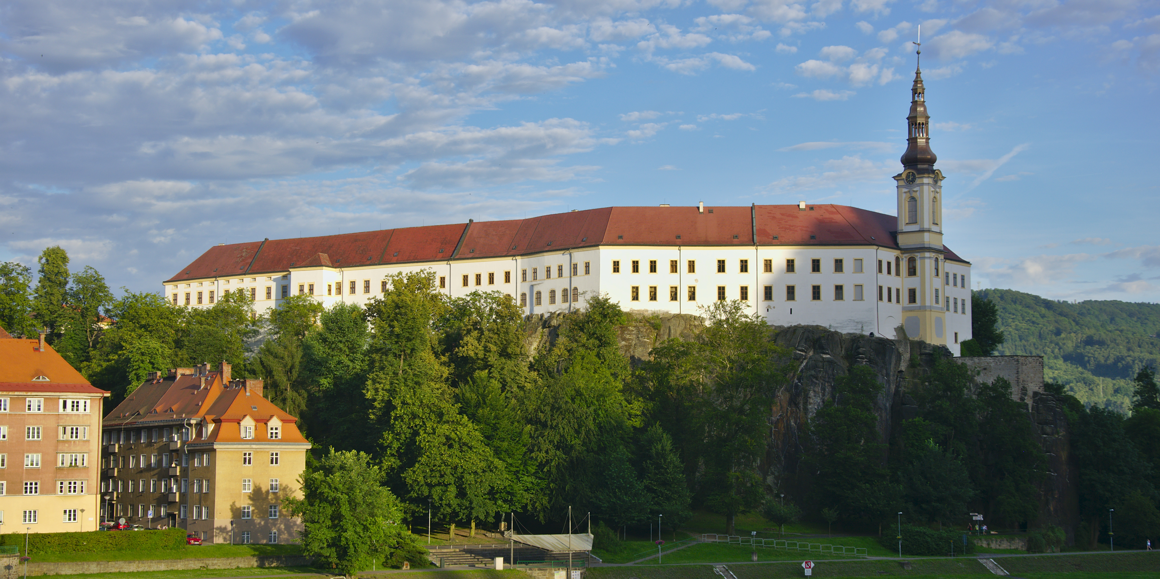
3rd Miniworkshop on Diffraction and UPC

Slide 2
Introduction to workshop n.2
Covered in Guillermo’s presentation:
Our members
Our activities
Agenda of the workshop
Covered in this presentation:
News from our group – news, students’ milestones
Prizes of our group members
Practical information about workshop
Surprise! :)

Slide 3
News from our group

Slide 4
ALICE-group news
New collaboration positions
Michal B. – convenor of PWG-UD, coordinator of PAG-UPC
Katka – coordinator of PAG-Flow, Conference Committee member
Tomáš – ALICE Junior Representative
Detectors
FDD – Calibration of PMT’s (Solangel & Vojta)
MFT – assembly, work on spare half-barrel, QC (Diana, Katka, Tomáš, JGC)
Ongoing analyses
Katka – Anisotropic flow with 2018 data (pp and PbPb)
Roman – Stability of vdM scan results for Pb-Pb collisions in 2018
Tomáš – Coherent production of J/Psi in classes of nuclear dissociation
Guillermo – Exclusive J/Psi production in p-Pb collisions
David H. – Coherent production of rho in Xe-Xe collisions

Slide 5
ALICE-group news
Selected recent papers
Michal B. & Guillermo – NOON paper
David H. – Coherent ρ photoproduction in Pb-Pb
Roman; Roman & Michal B. – paper proposals on J/psi production in PbPb collisions
Katka – ALICE review paper in progress
Conferences
Plenary talk at QM2019 in Wuhan by Katka, poster by Tomáš
Posters at QM (Tomáš), LHCP (David, Solangel), and ICHEP (Solangel)
More in Katka’s regular ALICE-CZ newsletter
Source – Jun/Jul/Aug newsletter

Slide 6
Pheno-group news
Selection of current topics
QCD phenomenology with b-BK
Angular version of b-BK
Numerical solution of NLO-BK
Fluctuations of the proton and nuclear structure (hot-spot model)
New papers
Marek, Honza, and Guillermo – Nuclear structure functions with b-BK
Honza & Marek – Contribution of the non-linear term in the BK equation to the nuclear structure functions
Guillermo, Dáša, Honza, and Marek – Photonuclear J/psi production at the LHC (submitted to PLB)
Honza, Dáša, Victor G., Guillermo, and Marek – Diffractive DIS with b-BK (in progress)
Michal K. – several papers with B. Kopeliovich, J. Nemcik, and R. Pasechnik
We were invited to contribute to EIC Yellow Report
Michal K. returned from Chile
Scientific visit by Victor Goncalves from Brazil in February
Marek – post-doc position in Zurich
Two new students – Matěj and Radim :)

Slide 7
Academic milestones
Daniel – bachelor degree
Diana and David G. – successful defence of their research projects
Marek – PhD thesis handed in (defence coming soon!)

Slide 8
Prizes

Slide 9
David H. for his conference contribution
LHCP Conference Best-poster award
CERN, EPJ

Slide 10
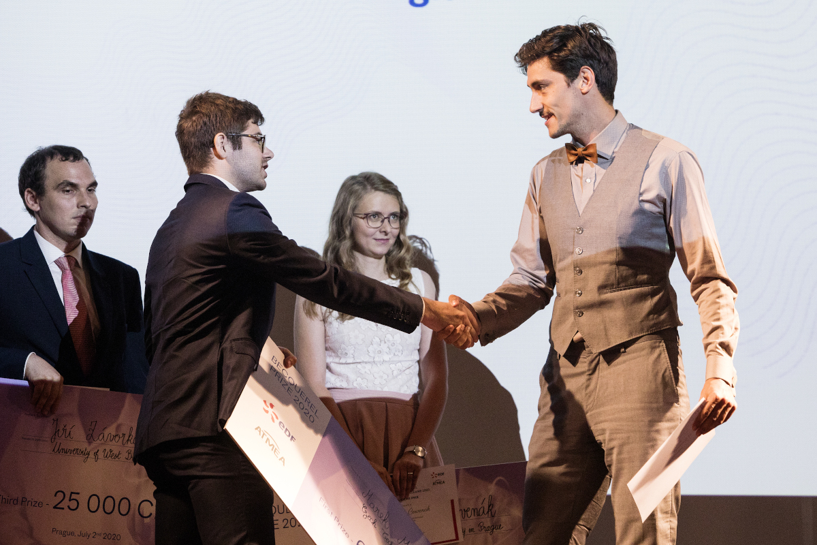
Marek for his research work
Becquerel prize for young scientist in the field
of nucleur physics
French Embassy

Slide 11
Practical information about our workshop

Slide 12
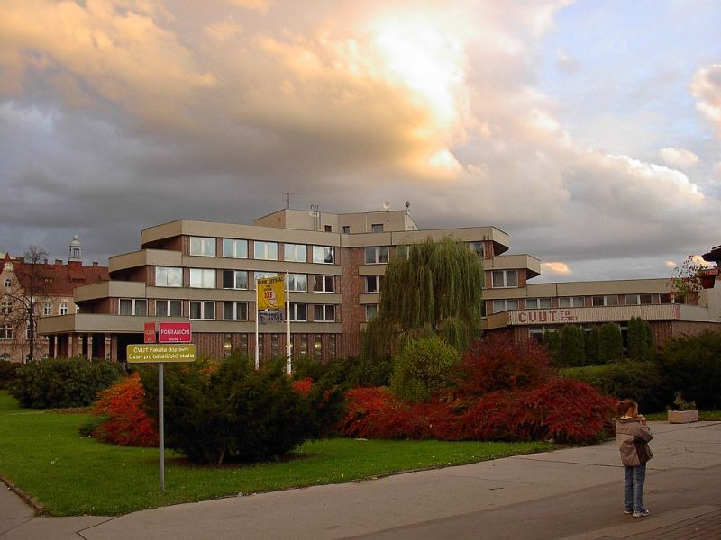
Workshop venue
ČVUT building in Děčín
FJFI and FD
FJFI – Software engineering (Bc.)

Slide 13
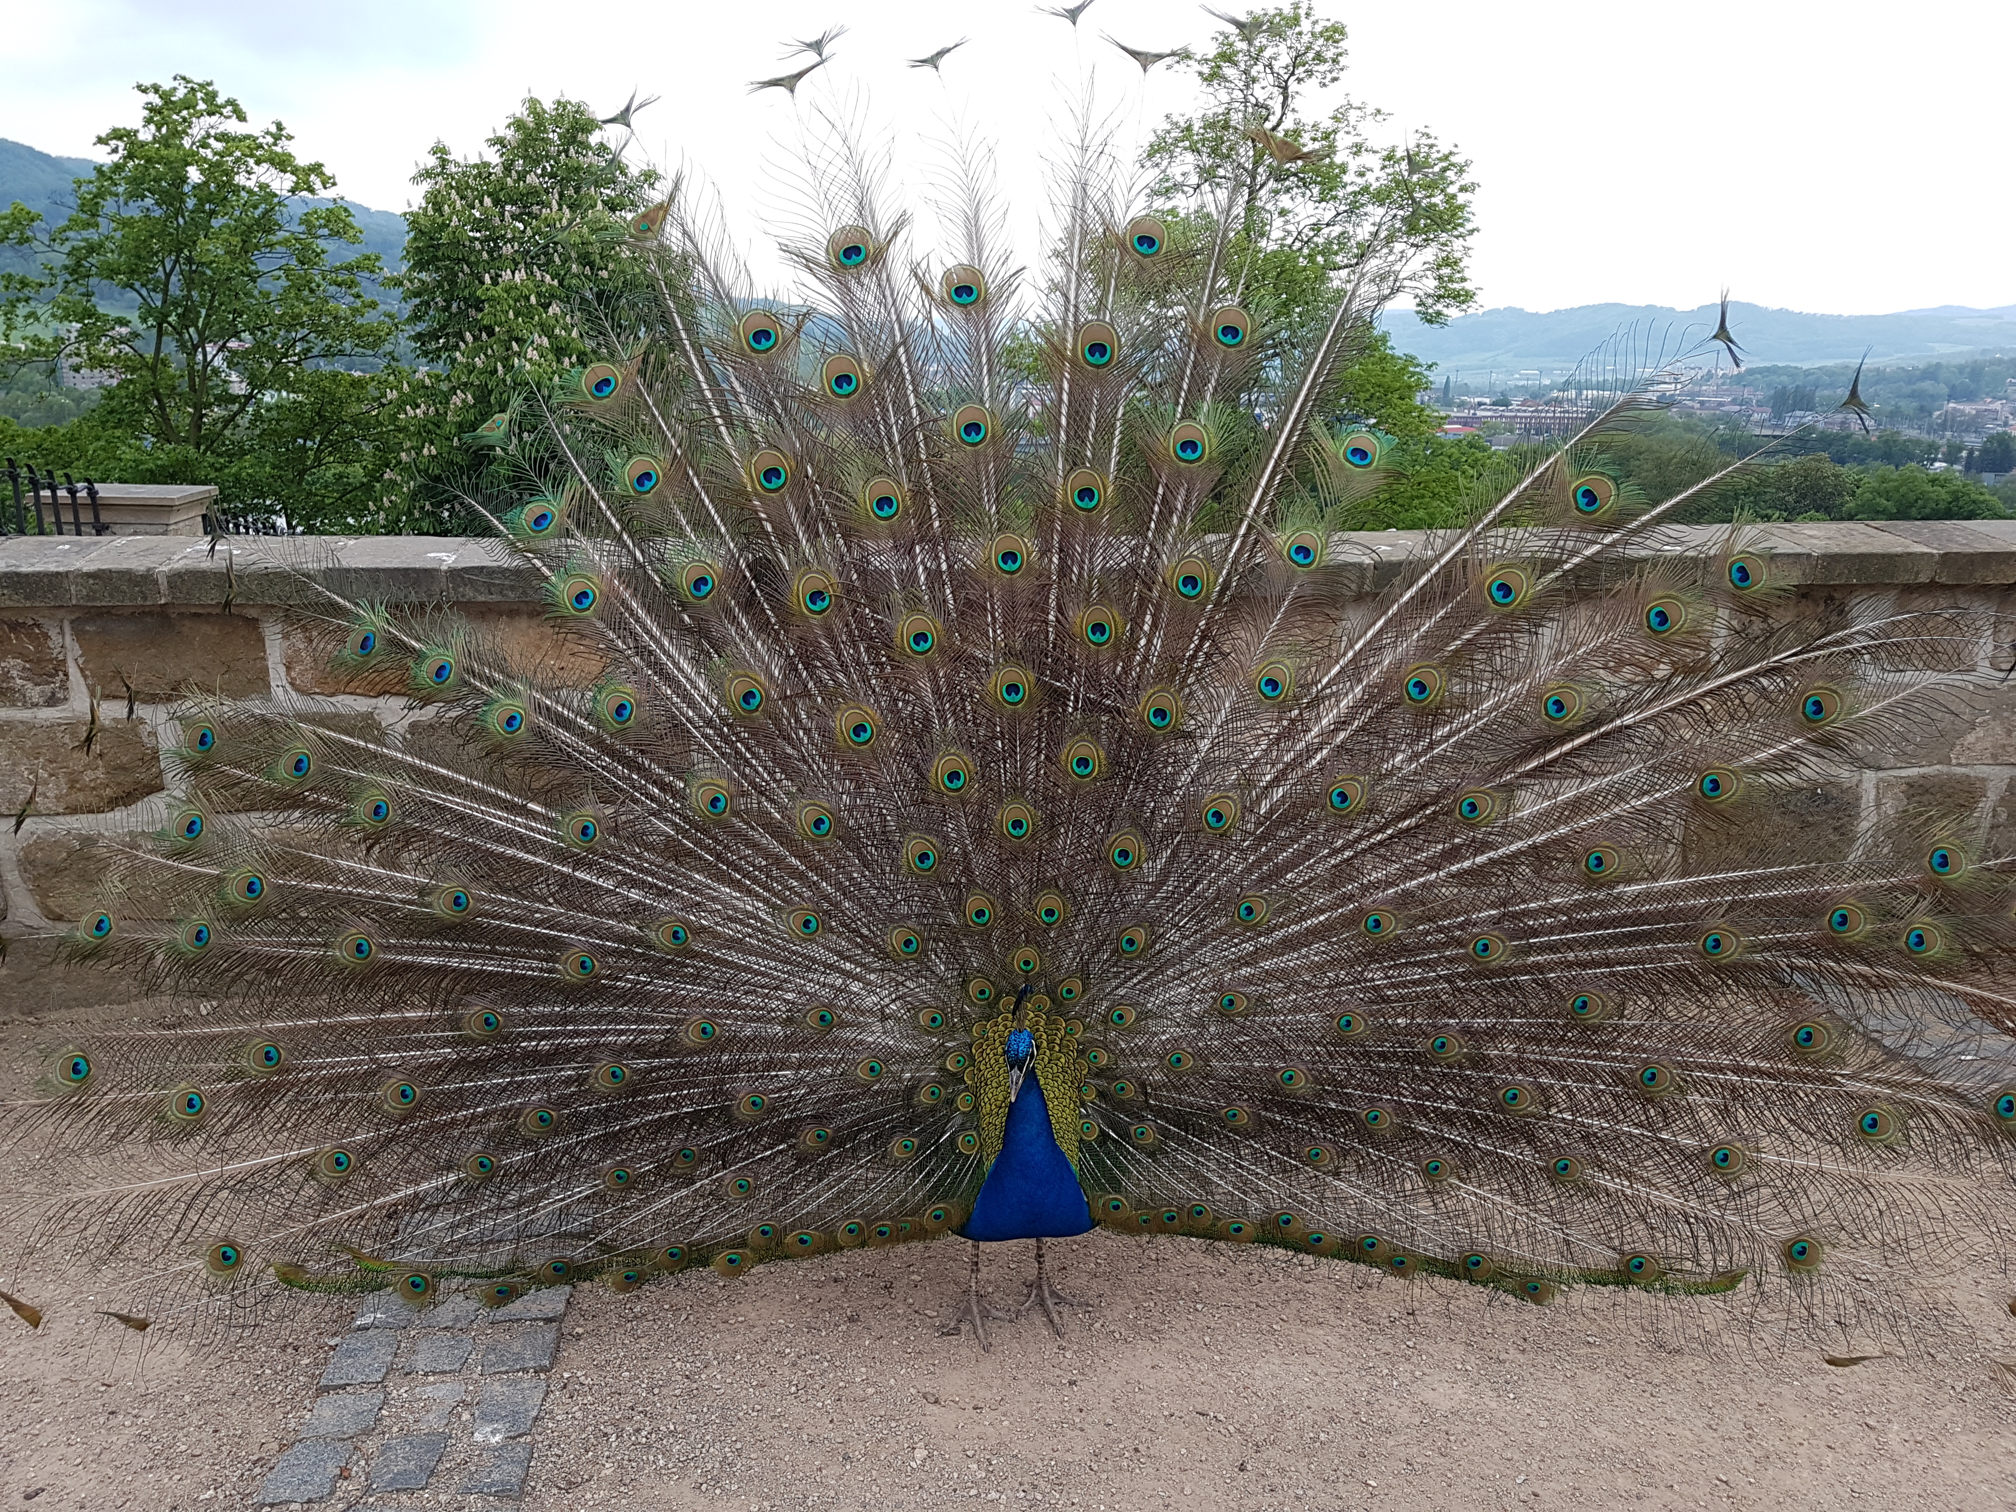
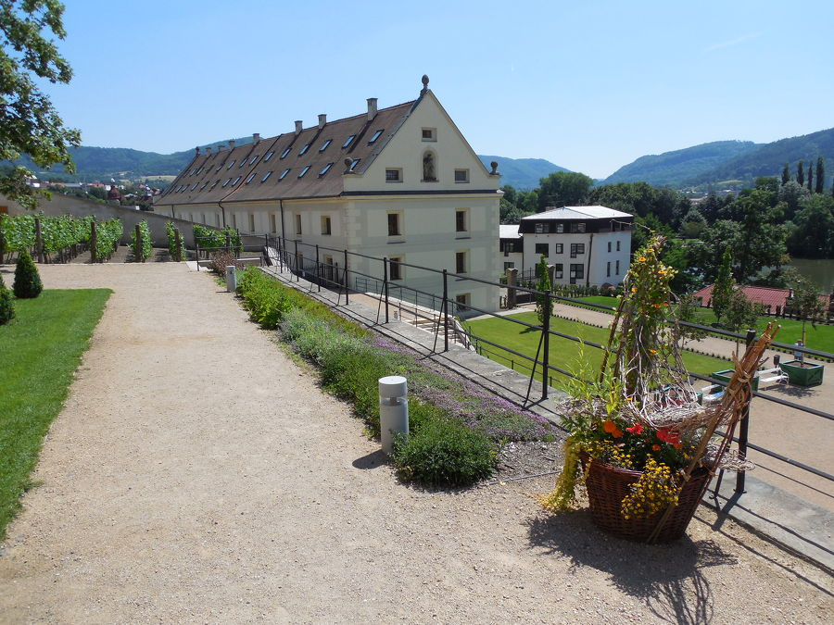
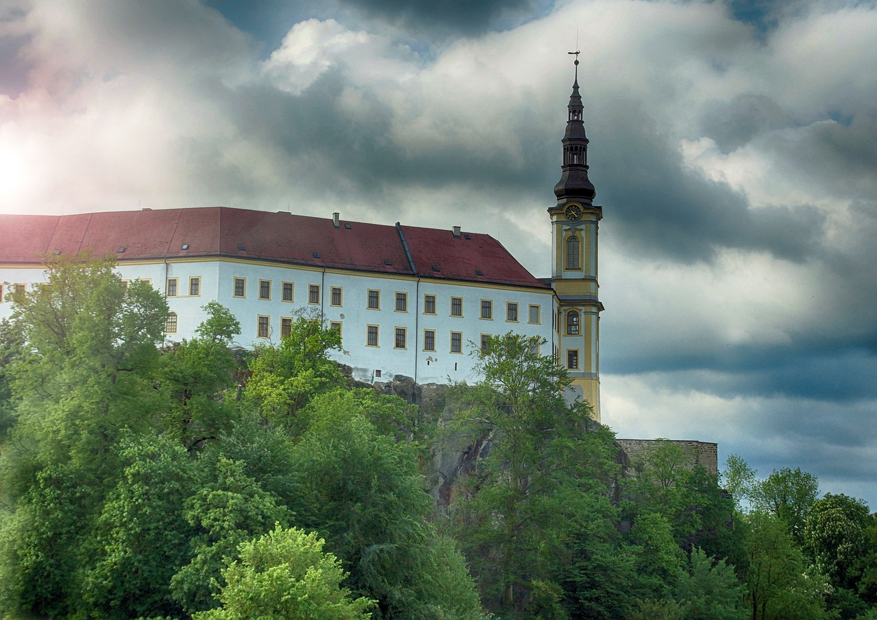
Accommodation and its surroundings
Zámecká Sýpka – students dormitory
Don’t miss Děčín castle and it’s gardens with peacocks!

Slide 14
Food :D
Monday dinner at ČVUT at 19:00
Breakfasts at ČVUT 8:30 – 9:00 (same room as Monday dinner)
Coffee breaks (same room)
Morning 10:30 – 11:00
Afternoon 15:30 – 16:00
Lunch 12:30 – 14:00
Tuesday – Restaurant Fabrika
Wednesday – Restaurant Radnice
Workshop dinner – Tuesday at 19:00 – Restaurant Prokopka

Slide 15
Safety measures
Keep reasonable distances
If you don’t feel healthy, let us know
Disinfectant gel at your disposal
Face masks at your disposal
Use of face masks recommended

Slide 16
Goal of the meeting
Learn about work of our colleagues
Learn something new (and useful)
Discuss our work, new ideas and plans
Get to know each other better
Relax little bit…
…and have fun!

Slide 17
The ultimate goal of the meeting…

Slide 18
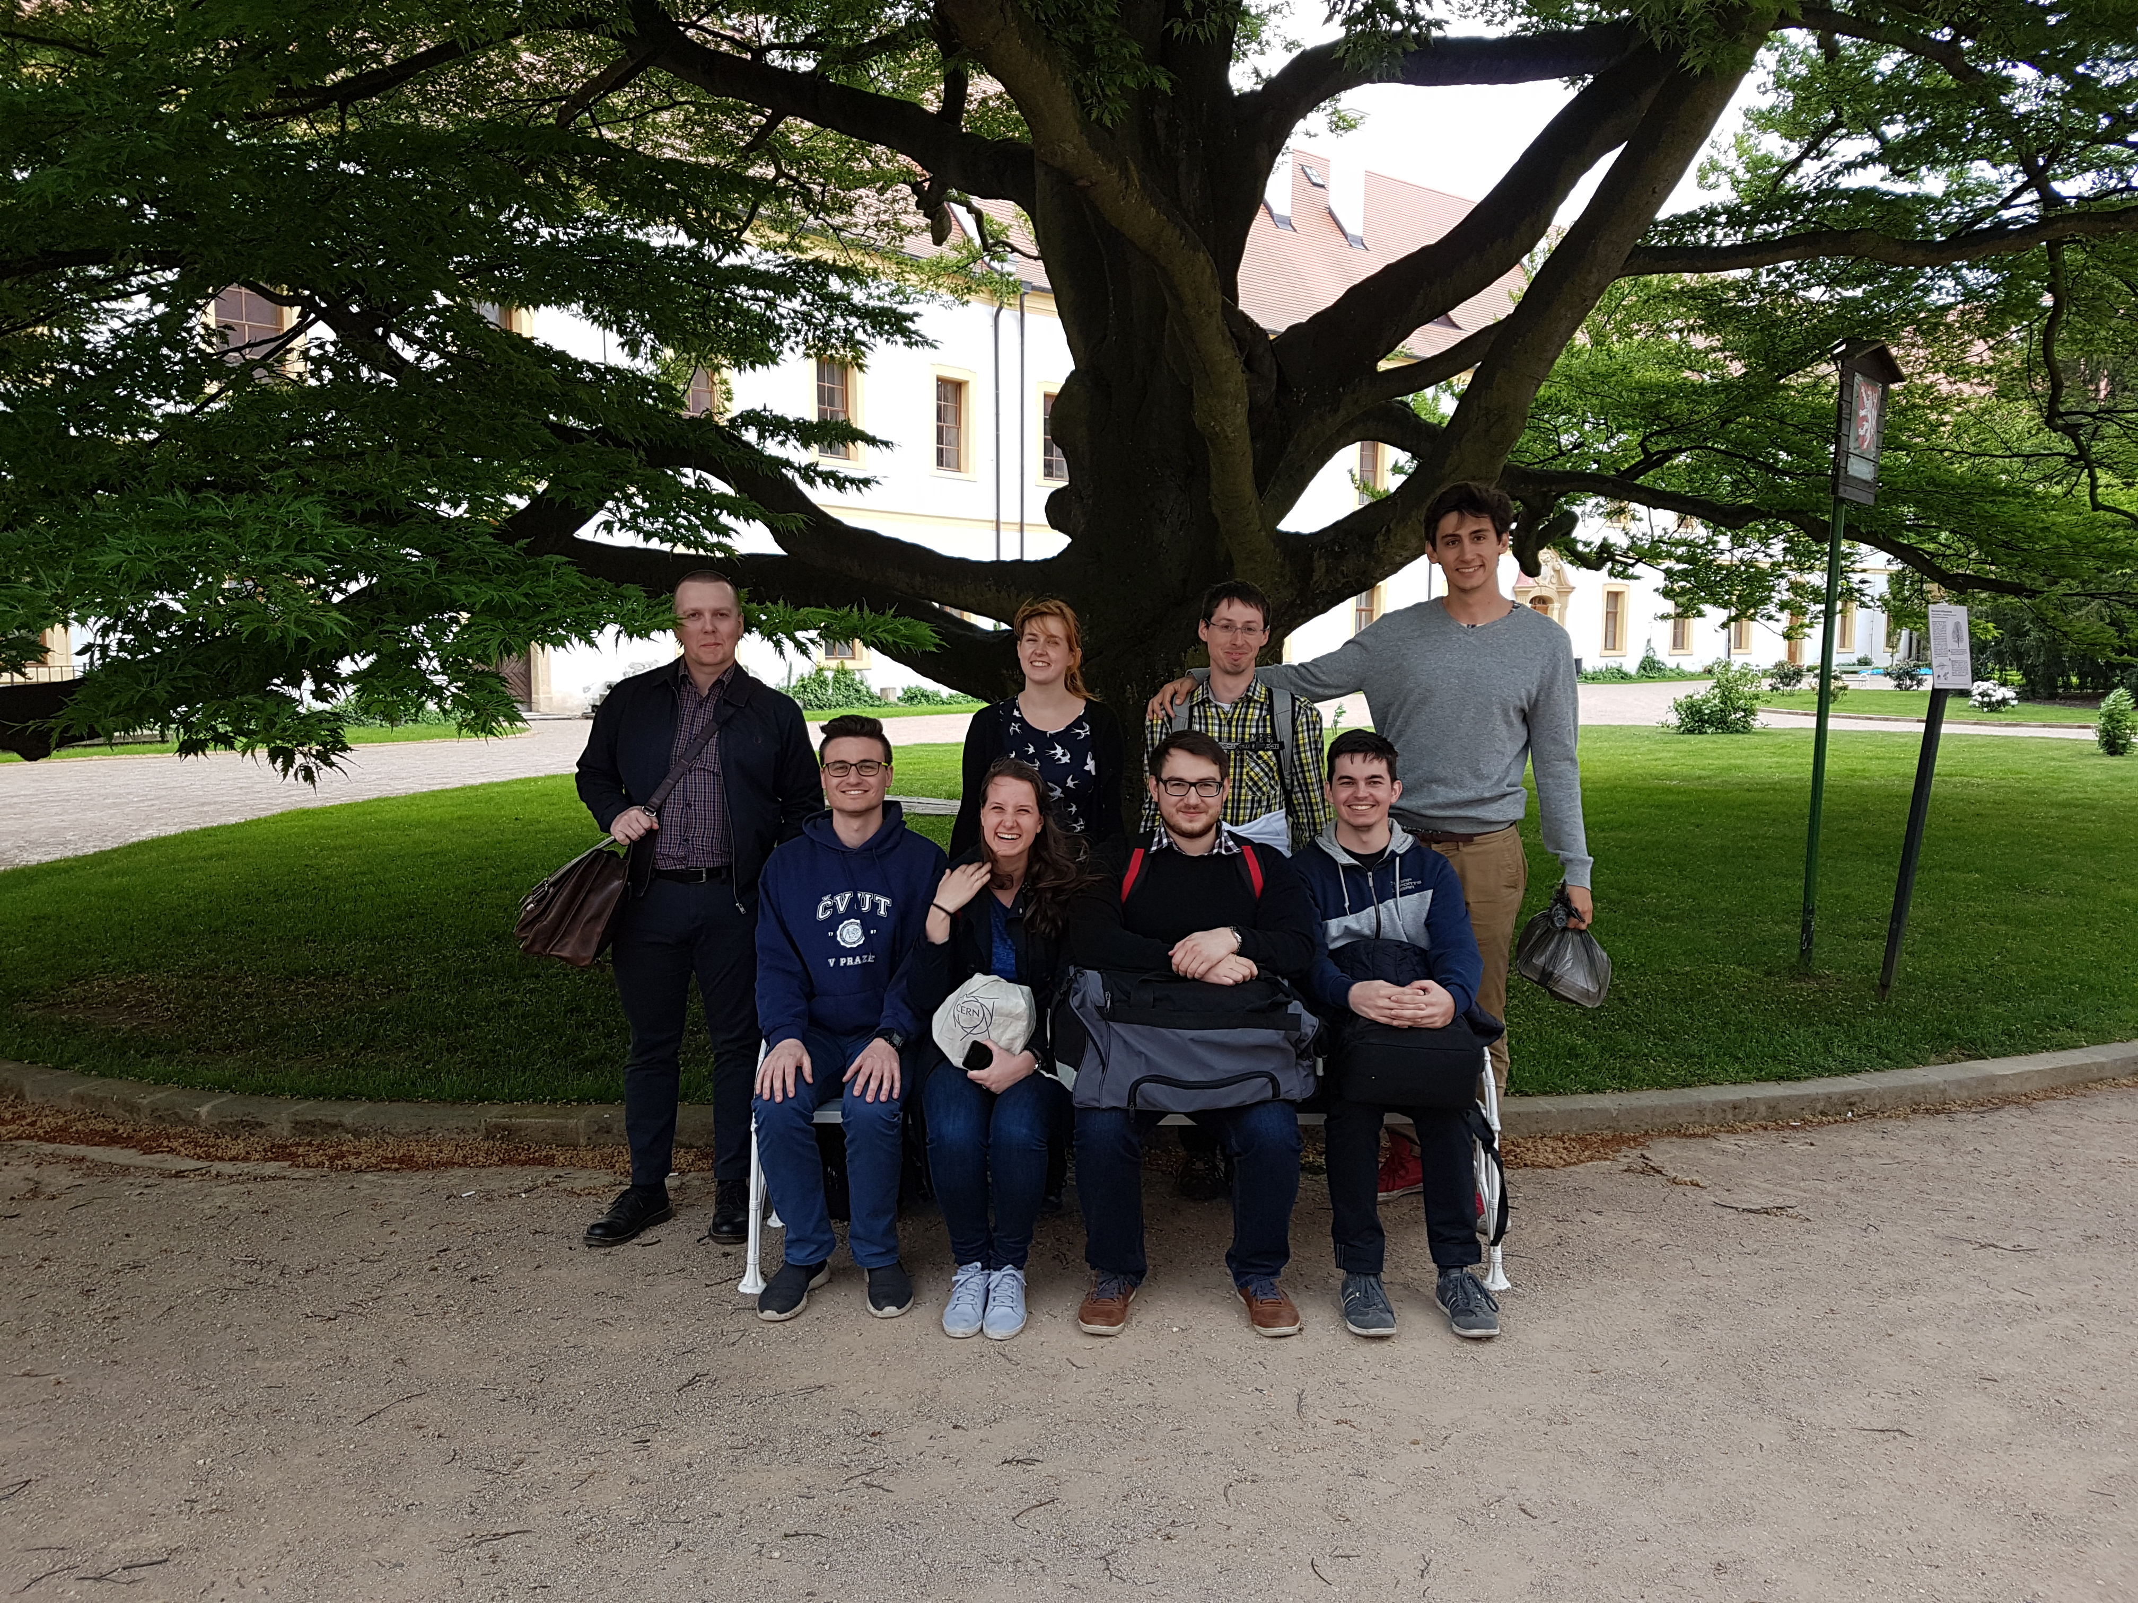
…new group photo!

Slide 19
Any questions regarding the workshop organization?

Slide 20
If not…

Slide 21
It’s time for a surprise!

Slide 22
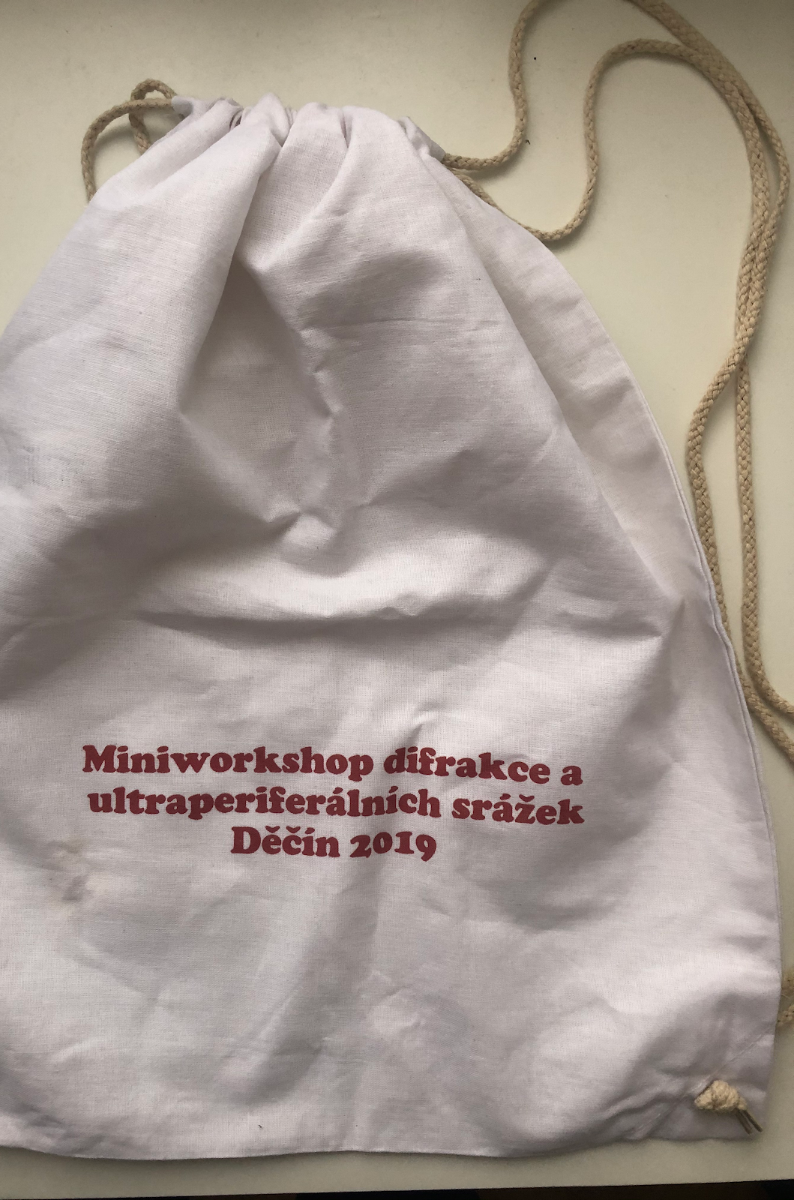
We have two beautiful workshop souvenirs from last two years…

Slide 23
…and we are going to continue with the tradition of practical souvenirs!

