Slide 1
Preparations for the HL-LHC Exascale computing
and
The contribution of the Czech Tier-2 center to the WLCG operations
Dagmar Adamova (NPI AS CR Prague/Rez)
Lanna 23.6.2021

Slide 2
OUTLINE
1. Exascale computing for HL-LHC
2. Czech contribution to the WLCG operations
2

Slide 3
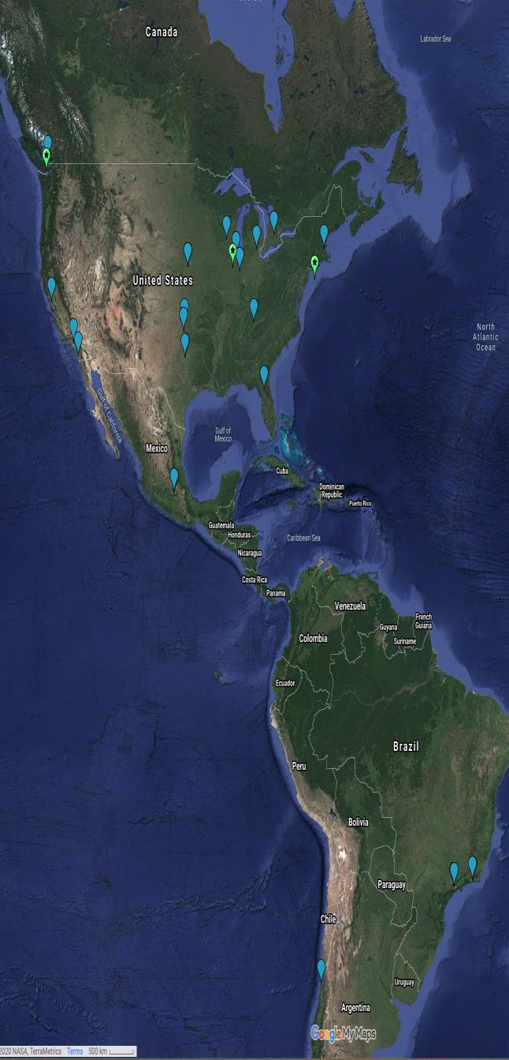
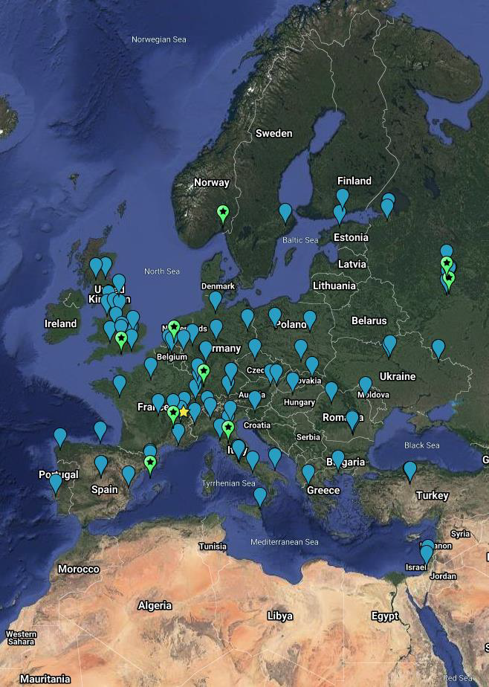
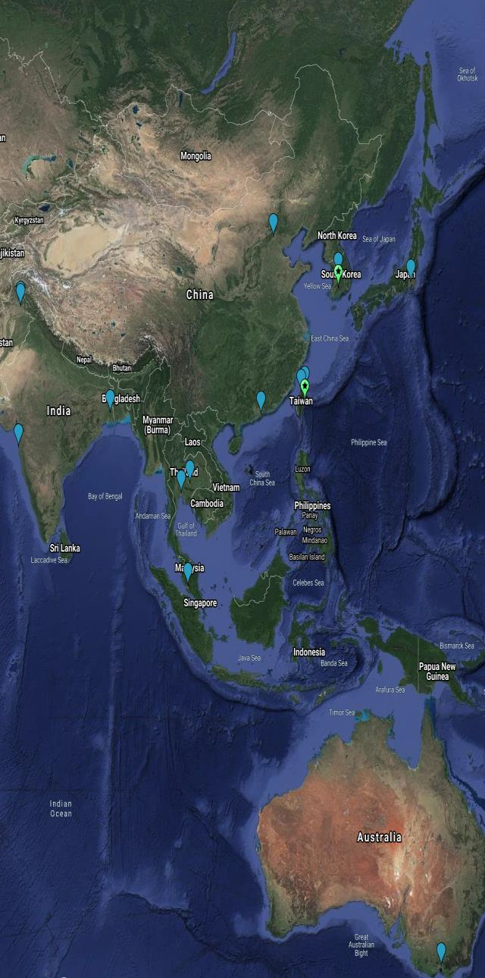
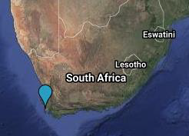
Worldwide LHC Computing Grid topology
66 MoUs
161 sites
42 countries
3

Slide 4
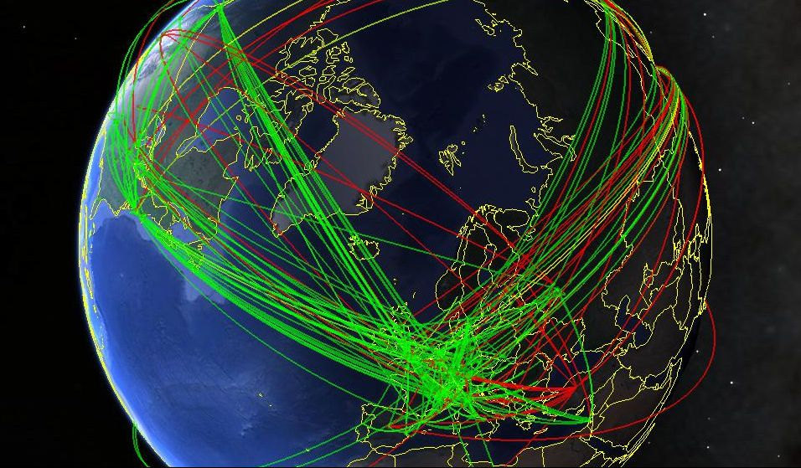
Worldwide LHC Computing Grid resources
52 GB/second
50 million files/week
> 1 ExaByte on disk and tape
~ 1 million fully occupied computer cores
4

Slide 5
WLCG Fabric and software
- Computing: mostly Intel or AMD CPUs with x86 instruction sets. Multi-core.
Some GPUs available at the main Grid sites and at HPC centers.
- Storage: mixture of tape and disk. Since 2018, the “Data Organization, Management and Access” (DOMA) project is active. R&D for “Data Lakes”.
Network: connection between CERN and T1s provided by a system of P2P connections of capacity of 100 Gb/s, so called LHC Optical Private Network (LHCOPN). Most T0/1/2 sites interconnected via LHC Open Network Environment (LHCONE). L3VPN service over research and education networks.
Software: complex system of experiments’ dedicated frameworks written in a mixture of C++ and Python. Rely on many external packages from within and outside the field. Many millions of lines of code. Generally written for x86, increasingly multi-threaded. Being ported e.g. to GPUs.
- Analysis : software quite various, but moving towards the Python ecosystem and particularly to notebooks.
5

Slide 6
LHC Optical Private Network (LHCOPN)
6

Slide 7
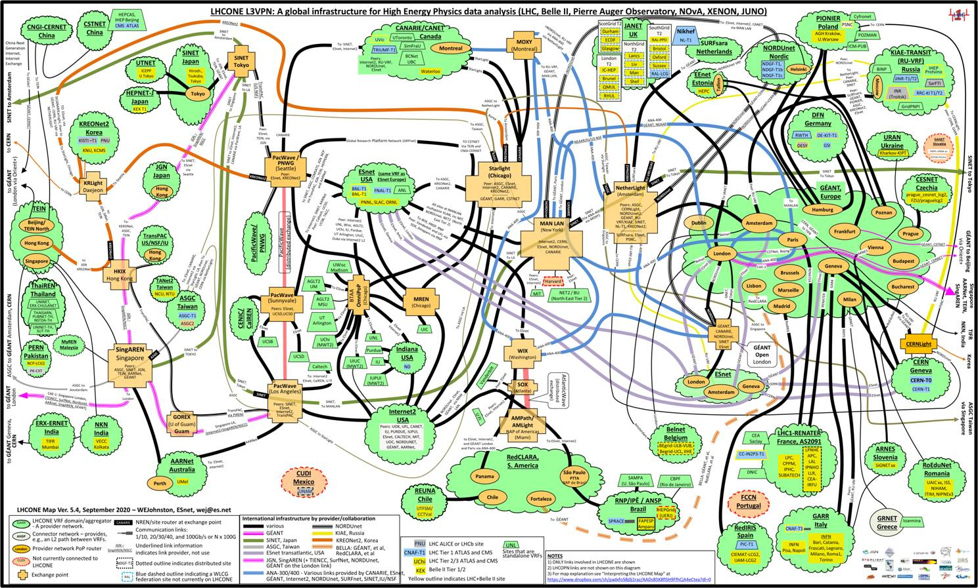
LHC Open Network Environment (LHCONE): a global private network infrastructure connecting the WLCG sites
5

Slide 8
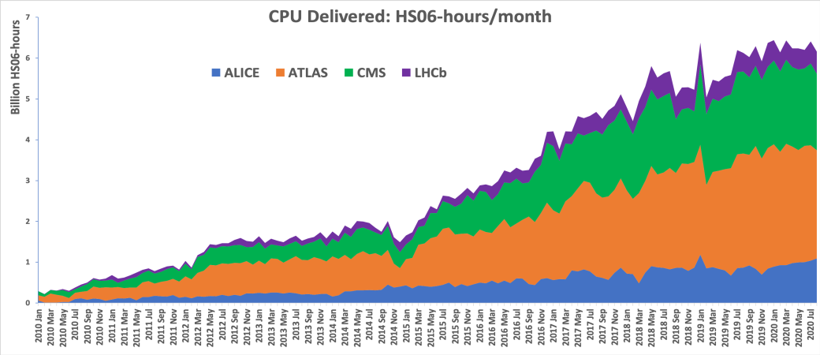
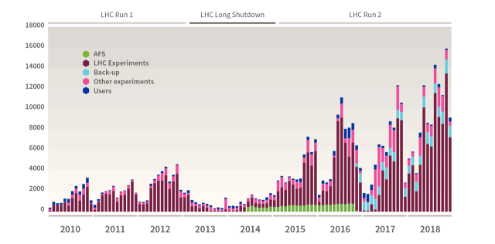
WLCG usage of resources
CPU use has been stable in 2020,
higher than in 2018 (Run 2) and
2019 (start of LS 2)
Current status:
~ 1 million cores fully occupied
CERN computing: Data (in TeraBytes) recorded on tapes at CERN month-by-month (2010–2018)
In the end of 2018, the data stored on CASTOR reached 330 PBytes, of which more than 200 PB was RAW data from LHC experiments
8

Slide 9
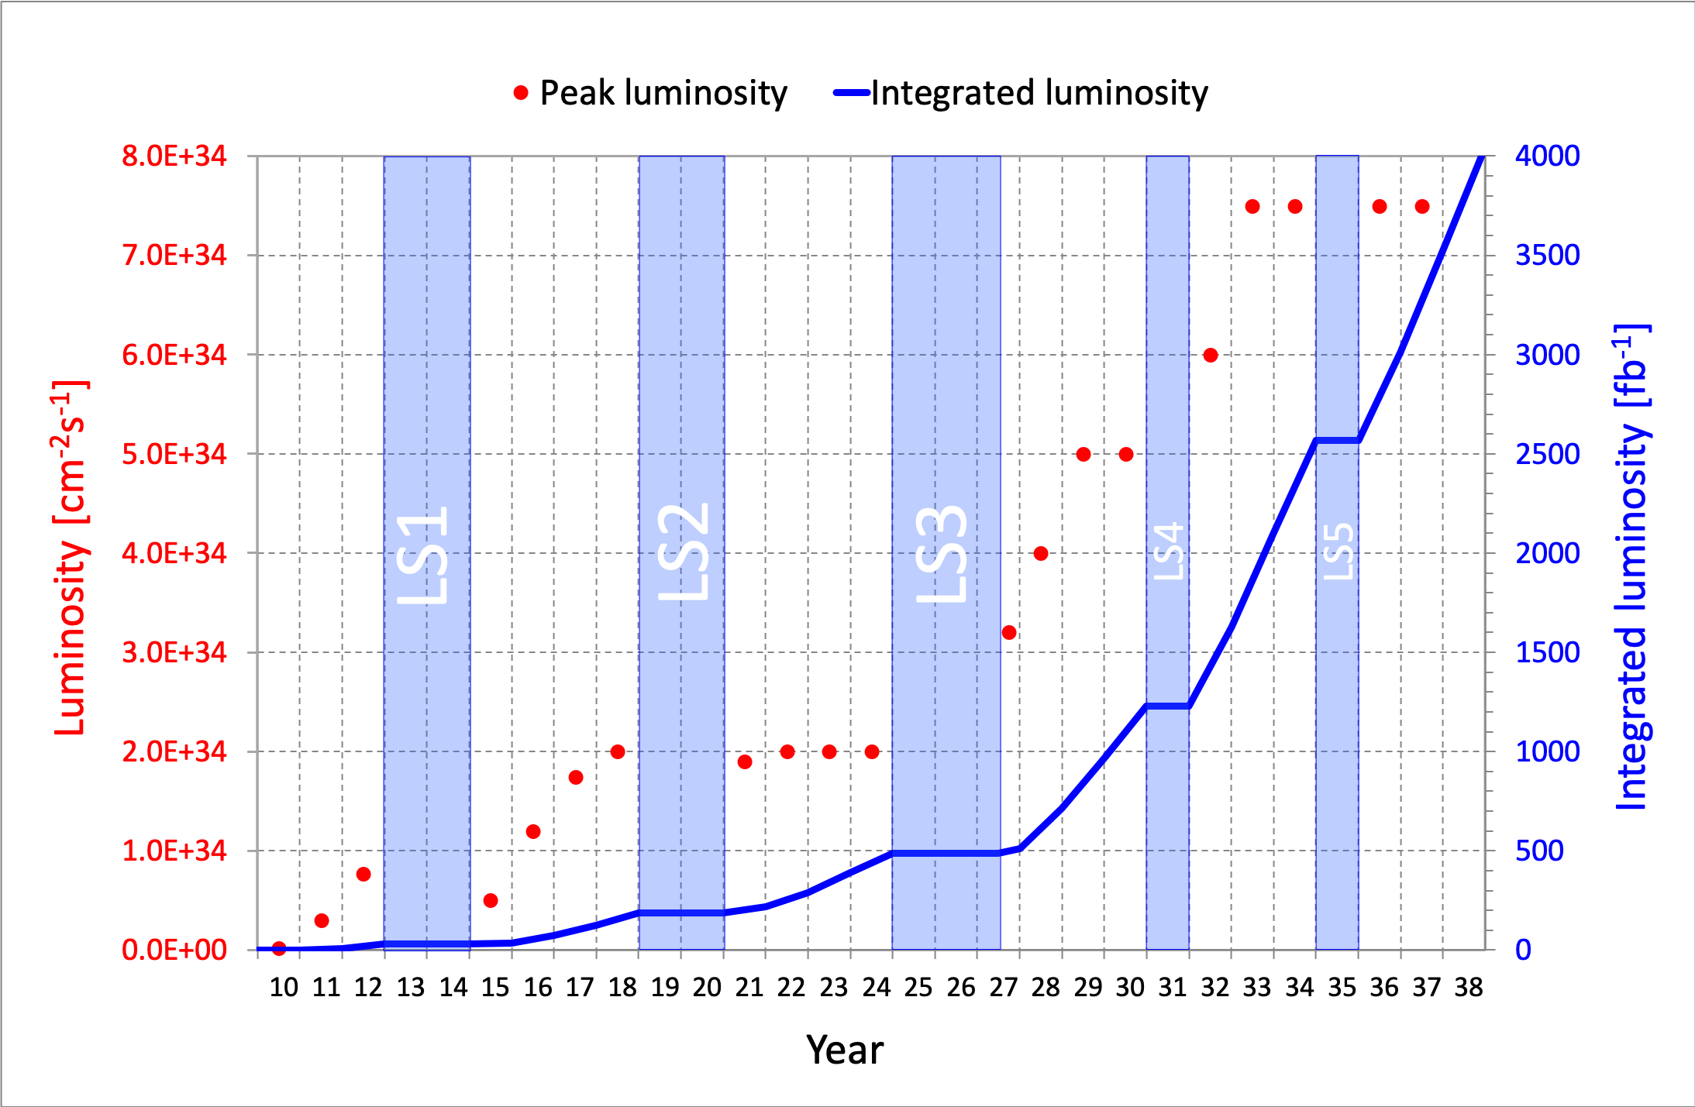
HL-LHC luminosity, current planning
<μ> ~ 200
~ 10 x Run 2
Note: LS2 now also includes 2021, Run 3 will be just 3 years 2022-2024
9

Slide 10
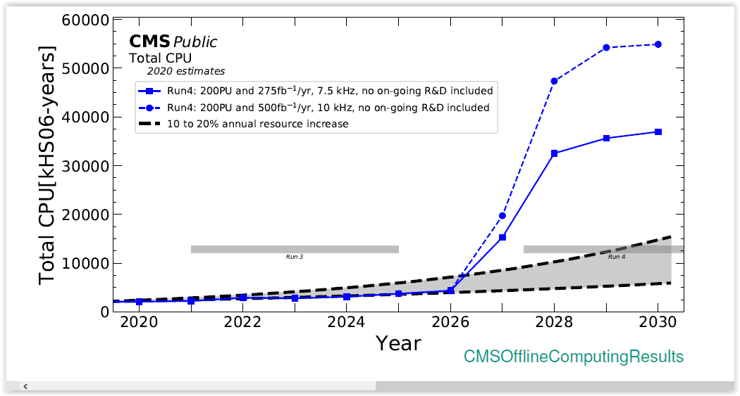
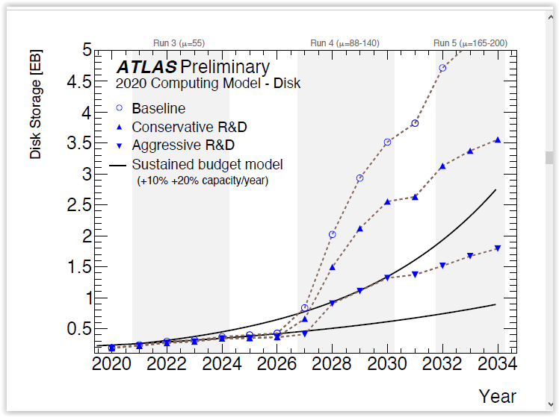
ATLAS and CMS resource needs for HL-LHC
CMS: Anticipated growth in CPU resources towards Run 4.
Factor ~6 difference between “flat budget” and Physics needs.
ATLAS: Anticipated growth in disk capacity towards Run 4.
Factor ~10 difference between “flat budget” and Physics needs.
10

Slide 11
Actions required to be prepared for HL-LHC
Computation: need to have enough compute power to process raw and provide enough simulated data. Necessary to make the best of available technology. Need to be able to use concurrency. This means portability, to allow for HEP code to run on different kind of resources without being re-written. Need to be able to use external facilities which were not built just for HEP, e.g. HPC centers.
Storage: need to find enough storage capacity and deliver processed data fast to analysts. Control demand e.g. by reducing the size of the analysis formats.
Network: not a real problem these days. With the explosion of the network traffic due to social media, the global network infrastructure became very robust and the global throughput continues to rise.
Software: need to provide portability and work on shooting up performance.
11

Slide 12
Portability and Machine Learning
- To speed up the existing code: either optimize or use concurrency. Use of multi threading rather extensive. Done on existing x86 architecture.
More speed-up using GPUs. Number of portability languages developed - to access heterogenous hardware - no need to re-write the existing code to be portable.
HPCC: In July 2020, CERN together with three other research organisations formed a collaboration to deal with the challenges related to the use of high-performance computing (HPC) to support large, data-intensive science projects like WLCG. The members of the collaboration are CERN, SKAO, GÉANT and PRACE (the Partnership for Advanced Computing in Europe).
Machine learning:
- has been used in the HEP community since the LEP days.
- recently huge advances in deep learning – rely on large neural networks
- software for building complex neural networks available.
- deep learning used in HEP simulation and analysis.
12

Slide 13
Simulation
Detector simulation is
the largest consumer of CPU time in HEP.
Monte Carlo simulations are highly parallelizable, which makes them a great target for GPU computation.
13

Slide 14
Simulation, Fast simulation and ML
To speed-up simulation:
- Optimization of the current Geant4 code to run faster
Adapt simulation to heterogenous architectures like GPUs
Plug trained network back into simulation via Geant4 ML models
Fast simulation is usually
Experiment dependent
Simplified, automatic, easy way to extract parameters
Improve Fast simulation:
- Use of Deep Learning
Use of Library of deposits
Improve Physics fidelity of Fast simulation
Fast Simulation Parametric and Machine Learning
- GFlash - historical parameterization of calorimeter energy deposition.
Working to improve both the speed and accuracy of the implementation.
- Auto-regressive neural networks training on different calorimeter data.
14

Slide 15
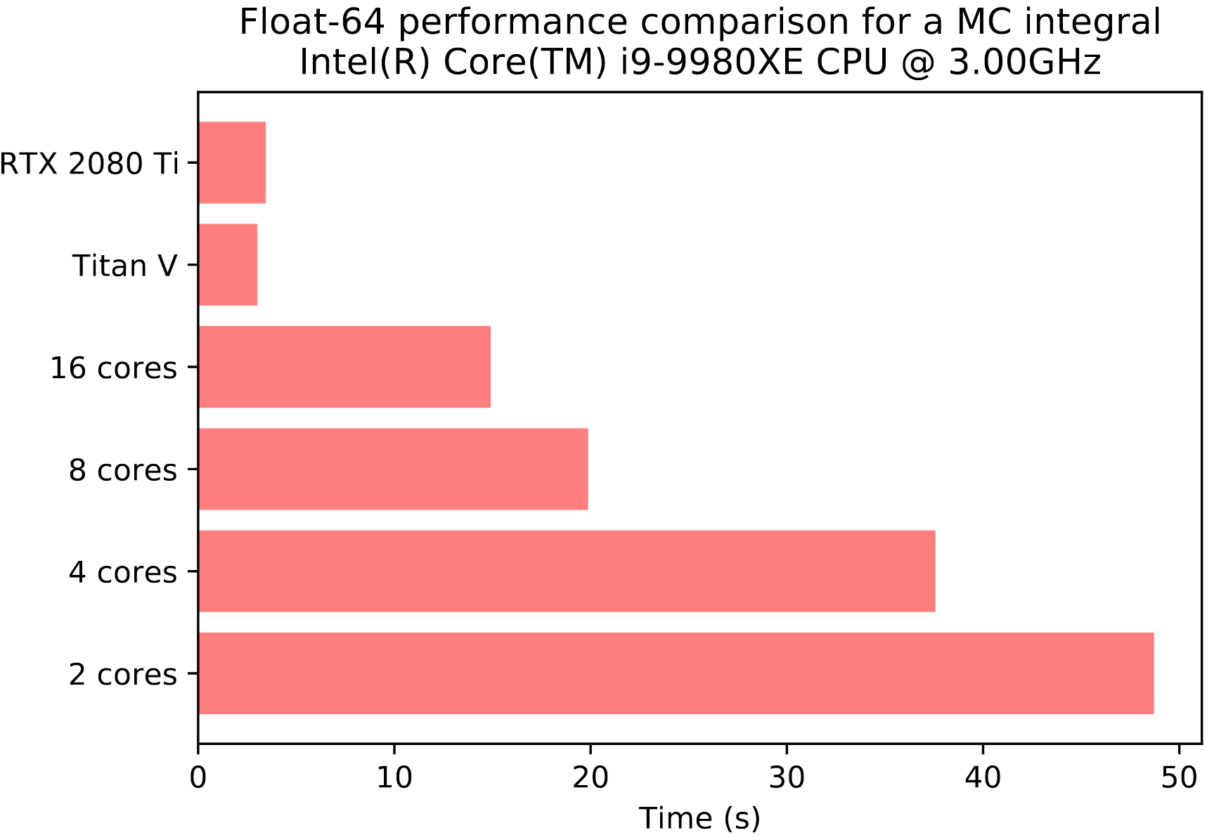
Parton-level Monte Carlo generators
Currently, the MC generators are not dramatic CPU consumers but this will change in the time of HL-LHC due to huge pile-up.
Behind most predictions for LHC phenomenology lies the numerical computation of basic integrals computed numerically using MC methods.
GPU computation can increase the performance of the integrator by more than an order of magnitude.
Monte Carlo integration of
n-dimensional gaussian function
15

Slide 16
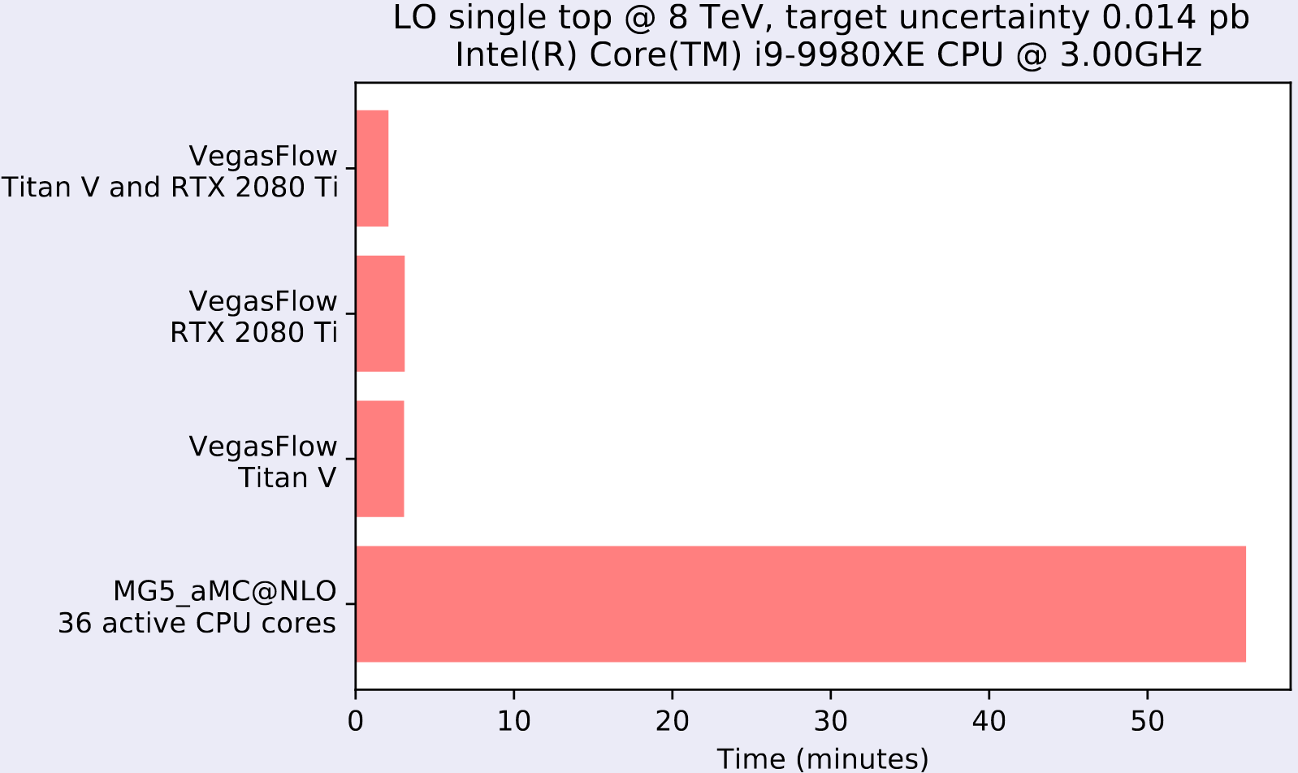
Generators: Running on GPUs with VegasFlow
VegasFlow: Framework for evaluation of high dimensional integrals based on MC algorithms.
Pported an old Fortran code to GPU. No GPU-specific optimization.
16

Slide 17
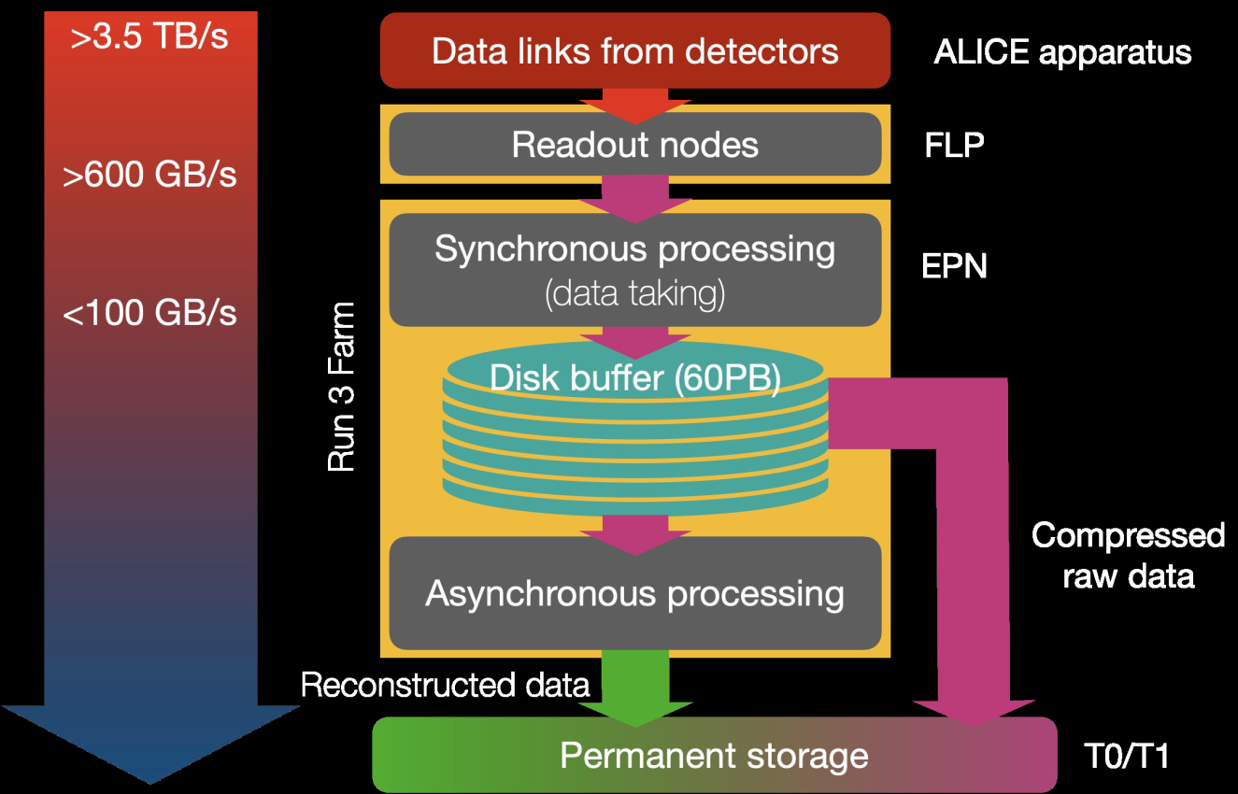
ALICE Data Processing – Run3 and Run4
Synchronous processing
Goal of synchronous reconstruction is to reach factor 35 of compression.
Most relevant detector is TPC: from 3.4 TB/s to 70 GB/s.
Efficient usage of accelerators allows to trade between
40 and 150 CPU cores for
a single graphics card.
Online reconstruction on the EPN farm
Event processing nodes equipped with GPUs (up to a few thousand)
Synchronous processing: during data taking, main user: TPC, 100% TPC standalone tracking on GPUs.
Asynchronous: during no-beam periods and pp collisions
17

Slide 18
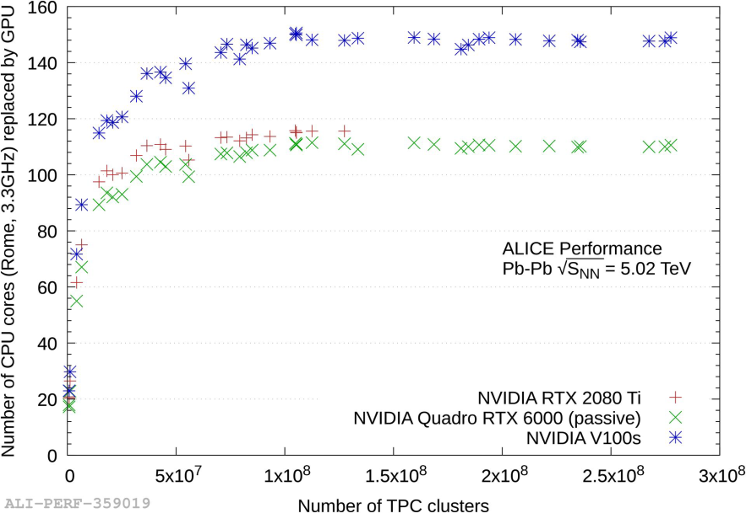
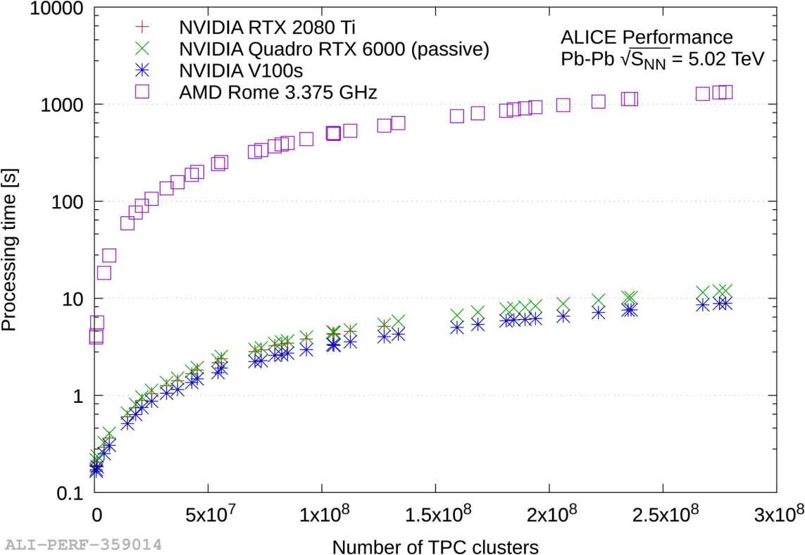
ALICE GPU tracking: performance
40-150 CPUs replaced by one GPU
TPC tracking speeded up by factor of 50-100
18

Slide 19
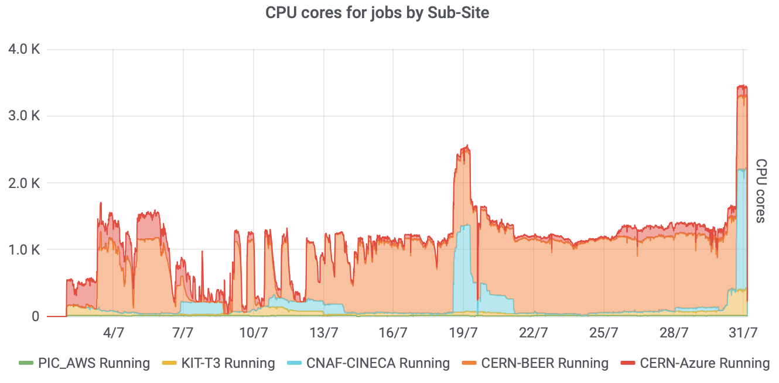
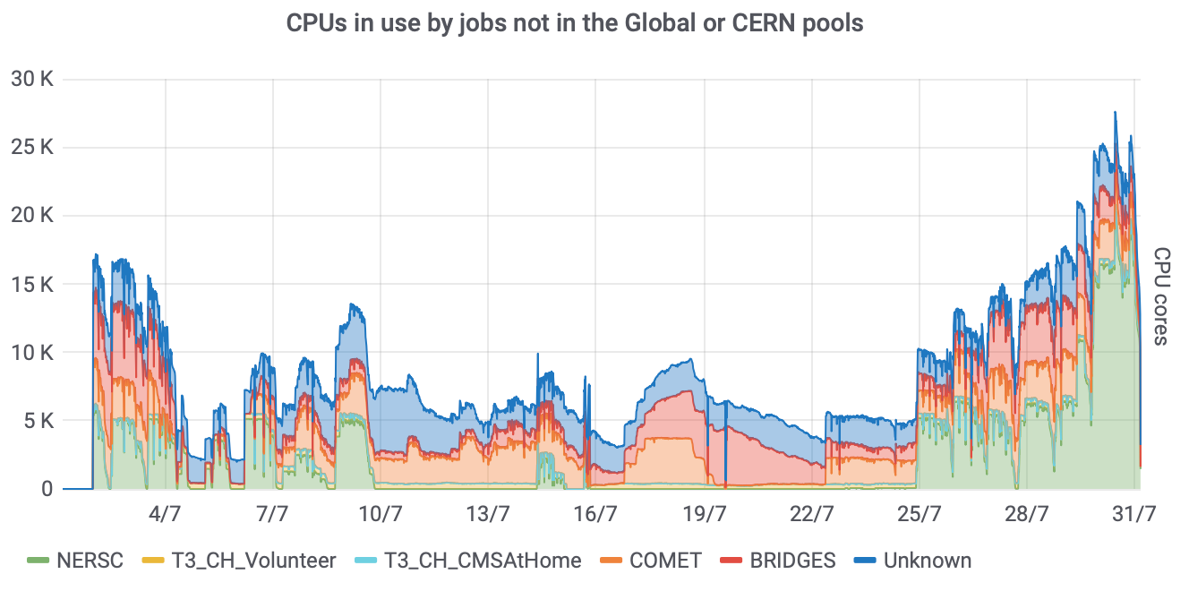
CMS: Dynamic heterogenous resources integration
Recent progress in the integration of new resources into the CMS Global Pool and for CMS use:
• HPC: via GlideinWMS pilot submission (CINECA) or integrated to HEPCloud (NERSC, etc)
• Cloud: as extension of Grid sites (CERN_Azure and PIC_AWS)
• Opportunistic use of clusters: CERN_BEER and Research or University campus (e.g. at Purdue)
Non-standard resources require enhanced workload-to-resource matchmaking: working on an expanded description of jobs and resources for flexible and efficient scheduling (e.g. select no-input data tasks etc.)
19

Slide 20
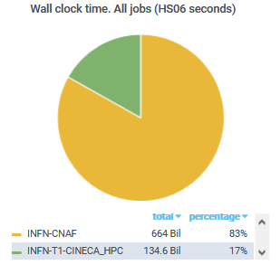
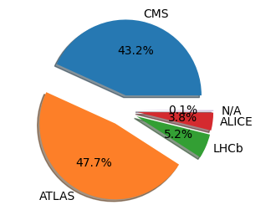
Integration of the HPC resources into WLCG ecosystem
Motivation for the use/integration of HPC resources:
● Growing funding in HPC infrastructures looking onwards to deploying Exascale machines
● Countries/Funding agencies pushing HEP communities to make use of these resources
● Interest in HEP experiments to access best technologies available, usually employed at HPC sites
● HPC contribution in the future regarded as integral part of WLCG strategy towards HL-LHC
Integration of CNAF (WLCG T1) HPCC CINECA (the largest Italian HPCC provided by PRACE) into a virtual facility, transparent (as much as possible) to the experiments and WLCG.
ATLAS: CINECA provided
~ 17% of the CNAF HS06 in 3 months
CINECA utilization per experiment
20

Slide 21
ATLAS data treatment: DataCarousel
- Objective: use tape as input for I/O intensive workflows to reduce the expensive storage of data on disks
- It is a sliding window approach to orchestrate data processing with the majority of data resident on tape storage
- The processing is executed by staging the data onto disk storage and promptly processing them
- Only the minimum required input data are located on disk at any time
- Tested on full Run2 RAW data reprocessing (18 PB staged over several weeks)
21

Slide 22
Conclusions (1)
- WLCG infrastructure is running smoothly in LS2
COVID-19 has had only little impact on operations so far
The HEP community has a number of challenges to address with respect to computing and software before the HL-LHC era:
Computation, Portability, Storage and Data Delivery, Analysis.
Fortunately, there are tools available for us to deal with the challenges .
Funding agencies and institutes must realize that computing and software are as important for physics as detector development and construction.
Flat budget planning is appreciated very much but may not be sufficient to take full advantage of the HL-LHC potential.
Computing systems for HEP now require detailed project planning, management and sustainability over coming years.
WLCG engaged with other HEP experiments (DUNE, Belle 2) and communities (astronomy) to collaborate on evolving the infrastructure according to the challenges ahead.
22

Slide 23
PART 2
Czech contribution to the WLCG operations
23

Slide 24
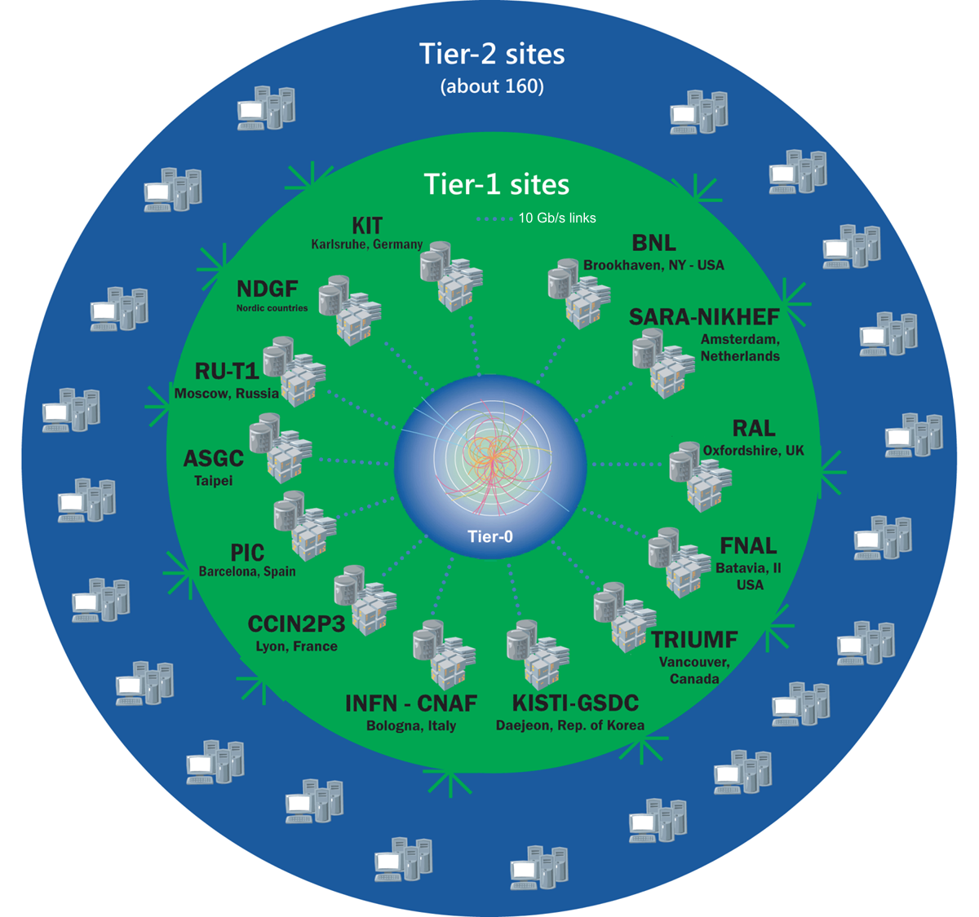
Tier-T2 sites in the WLCG ecosystem
The WLCG ecosystem consists of sites ranked as Tier-0, Tier-1 and Tier-2. Tier-0 is CERN, 14 Tier-1s are large computing centers and 146 Tier-2s are smaller size centers..
The role of Tier-2s in the WLCG ecosystem is crucial: they deliver resources same as Tier-1s.
24

Slide 25
praguelcg2 was one of the first computing centers included in WLCG. Its operations started already in 2004 and have been running steadily ever since delivering services of ever growing capacity.
Currently praguelcg2 is a modest size Tier-2 site with distributed resources. The main part is installed at the Institute of Physics of the CAS (FZU) in Prague, additional resources are provided by two other institutions in Prague, by Nuclear Physics Institute of the CAS (NPI) in Rez near Prague and by the CESNET association and HPC center in the city of Ostrava (cf. the map).
The complete stack of resources involves ~ 10,000 CPUs, 6.65 PBytes of disk space and network connectivity of the range between 10 Gb/s and 100 Gb/s. Very few links in WLCG top 100 Gb/s.
- The compute, storage and data management services provided by praguelcg2 are used predominantly by ATLAS and ALICE @LHC but also by other HEP and astroparticle experiments.
Czech WLCG Tier-T2 site: praguelcg2
25

Slide 26
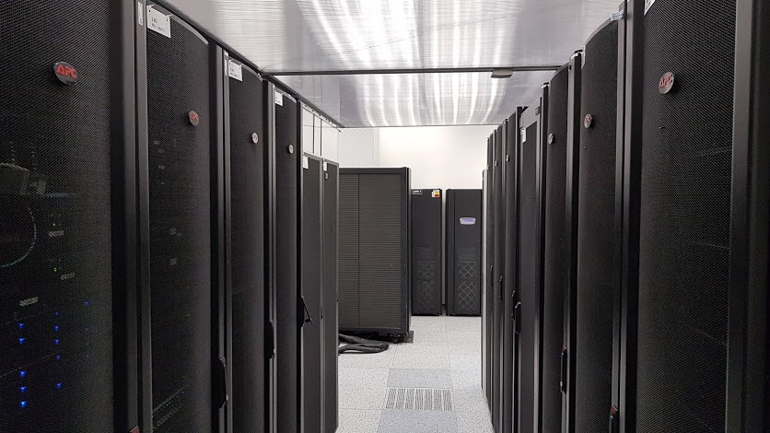
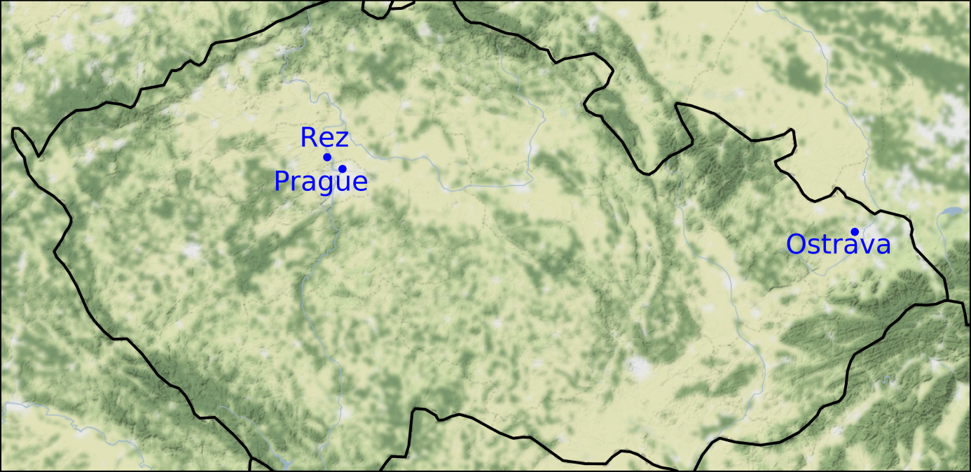
praguelcg2
Map of locations of the individual sites contributing to praguelcg2 operations. Connectivity between sites is 10 Gb/s. Connection to LHCONE is 100 Gb/s.
26

Slide 27
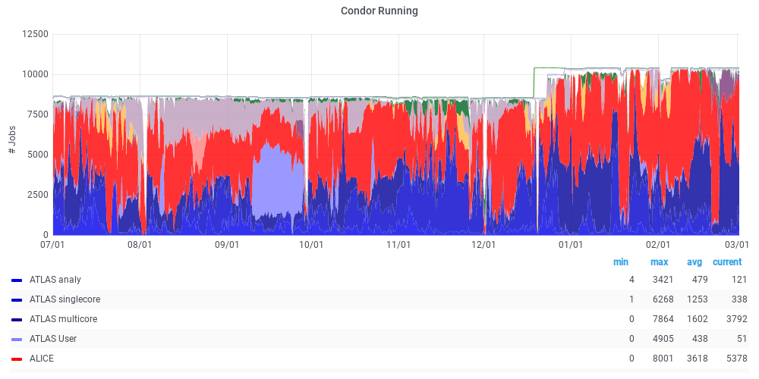
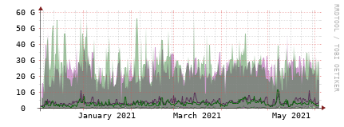
Performance plots
Running jobs profile for the recent 9 months provided by the local monitoring at the central site in Prague. Main CPU consumers are ALICE and ATLAS.
Network traffic between the main site of praguelcg2 and LHCONE during last 6 months. Maximum throughput reaches to 60 Gb/s, the nominal capacity is 100 Gb/s.
27

Slide 28
ALICE operations at praguelcg2
ALICE computing is special due to the obligation of each participating institution to deliver compute and storage capacities based on ALICE MoU-A.
Czech ALICE group is quite small and this translates also into a smaller share in available stack of resources.
Despite this disadvantage we manage to deliver required capacities.
pragelcg2 site is able to operate almost without interruptions and longer downtimes.
A suitable fairshare is set at the main site at FZU.
In addition, the ALICE jobs are very efficient in using any opportunistic resources.
As a result, millions of ALICE jobs are processed at praguelcg2 each year (e.g. 16,5M in 2015 – 2019; 5,46M during 3/2020 – 4/2021).
Our XRootD ALICE storage kept up to
~ 48,131,572 data files and ~ 67 PB of data was downloaded from our storage during 3/2020 – 4/2021.
28

Slide 29
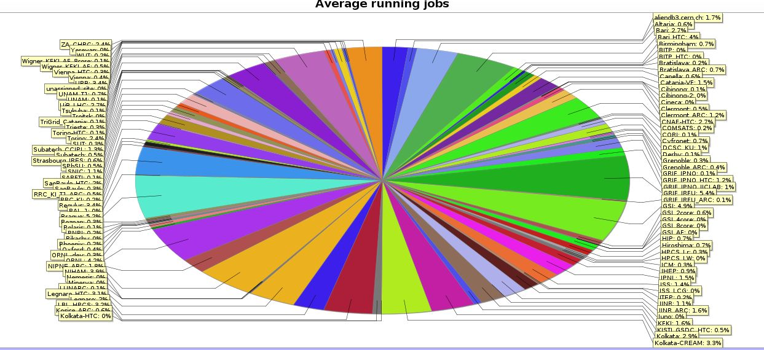
Performance plots
praguelcg2: 5.2 %
praguelcg2 was among top 10 Tier-2 contributors
Delivery of ALICE compute resources: Tier-2s share. 3/2020 – 4/2021
29

Slide 30
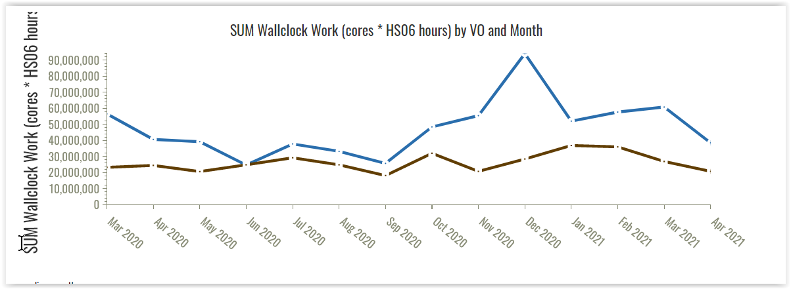
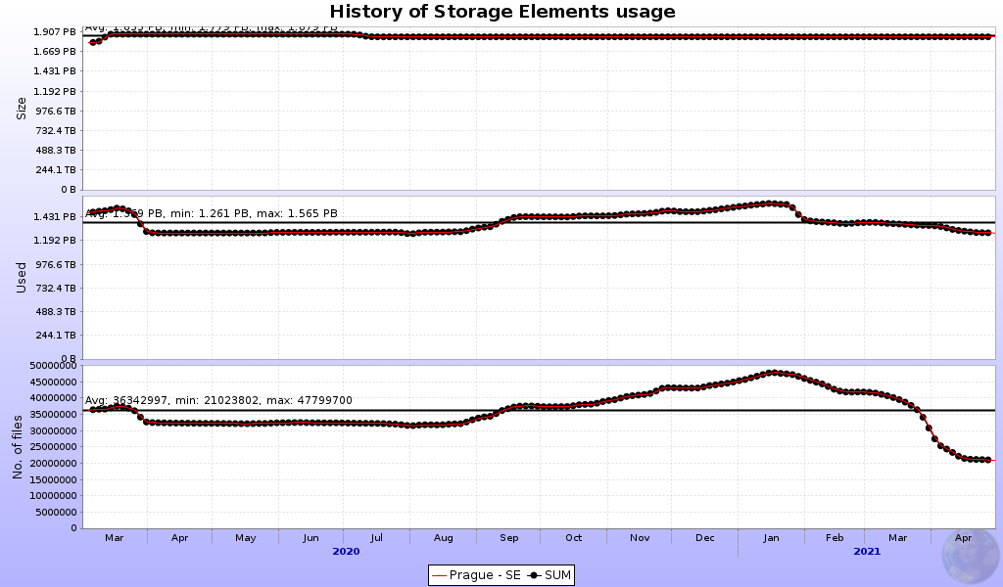
Performance plots
EGI accounting:
delivery of compute resources for ALICE and ATLAS by praguelcg2. 3/2020 – 4/2021
ATLAS
ALICE: delivery according to
the requirements
Delivery of ALICE storage resources: according to the requirements. 3/2020 – 4/2021 . Our XRootD ALICE storage kept up to
~ 48,131,572 data files.
30

Slide 31
Conclusions (2)
The Czech Tier-2 , praguelcg2 , is a modest size Tier-2 site with distributed resources involving Prague, Rez and the city of Ostrava.
Smart management of the computing servers and the batch system combined with quite large data storage and good networking allows for delivery of compute and storage services well visible within Tier-2 ecosystem. We are very active in keeping the site operational without major interruptions and continually fighting for financial support for computing.
The ALICE group is one of the largest consumers of the praguelcg2 resources. ALICE computing is special due to the obligation to deliver compute and storage capacities based on ALICE MoU-A.
Although ALICE has a smaller share in available stack of local resources, we manage to deliver required capacities, partly due to an efficient use of opportunistic resources and partly due to the site ability to operate almost without interruptions and downtimes.
We will do our best to keep up this performance into the future, meeting the challenges of the HL-LHC.
31

Slide 32
REMINDER
“The amount of data that experiments can collect and process
in the future
will be limited by affordable software and computing,
not by physics”
Cited from “Community White Paper” of the HEP Software Foundation : http://hepsoftwarefoundation.org/activities/cwp.html
32

Slide 33
BACKUP SLIDES
33

Slide 34
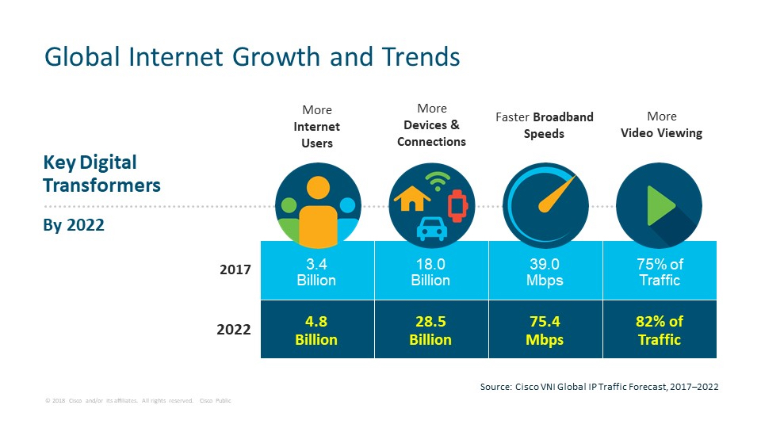
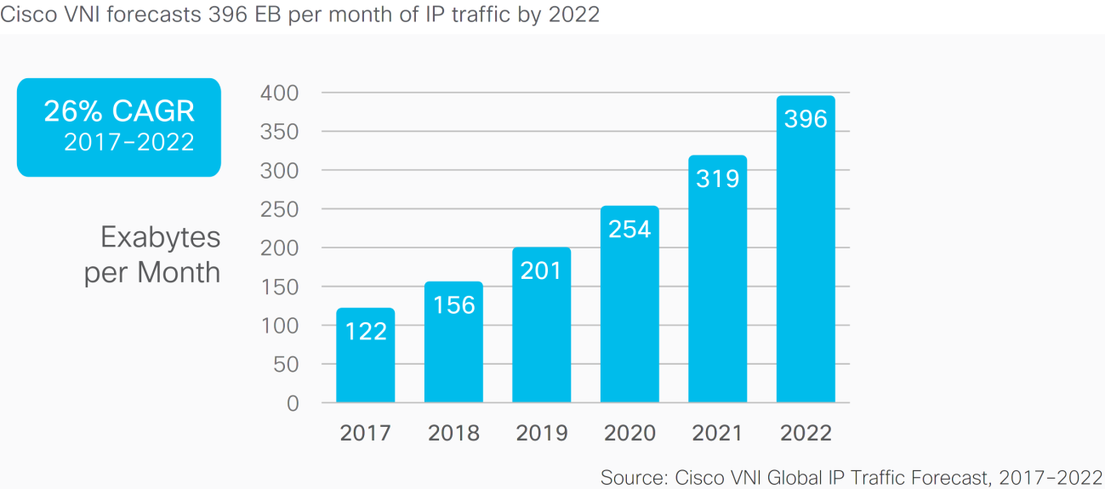
A glance at the numbers in the business ecosystem
Google, Facebook, Microsoft, and Amazon store at least 1200 PetaBytes of information per day at present.
By 2025, the amount of data generated each day is expected to reach
463 ExaBytes globally.
The entire digital universe is expected to reach 44 ZettaBytes by 2020.
If this number is correct, it will mean there are 40 times more bytes than there are stars in the observable universe. (World Economic Forum)
CISCO forecasts 396 ExaBytes per month of IP traffic by 2022.
(Source: Cisco Visual Networking Index)
34

Slide 35
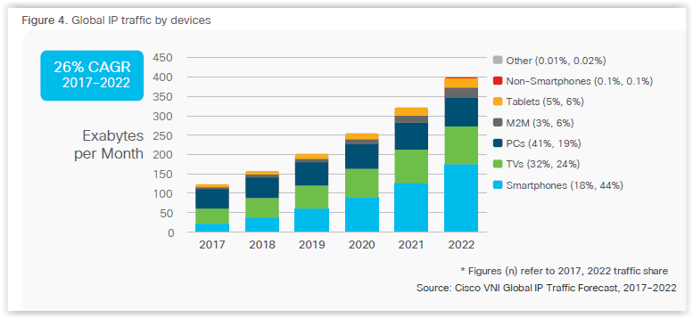
Future of global network traffic
Global IP traffic by devices
35

Slide 36
Future of global network traffic
Global IP traffic will more than triple
Global IP traffic is expected to reach 396 ExaBytes per month by 2022, up from 122 ExaBytes per month in 2017. That’s 4.8 ZettaBytes of traffic per year by 2022.
By 2022, the busiest hour of internet traffic will be six times more active than the average. Busy hour internet traffic will grow by nearly five times (37 percent CAGR) from 2017 to 2022, reaching 7.2 PetaBytes per second by 2022. In comparison, average internet traffic will grow by nearly four times (30 percent CAGR) over the same period to reach 1 PetaBbyte by 2022.
36

