Slide 1
Performance Analysis of Fast Independent Component Extraction
Václav Kautský

Slide 2
Content
BLIND SOURCE SEPARATION
BLIND SOURCE EXTRACTION
PIECEWISE MIXING MODELS
RESULTS
CONCLUSIONS

Slide 3
BLIND SOURCE SEPARATION

Slide 4
Blind Source Separation – BSS
… a fundamental signal processing problem
Unseen original signals are mixed by an unknown transform; only the mixed signals are observed through sensors
The goal is to retrieve the original signals using minimum information

Slide 5
Instantaneous Mixing Model
Blind Source Separation (BSS)
Independent Component Analysis (ICA)
mixing
matrix
samples
samples
sensors
independent sources
$$X = A ∙ S$$
#sources
#sources
Determined model
Underdetermined model
$$A=$$
$$A=$$
#sensors
#sensors

Slide 6
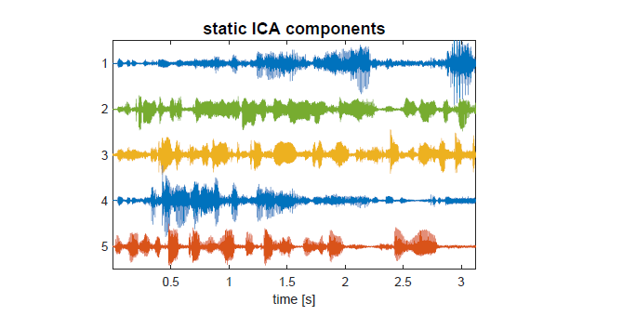

Slide 7
Instantaneous Mixing Model
Blind Source Separation (BSS)
Independent Component Analysis (ICA)
model | determined | underdetermined
#sources | #sources = #sensors | #sources > #sensors
Separating (de-mixing) matrix | ☺ | ☹
Dynamic conditions | ☹ | ☹
?
?
$A=\left(\begin{matrix}a_{11} & ⋯ & a_{1d} \\ ⋮ & ⋱ & ⋮ \\ a_{d1} & ⋯ & a_{dd}\end{matrix}\right)$ $A^{−1}=W=\left(\begin{matrix}w_{11} & ⋯ & w_{1d} \\ ⋮ & ⋱ & ⋮ \\ w_{d1} & ⋯ & w_{dd}\end{matrix}\right)$
$$S = W ∙ X$$

Slide 8
BLIND SOURCE EXTRACTION
BLIND SOURCE EXTRACTION

Slide 9
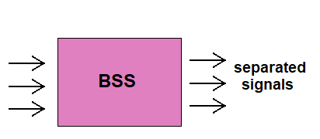
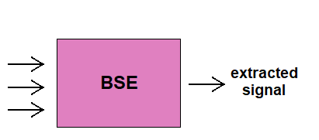
Blind Source Extraction (BSE)
The goal of BSS:
The goal of BSE:
Keep in mind: When data obey the BSS mixing model, the BSE problem is just a subtask of BSS unless it models the data differently.

Slide 10
Blind Source Extraction (BSE)
Independent Component Extraction (ICE)
mixing
vector
source of interest (SOI)
background
$$X = A ∙ S$$
ICE: Structured mixing and de-mixing matrices
$A=\left(\begin{matrix}a & Q\end{matrix}\right)=\left(\begin{matrix}γ & h^{H} \\ g & \frac{1}{γ}(gh^{H}−I)\end{matrix}\right)$ $A^{−1}=W=\left(\begin{matrix}w^{H} \\ B\end{matrix}\right)=\left(\begin{matrix}\overline{β} & h^{H} \\ g & −γI\end{matrix}\right)$

Slide 11
BLIND SOURCE EXTRACTION
PIECEWISE DETERMINED MIXING MODELS

Slide 12
Piecewise Instantaneous Mixing Model
Blind Source Separation (BSS)
Independent Component Analysis (ICA)
blocks $m=1,⋯,M$
blocks $m=1,⋯,M$
# sensors
# sources
$$X^{m} = A^{m} ∙ S^{m}$$
$$A^{m}=\left(\begin{matrix}a_{11}^{m} & ⋯ & a_{1d}^{m} \\ ⋮ & ⋱ & ⋮ \\ a_{d1}^{m} & ⋯ & a_{dd}^{m}\end{matrix}\right) ({A^{m})}^{−1}=W^{m}=\left(\begin{matrix}w_{11}^{m} & ⋯ & w_{1d}^{m} \\ ⋮ & ⋱ & ⋮ \\ w_{d1}^{m} & ⋯ & w_{dd}^{m}\end{matrix}\right)$$

Slide 13
Piecewise Instantaneous Mixing Model
Blind Source Separation (BSS)
Independent Component Analysis (ICA)
model | piece-wise determined | underdetermined
#sources | #sources > #sensors | #sources > #sensors
Separating (de-mixing) matrix | ☺ | ☹
Dynamic sources | 😐 | ☹
Just a sequential BSS / ICA
NOT INTERESTING

Slide 14
Piecewise Determined Mixing Model
Constant Mixing Vector (CMV)
static source, dynamic background
constant mixing
vector over blocks
static
source of interest (SOI)
dynamic
background
$$X^{m} = A^{m} ∙ S^{m}$$
Structured mixing and de-mixing matrices:
$$A^{m}=\left(\begin{matrix}a & Q^{m}\end{matrix}\right) W^{m}=\left(\begin{matrix}{{(w}^{m})}^{H} \\ B\end{matrix}\right)$$

Slide 15
Piecewise Determined De-Mixing Model
Constant Separating Vector (CSV)
Moving source, dynamic background
moving
source of interest (SOI)
constant separating
vector over blocks
dynamic
background
$$S^{m} = W^{m} ∙X^{m}$$
Structured de-mixing matrix:
$$W^{m}=\left(\begin{matrix}w^{H} \\ B^{m}\end{matrix}\right)$$

Slide 16
Joint BSE: Piecewise Independent Vector Extraction
Constant Mixing Vector
K mixtures
(datasets)
$$X^{k,m} = A^{k,m} ∙ S^{k,m}$$
$$A^{k,m }=\left(\begin{matrix}a^{k} & Q^{k,m}\end{matrix}\right) W^{k,m}=\left(\begin{matrix}{{(w}^{k,m})}^{H} \\ B^{k}\end{matrix}\right)$$
Mixtures (datasets): $k=1,⋯,K$ Blocks: $m=1,⋯,M$

Slide 17
Piecewise Determined Mixing Models
Constant Mixing/Separating Vector
model | Piecewise determined | underdetermined
#sources | #sources > #sensors | #sources > #sensors
Separating (de-mixing) matrix | ☺ | BSS ☹ ☺ BSE
Static or moving SOI and dynamic background | ☺ | BSS ☹ ☺ BSE

Slide 18
BLIND SOURCE EXTRACTION
RESULTS

Slide 19
Performance Bounds
Cramér-Rao Lower Bound on Separation Accuracy
Model | Cramér-Rao-induced bound for Interference-to-Signal Ratio
Standard ICE | $$E[ISR]≥\frac{M}{N}\frac{d−1}{κ−1}$$
Piecewise ICE, CMV | $$E[ISR]≥\frac{d−1}{N}\left(\frac{1}{κ−1}+\frac{M−1}{κ}\right)$$
Piecewise ICE, CSV | $$E[ISR]≥\frac{1}{N}\frac{d−1}{κ−1}$$
where $κ=E[{|ψ|}^{2}]$ and $ψ(x)=−\frac{∂}{∂x}\log{p(x)}$

Slide 20
Performance Analysis
Analysis of one-unit FastDIVA* algorithm
What is the achieved accuracy when non-exact nonlinearity is used?
*FastDIVA is a modification of popular fastICA algorithm designed for extraction of dynamic mixtures.
Points to statistical efficiency!

Slide 21
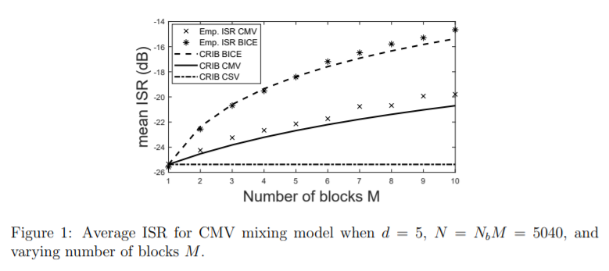
Numerical Simulations
Comparison of Piecewise models to block ICE under CMV mixing model

Slide 22
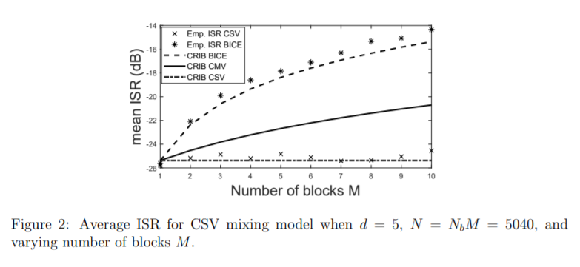
Numerical Simulations
Comparison of Piecewise models to block ICE under CSV mixing model

Slide 23
Real Speech Separation
Comparison of Piecewise models to block ICE under CSV mixing model
Moving female speech = source of interest (SOI)
Static background = male speech
Input SIR (female speech is stronger) = 10 dB
1m
original mixture | Standard IVE (M=1) | Piecewise IVE, CSV (M=7) | Piecewise IVE, CMV (M=7)

Slide 24
Did you like it?
No!
Yes!
Why not?
Wanna join us?
Lame topic
Boring presentation, I can do better
Yes!
No
ok
Thank you for attention!
Too far from practice
Poor science
Thank you for your time…

