Slide 1
Multiscale Statistical Identification of Skin Nonlinear Characteristics in the Time Domain
Parnian Hemmati, Serge Dos Santos,
Jean-Christophe Pittet
Presenter Parnian Hemmati
INSA Centre Val de Loire, Blois, France
Sharif University of Technology, Tehran, Iran
1

Slide 2
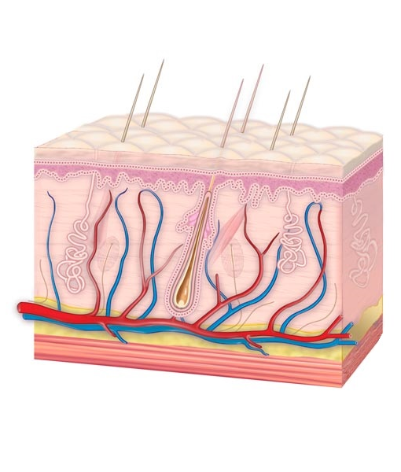
The study of skin
Skin: anisotropic, nonlinear and viscoelastic [1]
Memory effects and aging process[2]
Not many in vivo studies, porcine skin as a model for human skin[3]
2

Slide 3
Previous Studies
 | Authors | Year | Purpose | Outcome
1 | Shull et al. [4] | 2010 | Nonlinearities of skin and its influence on user perception of rotational skin stretch | Human skin characteristics in case of rotational force and how the movements are distinguishable by the subject
2 | Remache et al. [5] | 2018 | Defining mechanical properties of porcine skin | The hysteresis loop and the characteristics of the skin under cyclic stretching and stress loading
3 | Bose et al.[6] | 2022 | Mechanics of collagen at different scales as one of the main components of skin | The mechanical properties of collagenous tissues and its variation range
3

Slide 4
Purposes
Study and extract the mechanical properties of skin
Validate the results using Finite Element Method and simulation software
Study the skin properties variation on a group of subjects after performing physical activities
4

Slide 5
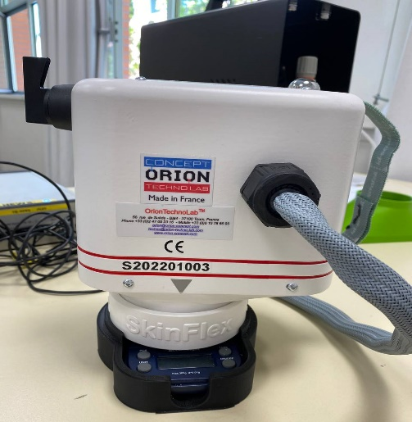
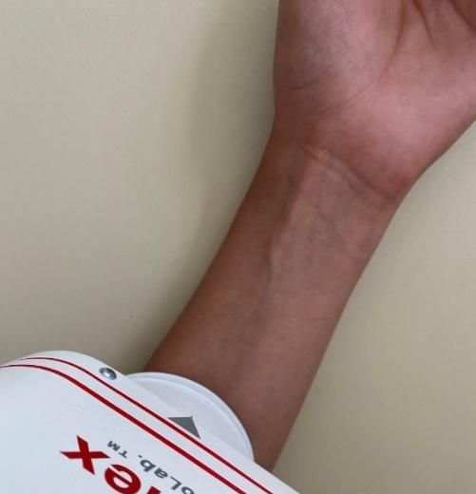
Test Setup and Subject
Compressor, air blower, camera, laser for tracking the skin surface
23 year old, Female, Caucasian, left forearm
Five different pressure groups, each three times
5

Slide 6
Processing the device output
Frame extraction
from video
Rgb2gray
grayscale
Imbinarize
Binary Image
bwboundaries
Matric of
Boundary elements
6

Slide 7
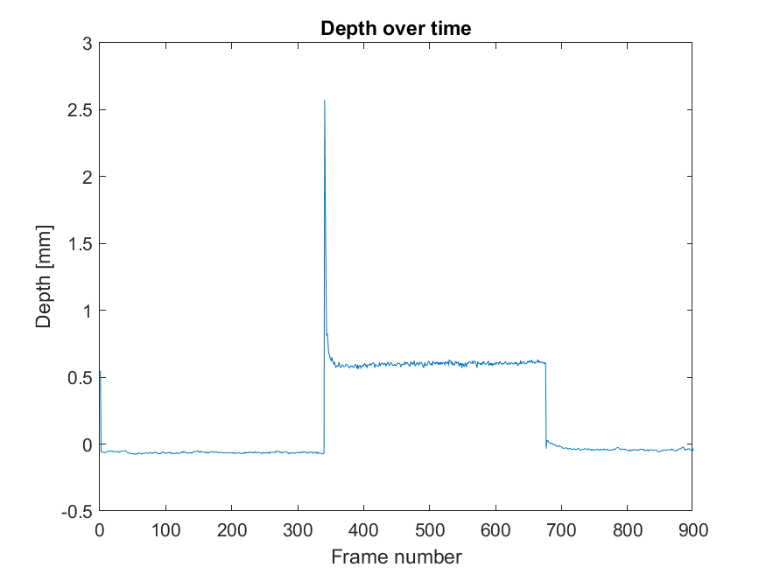
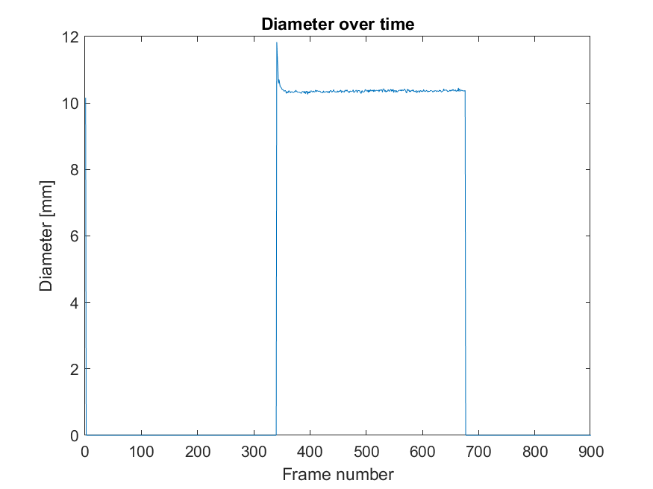
Processing the device output
Two dimensional, compressive and tangential force
7

Slide 8
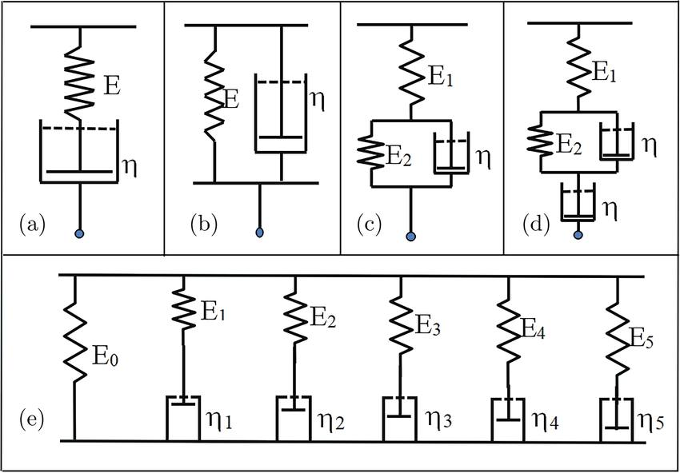
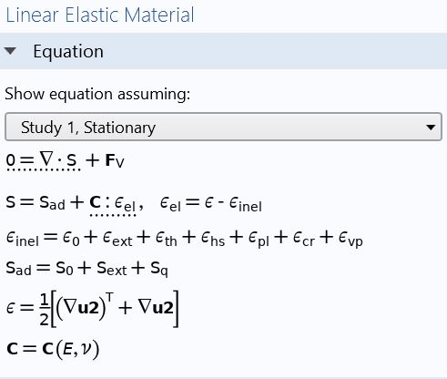
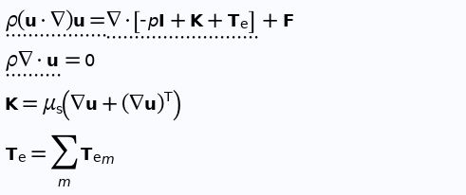
Nonlinear behavior of the skin
Viscoelastic Signature
(a) The Maxwell model. (b) The Kelvin model. (c) The Voigt model. (d) The Burger model. (e) The generalized Maxwell model
Viscoelastic Fluid
8

Slide 9
Nonlinear behavior of the skin
Viscoelastic Signature
Rough estimation of elastic modulus
Loading
Slope
Deflection Equation
Max Deflection
$$EI\frac{d^{2}y}{{dx}^{2}}=M$$
8

Slide 10
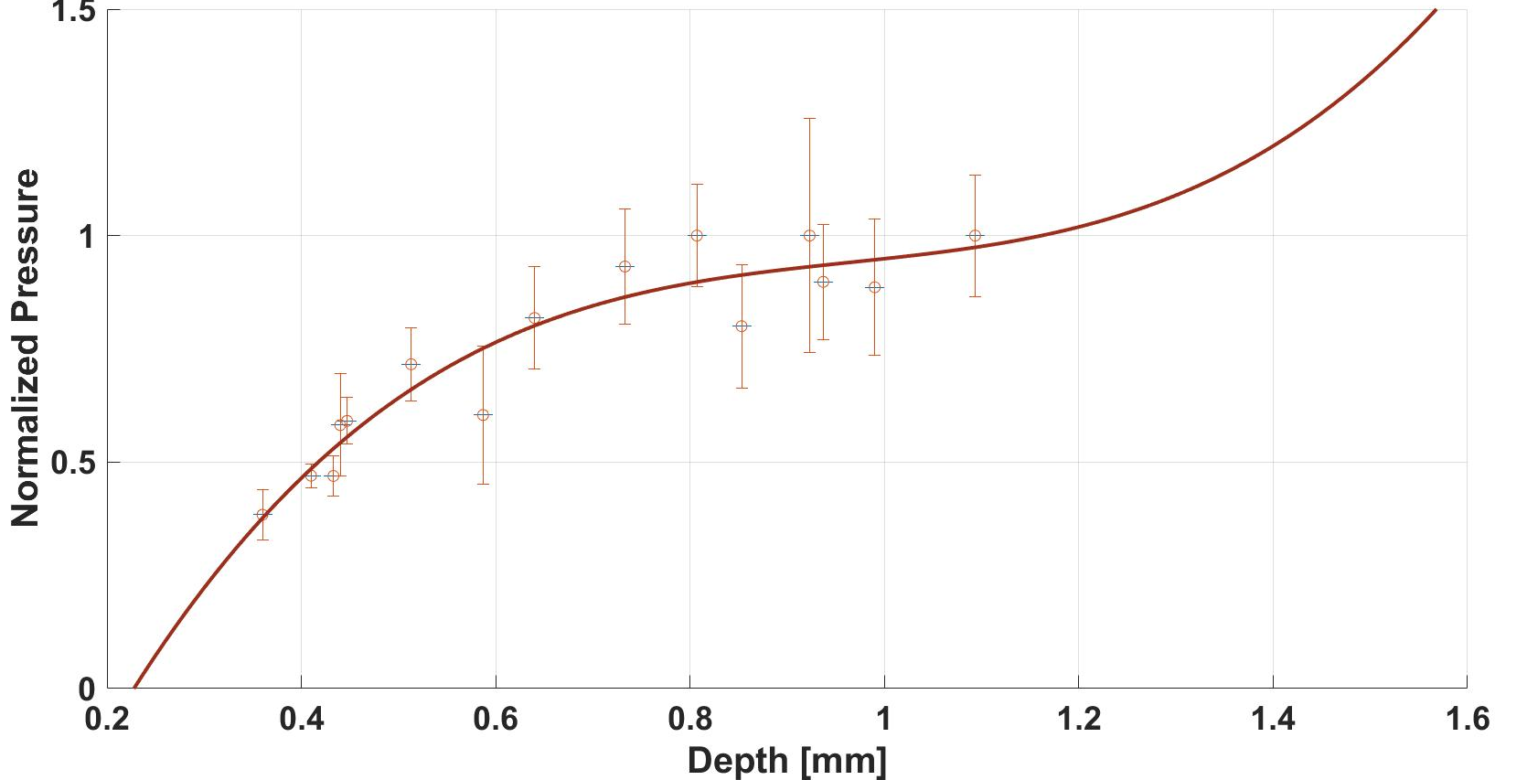
Nonlinear behavior of the skin
Viscoelastic Signature
$$f_{(x)}=p_{1}x^{3}+p_{2}x^{2}+p_{3}x+p_{4}$$
$$p_{1}$$ | $$p_{2}$$ | $$p_{3}$$ | $$p_{4}$$ | $$R^{2}$$
1.93 | -5.59 | 5.621 | -1.013 | 0.91
8

Slide 11
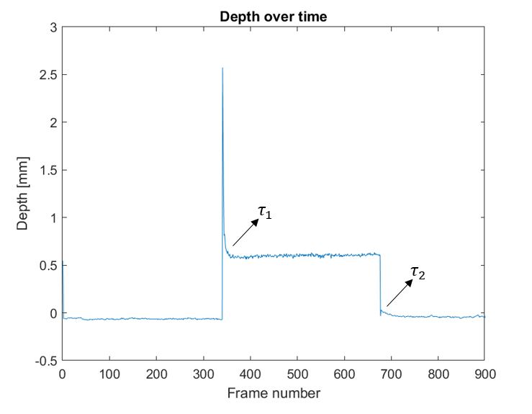
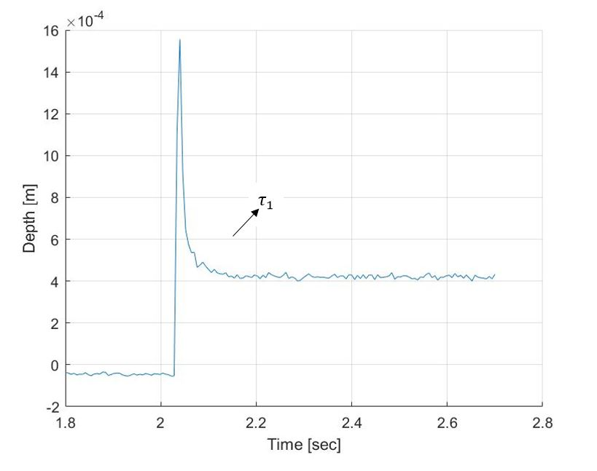
Nonlinear behavior of the skin
Relaxation Rate
$$y=ae^{\frac{−(t−t_{0})}{τ}}$$
 | 1 | 2
$$a$$ | 15$.56×{10}^{−4}$ | $$3.53×{10}^{−4}$$
$$t_{0}$$ | $$2.04$$ | $$4.04$$
$$τ$$ | $$0.014±0.002$$ | $0.006±0.002$
9

Slide 12
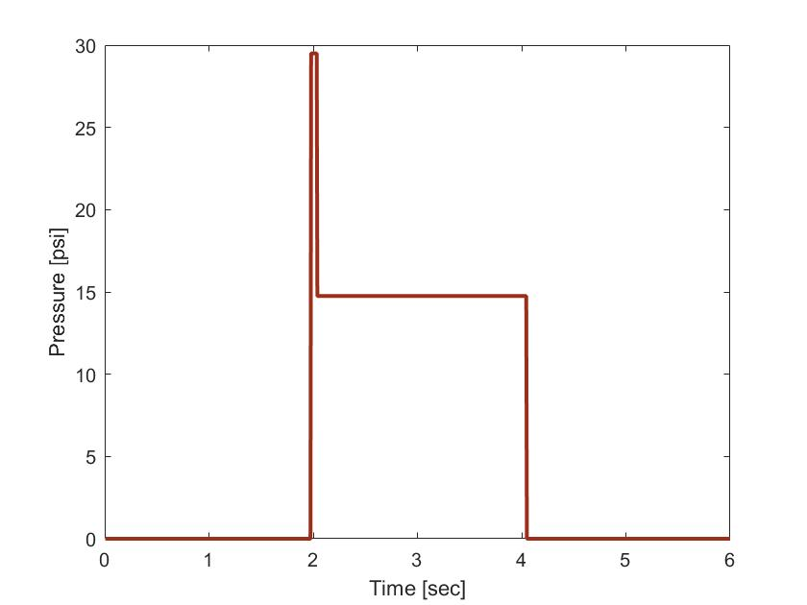
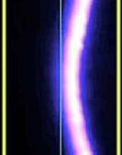
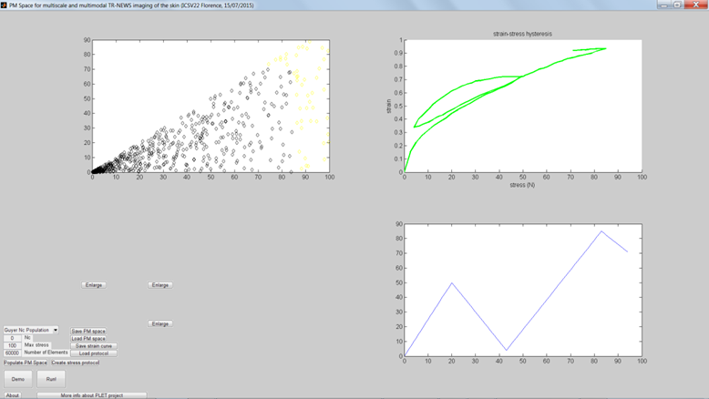
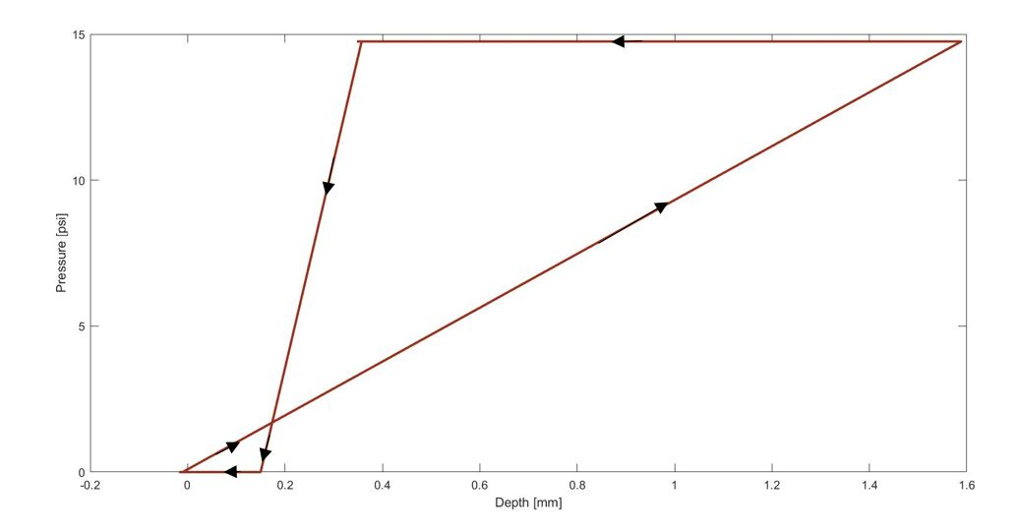
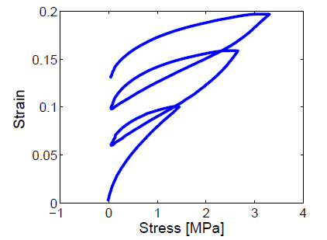
Nonlinear behavior of the skin
Hysteresis
Under cyclic loading-unloading
[7]
10

Slide 13
Nonlinear behavior of the skin
PM Space [8]
Hysteron as elastic particle
[8]
11

Slide 14
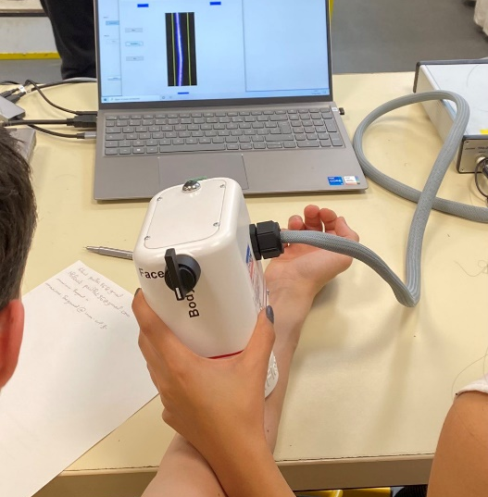
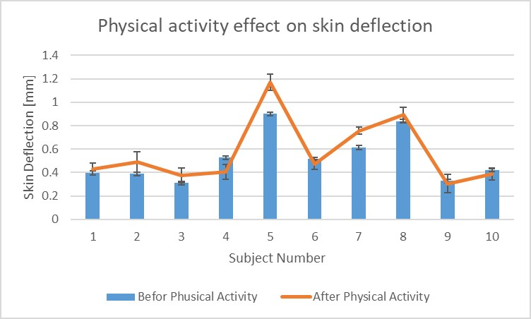
A Case Study
10 subjects before and after physical activity
Change in the humidity percentage while an enhancement in blood circulation
An Overall increase trend, the exceptional subjects did more sports and hence more adapted
12

Slide 15
Conclusion and Future Perspective
The extraction of skin’s mechanical properties including nonlinearity and relaxing time
An in vivo case study showing the physical activity causes an overall increasing trend for deflection
Validate the model using FEM simulation software
Experimental studies on a more expanded sample of subjects concerning the hysteresis behavior and developing the final statistical model
13

Slide 16
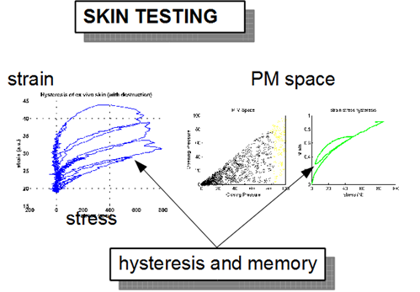
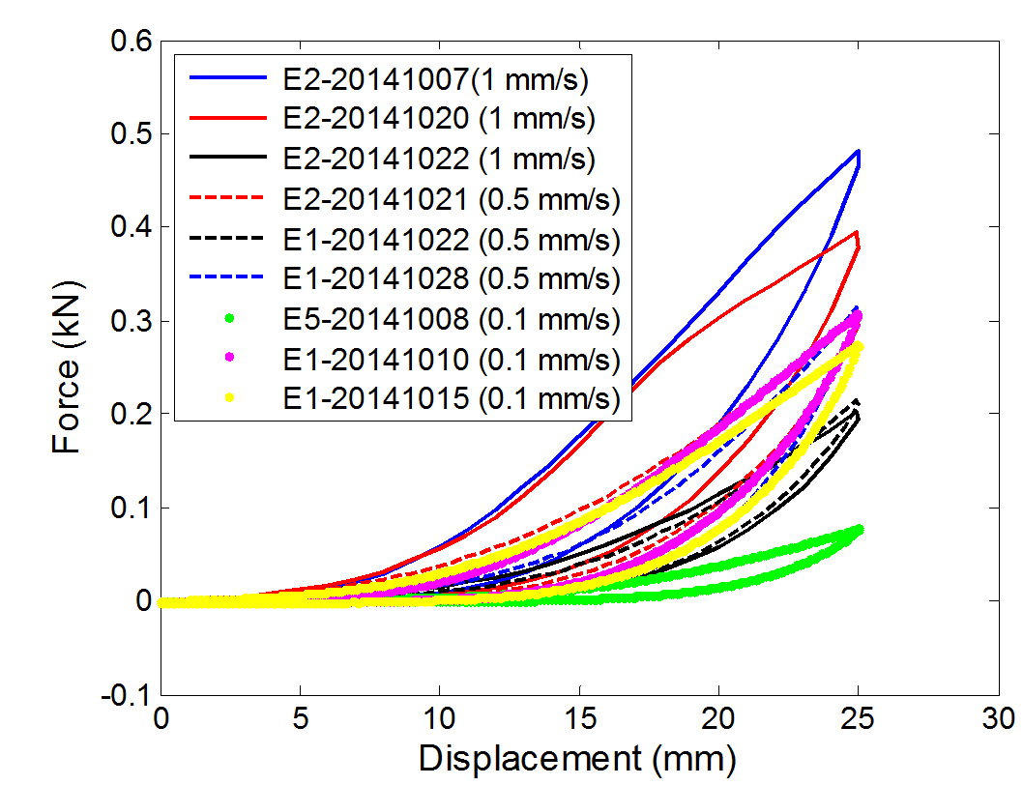
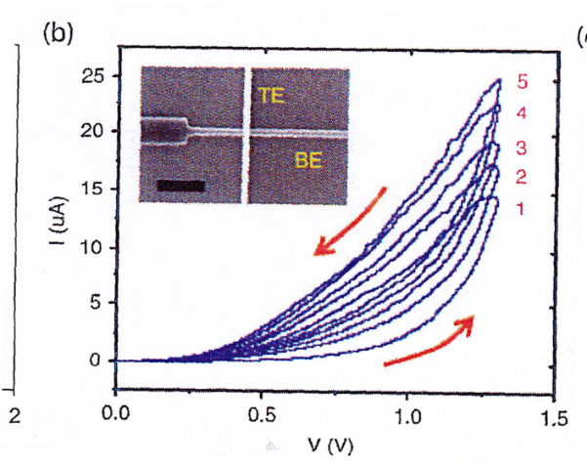
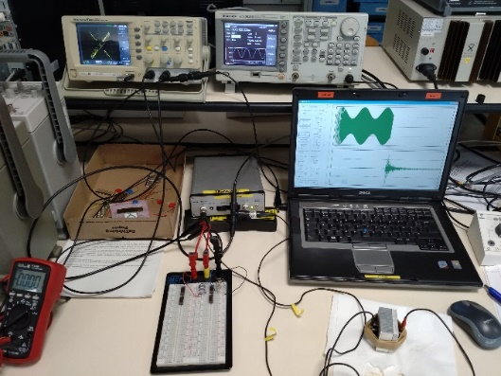
Future Perspective
Aging, memory, nonlinearity and hysteresis networks
Plasticity and memory properties
Memristor networks :
T. Chang, Y. Yang, W. Lu, IEEE Circuits and Systems Magazine 13, 56 (2013)
14

Slide 17
References
[1] H. Wei et al., “Visual indentation apparatus and finite element modelling as a method to characterize 3D mechanical properties of facial skin in vivo,” Mech. Mater., vol. 157, 2021, doi: 10.1016/j.mechmat.2021.103852.
[2] O. Pabst et al., “Storing information electrically in human skin,” J. Electr. Bioimpedance, vol. 12, no. 1, 2021, doi: 10.2478/joeb-2021-0010.
[3] S. Schick, M. Leiderer, F. Lanzl, M. Graw, and S. Peldschus, “Maximum tensile stress and strain of skin of the domestic pig—differences concerning pigs from organic and non-organic farming,” Int. J. Legal Med., vol. 134, no. 4, 2020, doi: 10.1007/s00414-019-02207-w.
[4] P. Shull, K. Bark, and M. Cutkosky, “Skin nonlinearities and their effect on user perception for rotational skin stretch,” 2010
[5] D. Remache, M. Caliez, M. Gratton, and S. Dos Santos, “The effects of cyclic tensile and stress-relaxation tests on porcine skin,” J. Mech. Behav. Biomed. Mater., vol. 77, 2018, doi: 10.1016/j.jmbbm.2017.09.009.
[6] Bose, Shirsha, Simin Li, Elisa Mele, and Vadim V. Silberschmidt. 2022. "Exploring the Mechanical Properties and Performance of Type-I Collagen at Various Length Scales: A Progress Report" Materials 15, no. 8: 2753.
15

Slide 18
References
[7] S. Dos Santos et al, Viscoelastic and hysteretic properties of the skin : Acousto-mechanical evaluation using nonlinear time reversal imaging, IFSCC, Oct. 2014, Paris
[8] S. Dos Santos et al., "Acousto-Mechanical Instrumentation of Multiscale Hysteretic Memristive Properties of the Skin with Nonlinear Time Reversal Imaging," 2017 Cosmetic Measurements And Testing (COSMETIC), 2017, pp. 1-4 (2017)
16

