Slide 1
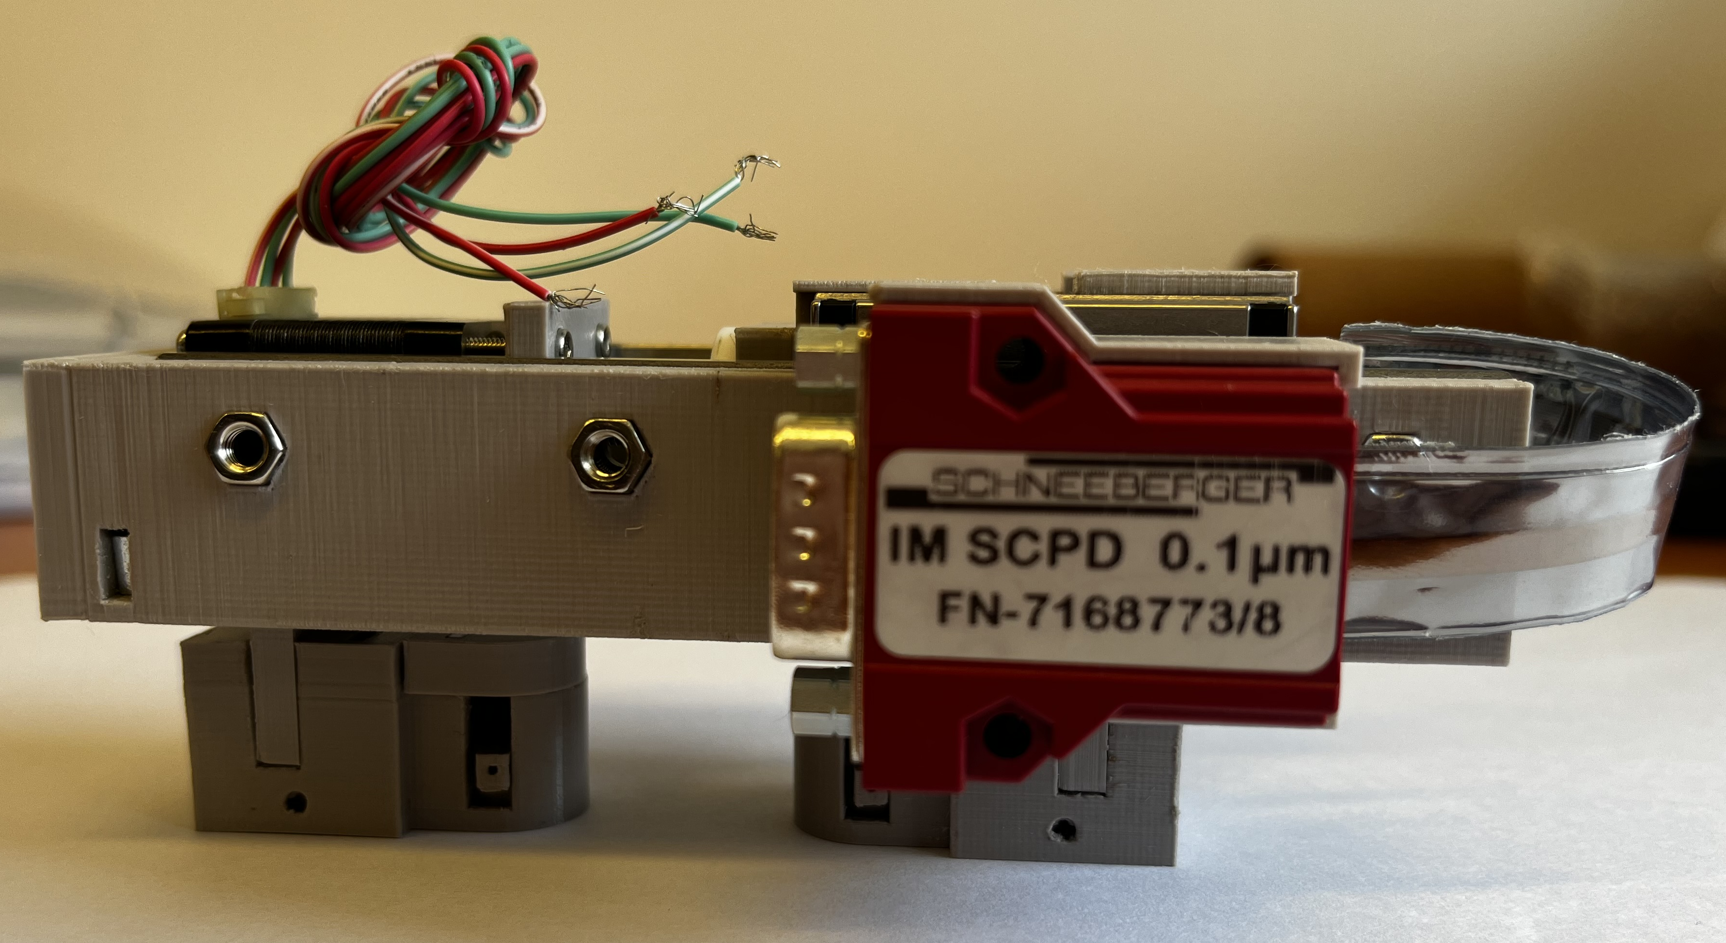
Novel design of a device for measurement of human skin viscoelastic properties
Perrine BEGON & Flavie DELOUYE
INSA Centre Val de Loire, Blois, France – Institute of Thermomechanics, Prague, Czech Republic
SPMS conference, Rumburk, Czech Republic, 23 - 27 June 2022

Slide 2
OUTLINE
Introduction
Design specifications
Previous design
Novel design
Mechanical design
Motor piece
Movement transmission piece
Strain gauges piece
Ultrasonic transducer pieces
Future steps
Electrical part
Novel device assembly and verifications
SPMS conference, Rumburk, Czech Republic, 23 - 27 June 2022

Slide 3
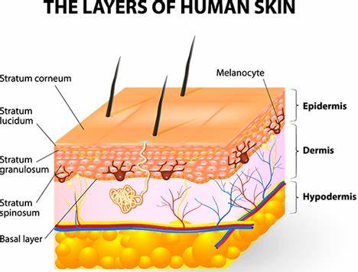
Introduction
Anisotropic and non-linearly viscoelastic properties
Cosmetic industry and aesthetic medicine
SPMS conference, Rumburk, Czech Republic, 23 - 27 June 2022

Slide 4
PrevIOUS DESIGN
Mechanical loading and ultrasonic testing device in 2013
SPMS conference, Rumburk, Czech Republic, 23 - 27 June 2022

Slide 5
Novel design
3D-printing
Modelisation with Fusion software
Dimensions not lower than 1 mm
PRUSA I3 MK3, 3D printer
Novel device in June 2022
SPMS conference, Rumburk, Czech Republic, 23 - 27 June 2022

Slide 6
Novel design
Interface module
Step motor
Static transducer mounting piece
Mobile transducer mounting piece
Strain gauges
SPMS conference, Rumburk, Czech Republic, 23 - 27 June 2022

Slide 7
Motor piece
General view
SPMS conference, Rumburk, Czech Republic, 23 - 27 June 2022

Slide 8
Motor piece
Rails
Step-motor
Printed piece
Printed piece with cork and silicon layers
Assembly with the step-motor and the rails
SPMS conference, Rumburk, Czech Republic, 23 - 27 June 2022

Slide 9
Motor piece
Back view of the motor piece
5-7 cm between the center of the two ultrasonic transducers
SPMS conference, Rumburk, Czech Republic, 23 - 27 June 2022

Slide 10
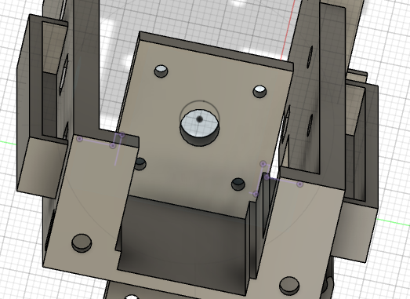
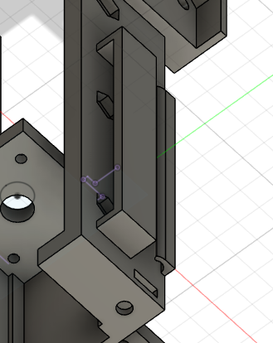
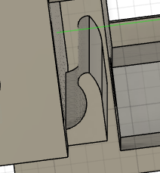
Motor piece
Back view
Elastic strip hook
Coaxial cable hook
SPMS conference, Rumburk, Czech Republic, 23 - 27 June 2022

Slide 11
Motor piece
Printed piece
Interface module for position measurement
SPMS conference, Rumburk, Czech Republic, 23 - 27 June 2022

Slide 12
Movement transmission part
Step-motor
General view
SPMS conference, Rumburk, Czech Republic, 23 - 27 June 2022

Slide 13
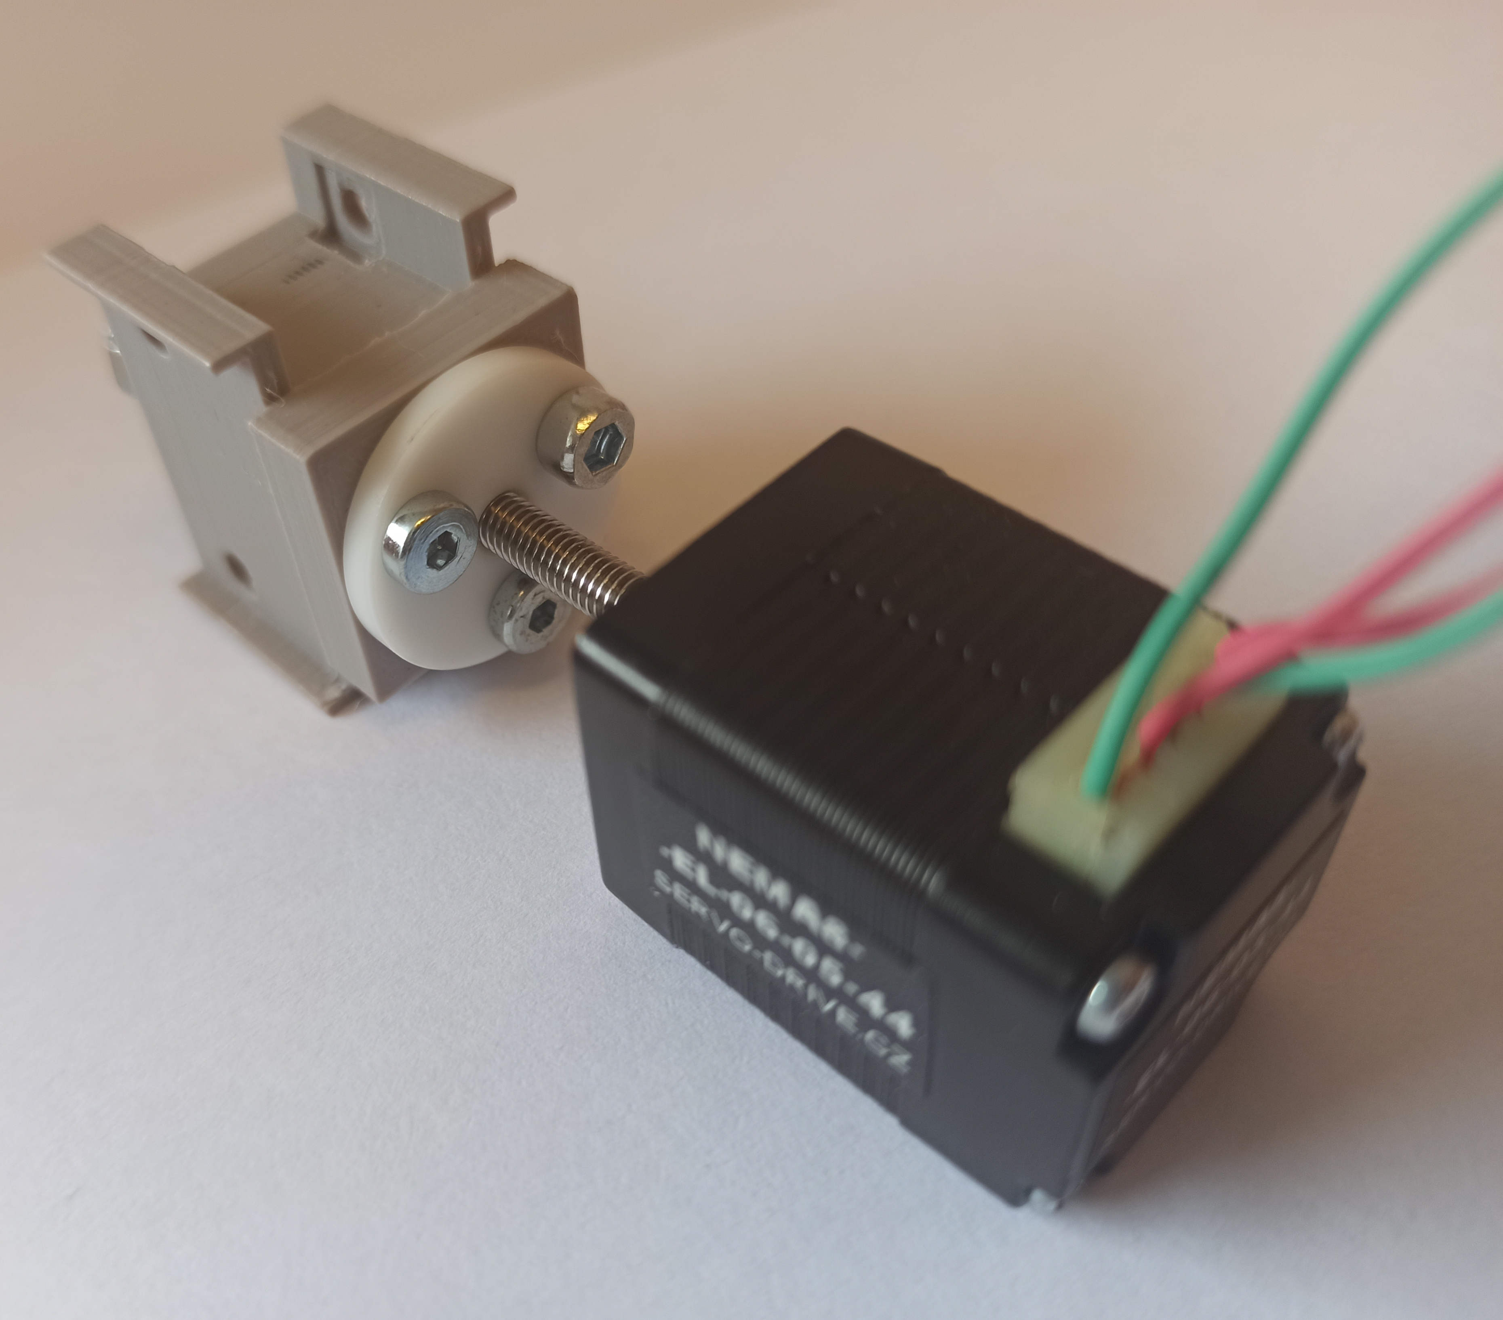
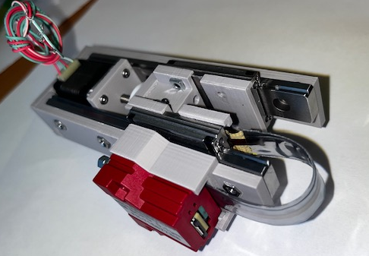
Movement transmission part
White plastic nut
Printed part
Motor screw
Step motor
Wagons
Movement transmission part assembly with the motor
Assembly of the new device
SPMS conference, Rumburk, Czech Republic, 23 - 27 June 2022

Slide 14
Movement transmission part
Printed part with 3 equidistant holes
Bottom views
SPMS conference, Rumburk, Czech Republic, 23 - 27 June 2022

Slide 15
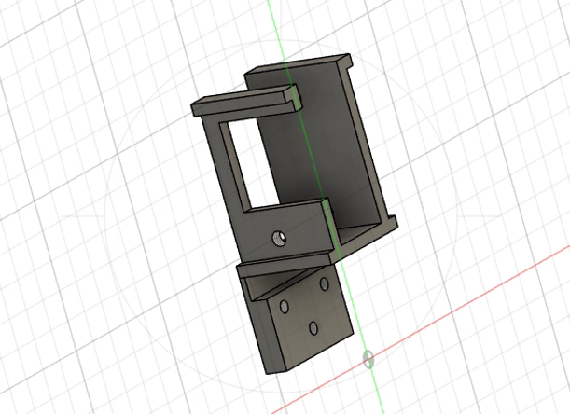
Strain gauges piece
General view
SPMS conference, Rumburk, Czech Republic, 23 - 27 June 2022

Slide 16
Strain gauges piece
Strain gauges piece
1 mm thickness rectangle to put the strain gauges on
Printed strain gauges piece
SPMS conference, Rumburk, Czech Republic, 23 - 27 June 2022

Slide 17
Strain gauges piece
Strain gauges piece
Hole connecting the sensors
Printed strain gauges piece
SPMS conference, Rumburk, Czech Republic, 23 - 27 June 2022

Slide 18
Ultrasonic transducer pieces
Transducer mounting piece
Empty part for the motor part or the strain gauges part
Hollow cylinder
Hole for negative pressure
Bottom view
Loading part
SPMS conference, Rumburk, Czech Republic, 23 - 27 June 2022

Slide 19
Ultrasonic transducer pieces
Ultrasonic transducer cup
Ultrasonic transducer cup
Shielding
Ultrasonic transducer in the cup
Hole for the coaxial cable
SPMS conference, Rumburk, Czech Republic, 23 - 27 June 2022

Slide 20
Ultrasonic transducer pieces
Ultrasonic transducer cup
Cap
Spring
Printed ultrasonic transducer cup with the spring
Printed loading part
SPMS conference, Rumburk, Czech Republic, 23 - 27 June 2022

Slide 21
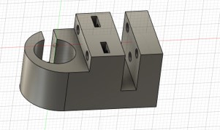
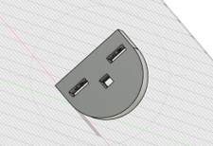
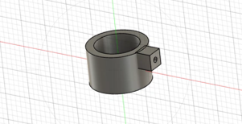
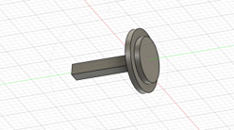
Ultrasonic transducer pieces
Transducer mounting piece and its cap
Assembly
Ultrasonic transducer cup and its cap
SPMS conference, Rumburk, Czech Republic, 23 - 27 June 2022

Slide 22
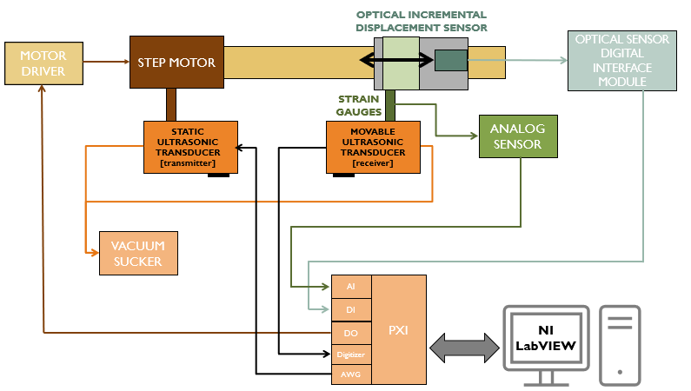
Novel design block diagramm
SPMS conference, Rumburk, Czech Republic, 23 - 27 June 2022

Slide 23
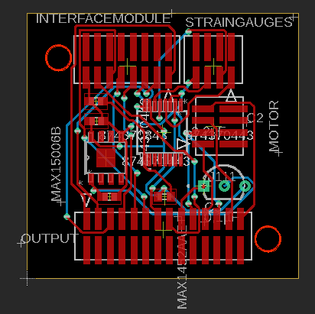
Design of 2 printed circuit boards with eagle software
Schematic of the internal PCB
Internal PCB
SPMS conference, Rumburk, Czech Republic, 23 - 27 June 2022

Slide 24
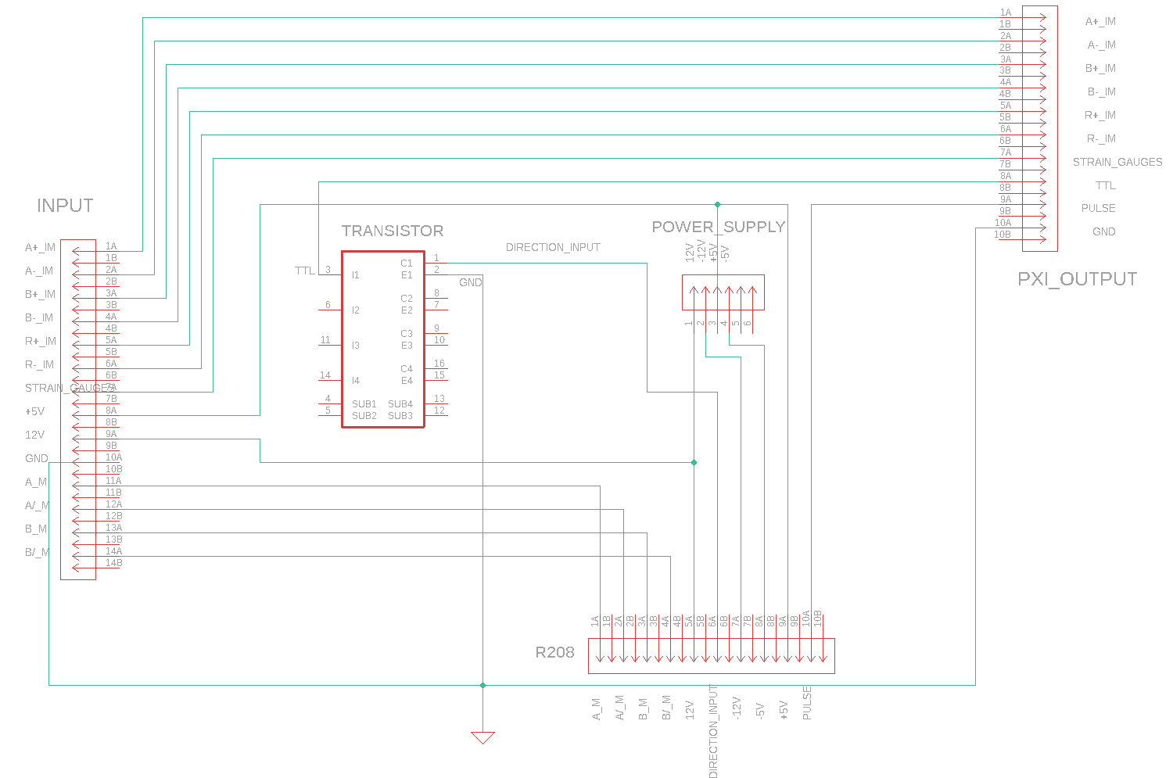
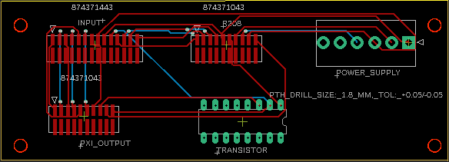
Design of 2 printed circuit boards with eagle software
Schematic of the external PCB
External PCB
SPMS conference, Rumburk, Czech Republic, 23 - 27 June 2022

Slide 25
NOVEL DESIGN ASSEMBLY AND VERIFICATIONS
Assembly of the new device
SPMS conference, Rumburk, Czech Republic, 23 - 27 June 2022

Slide 26
CONCLUSION
Interest in scientific area
3D-printing → many advantages
SPMS conference, Rumburk, Czech Republic, 23 - 27 June 2022

Slide 27
SUPERVISORS
Ing. Daniel Tokar, prototype design concept lead and internship project supervisor
Dr. Zdeněk Převorovský, internship project supervisor
Acknowledgement
Dr. Josef Krofta, technical support
Dr. Milan Chlada, technical support
SPMS conference, Rumburk, Czech Republic, 23 - 27 June 2022

Slide 28
Thank you for your attention!

