Slide 1
Crash! Boom! Bang!
Mgr. Michaela Krbálková
Faculty of Science, University of Hradec Králové
Faculty of Transport Engineering, University of Pardubice

Slide 2
Investigated problem
vehicular dynamics in the vicinity of an unsignalized intersection of the T-type

Slide 3
main stream
  vehicles not affected by events on the minor road
  moving independent of vehicles in opposite direction
  dynamic properties description well-developed (physics of vehicular traffic)
minor stream
  commanded direction of turn
  implicit real-time decision-making procedure based on critical gap
  acceptance or rejection of a given time gap

Slide 4
=> Gap Acceptance theory (GA)
standardly-applied engineering method
capacity models for optimal designing of urban intersections and roundabouts

Slide 5
Our goal
reformulation into a purely mathematical form operating strictly in the language of random variables
in-depth revision of commonly accepted starting points
= essentials for capacity problem!

Slide 6
Fundamental terms
time headway = time interval between two events:
  1) front bumper of the preceding vehicle intersects a detector line
  2) front bumper of the reference vehicle intersects a detector line
time clearance = time interval between two events:
  1) back bumper of the preceding vehicle intersects a detector line
  2) front bumper of the reference vehicle intersects a detector line
  traffic intensity = the number of vehicles passing a fixed point located on the main street within a time interval
main/minor traffic stream: right-of-way / no right-of-way

Slide 7
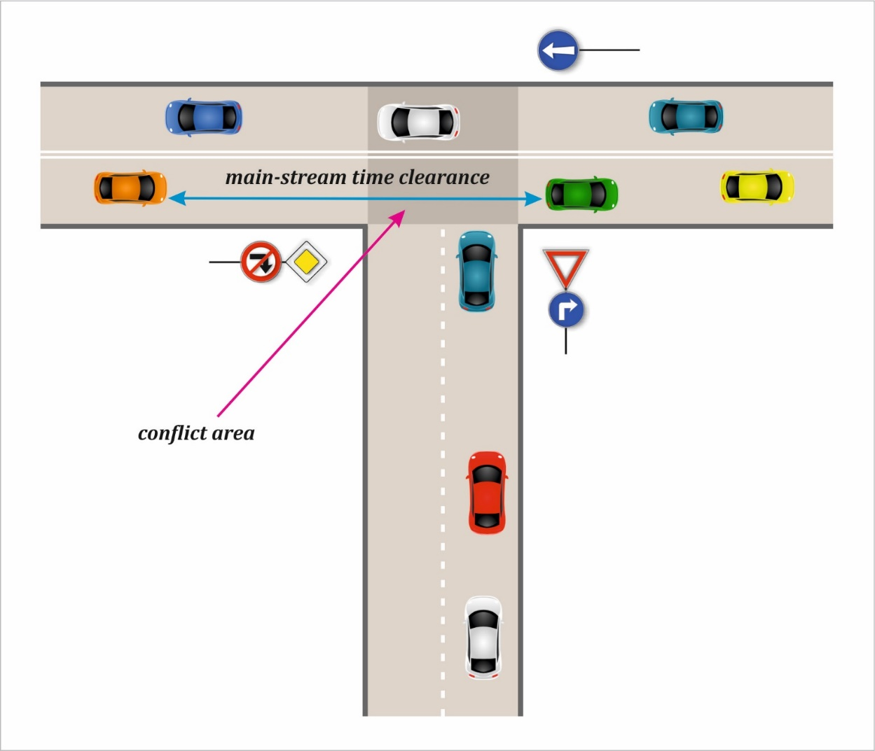

The standardly-applied engineering methods
inputs
  main-stream time-clearance distribution: $g(x)$
  main-stream traffic intensity: $I$
  number of minor-stream vehicles accepting
  the main-stream clearance of size $x$: $\left(x;n(x)\right)$
  assumptions
  saturated traffic flow for the minor-stream
  $g(x)$ exponentially distributed
  critical gap = single value

Slide 8

based predominantly on study by Werner Siegloch (1973)
Siegloch‘s function – expectation of $N_{x}$
$s\left(x\right)=\sum_{k=0}^{∞}{k}P\left[N_{x}=k\right]$
capacity of the unsignalized intersection
$$C=I\int_{0}^{∞}{g\left(x\right)s\left(x\right) dx}$$

Slide 9
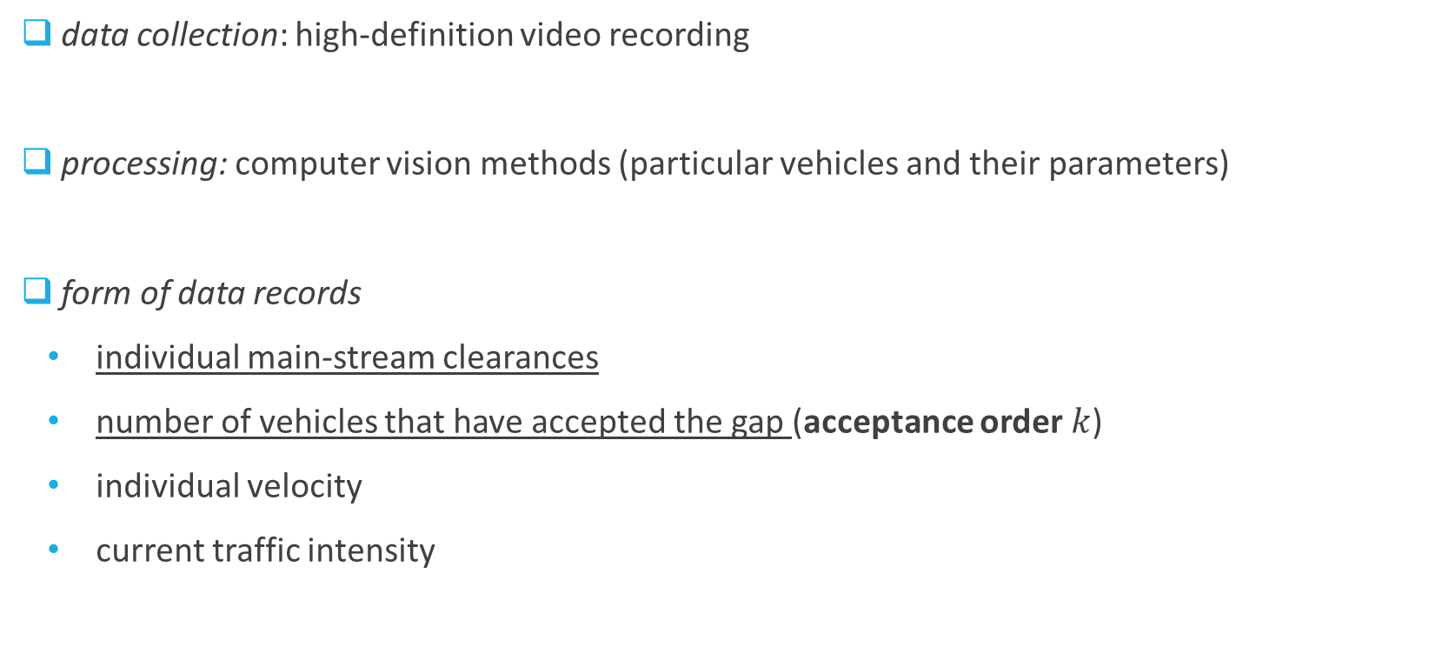
data collection: high-definition video recording
processing: computer vision methods (particular vehicles and their parameters)
  form of data records
    individual main-stream clearances
    number of vehicles that have accepted the gap (acceptance order $k$)
    individual velocity
    current traffic intensity

Slide 10
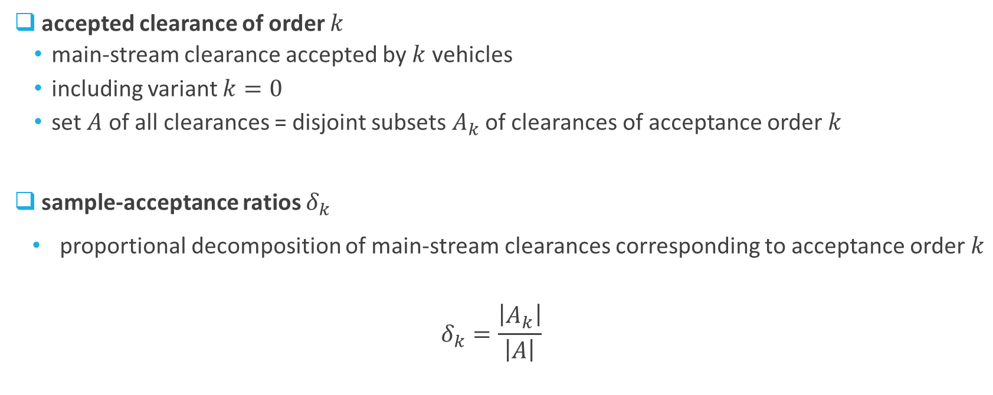
accepted clearance of order $k$
  main-stream clearance accepted by $k$ vehicles
  including variant $k=0$
  set $A$ of all clearances = disjoint subsets $A_{k}$ of clearances of acceptance order $k$
  sample-acceptance ratios $δ_{k}$
    proportional decomposition of main-stream clearances corresponding to acceptance order $k$
  $$δ_{k}=\frac{\left|A_{k}\right|}{\left|A\right|}$$

Slide 11
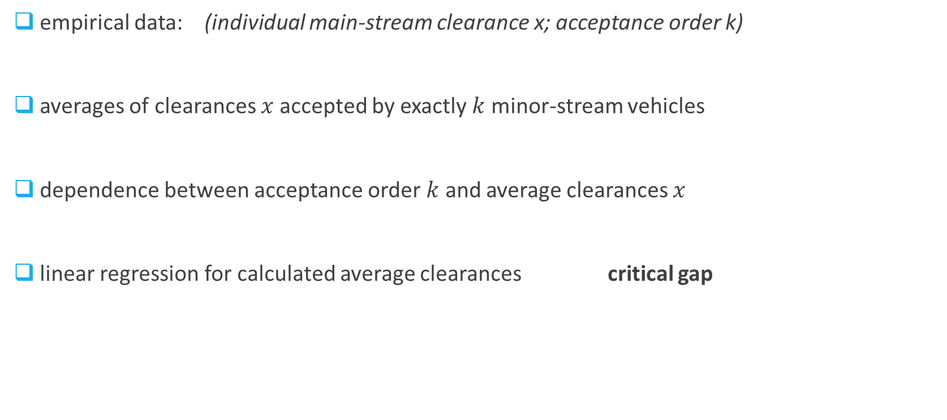
Standardly-used approach for the approximation of the Siegloch‘s function
empirical data: (individual main-stream clearance x; acceptance order k)
averages of clearances $x$ accepted by exactly $k$ minor-stream vehicles
dependence between acceptance order $k$ and average clearances $x$
linear regression for calculated average clearances critical gap

Slide 12
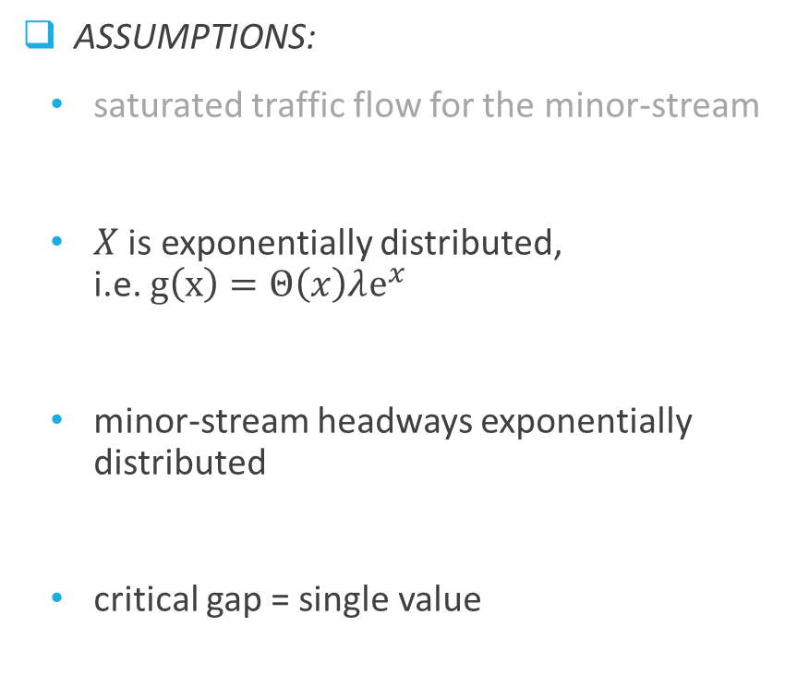
Discrepancies
  assumptions:
    saturated traffic flow for the minor-stream
    $X$ is exponentially distributed, i.e. $g\left(x\right)=Θ\left(x\right)λ{\text{e}}^{x}$
    minor-stream headways exponentially distributed
    critical gap = single value
  reality:
    saturated traffic flow for the minor-stream
    NO! GIG distribution
    NO! saturated traffic flow ≠ exponential distribution
    NO! it differs from driver to driver, from time to time, etc.

Slide 13
Reformulation to random variables
vast majority of contemporal approaches are „average-based“
the same numerical characteristic (i.e. critical gap)
  various distributions
  different Siegloch‘s function
  (dramatically) different capacity
  new assumption: critical gap varies in each individual implementation
… CRASH!

Slide 14

  main-stream time clearance
  random variable $X$
  stochastic nature
  critical gap
    random variable $Y$!
  minimum time clearance between two succeeding
  vehicles in the priority stream that a minor-street
  driver is willing to accept for entering the
  main-stream

Slide 15

New probabilistic model
  statistical distributions of main-stream time-clearances $g(x)$and critical gaps $h(y)$
  $g(x), h(y)$≠ exponential probability density
  probability densities $g(x), h(y)$= comprehensive knowledge about intersection capacity
  … BOOM!

Slide 16

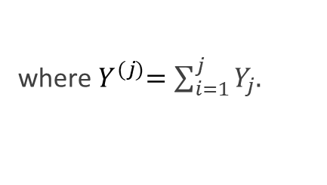

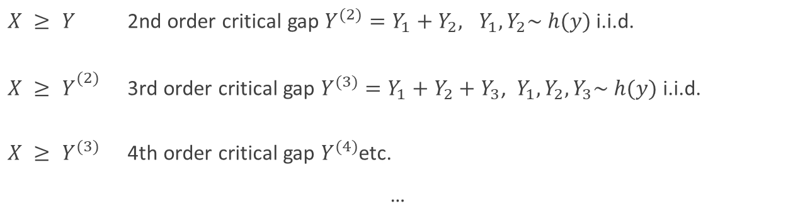
Gap Acceptance procedure
simple decision routine
critical gap $Y \sim h(y)$compared to an offered main-stream clearance $X \sim g(x)$:
repeat with new clearance X
    $$X < Y → k = 0$$
    $$X < Y^{(2)} → k = 1$$
    $$X < Y^{(3)} → k =2$$
    …
    $$X < Y^{(j)} → k =j−1$$
    $X ≥ Y$ 2nd order critical gap $Y^{(2)}=Y_{1}+Y_{2}, Y_{1},Y_{2}\sim h(y)$i.i.d.
    $X ≥ Y_{}^{(2)}$ 3rd order critical gap $Y^{(3)}=Y_{1}+Y_{2}+Y_{3}$, $Y_{1},Y_{2},Y_{3}\sim h(y)$i.i.d.
$X ≥ Y^{(3)}$ 4th order critical gap $Y^{(4)}$etc.
…
where${ Y}^{(j)}=\sum_{i=1}^{j}{Y_{j}.}$

Slide 17




Distributions of gaps accepted by $k$ vehicles
main-stream time clearances: random variable $X \sim g(x)$with realization $x$
individual critical gap of the driver $k$th minor-stream vehicle: random variable $Y_{k} \sim h(y)$ with realization $y_{k}$
modeled proces of inclusion:
  generate $x,$ $y_{1},y_{2},$… and apply decision rule
    $y_{1} < x$
    $y_{2}< x−y_{1}$
    etc. until the remaining time clearance is not accepted by the actual driver
    1st driver enters the main stream; remaining time $x−y_{1}$
2nd driver accept the same gap; remaining time $x−y_{1}−y_{2}$

Slide 18
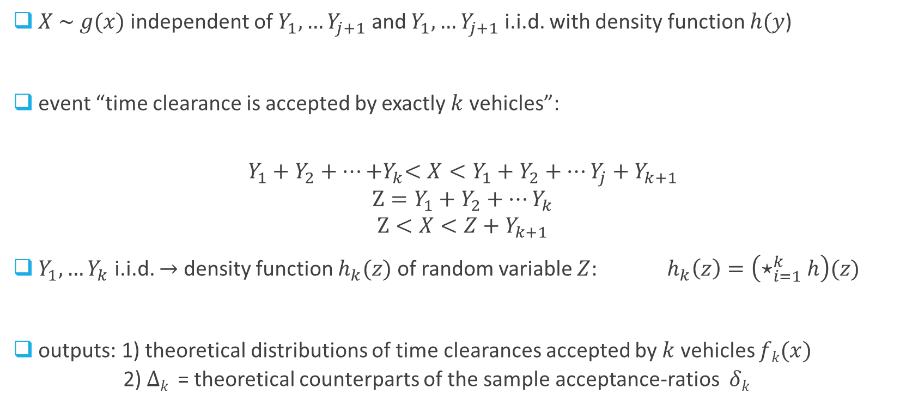
$X \sim g(x)$independent of $Y_{1},…Y_{j+1}$ and $Y_{1},…Y_{j+1}$ i.i.d. with density function $h(y$)
event “time clearance is accepted by exactly $k$ vehicles”:
$$Y_{1}+Y_{2}+…{+Y}_{k}<X<Y_{1}+Y_{2}+…Y_{j}+Y_{k+1}$$
$$Z=Y_{1}+Y_{2}+…Y_{k}$$
$$Z<X<Z+Y_{k+1}$$
$Y_{1},…Y_{k}$ i.i.d. $→$ density function $h_{k}(z)$of random variable $Z$: $h_{k}\left(z\right)=\left(⋆_{i=1}^{k}h\right)(z)$
outputs: 1) theoretical distributions of time clearances accepted by $k$ vehicles $fk(x)$
  2) $Δk$ = theoretical counterparts of the sample acceptance-ratios $δk$

Slide 19
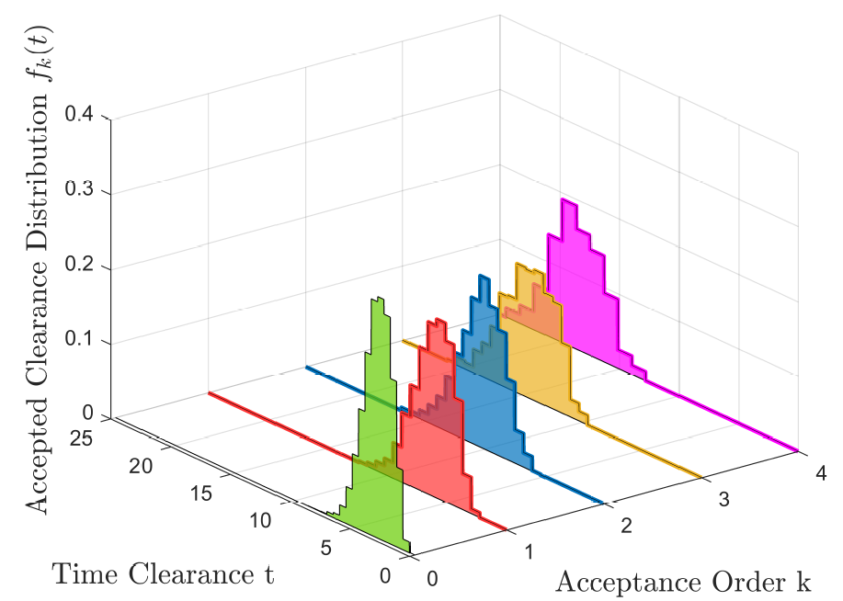

Slide 20
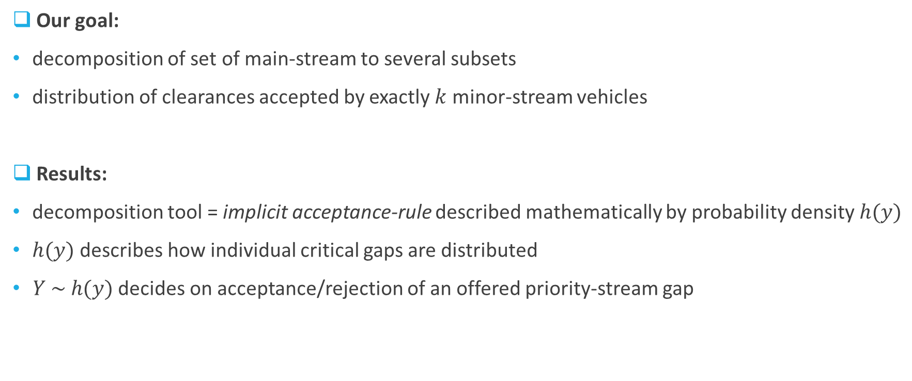
Goals vs. results
Our goal:
decomposition of set of main-stream to several subsets
distribution of clearances accepted by exactly $k$ minor-stream vehicles
Results:
decomposition tool = implicit acceptance-rule described mathematically by probability density $h(y)$
$h(y)$describes how individual critical gaps are distributed
$Y \sim h(y)$decides on acceptance/rejection of an offered priority-stream gap

Slide 21
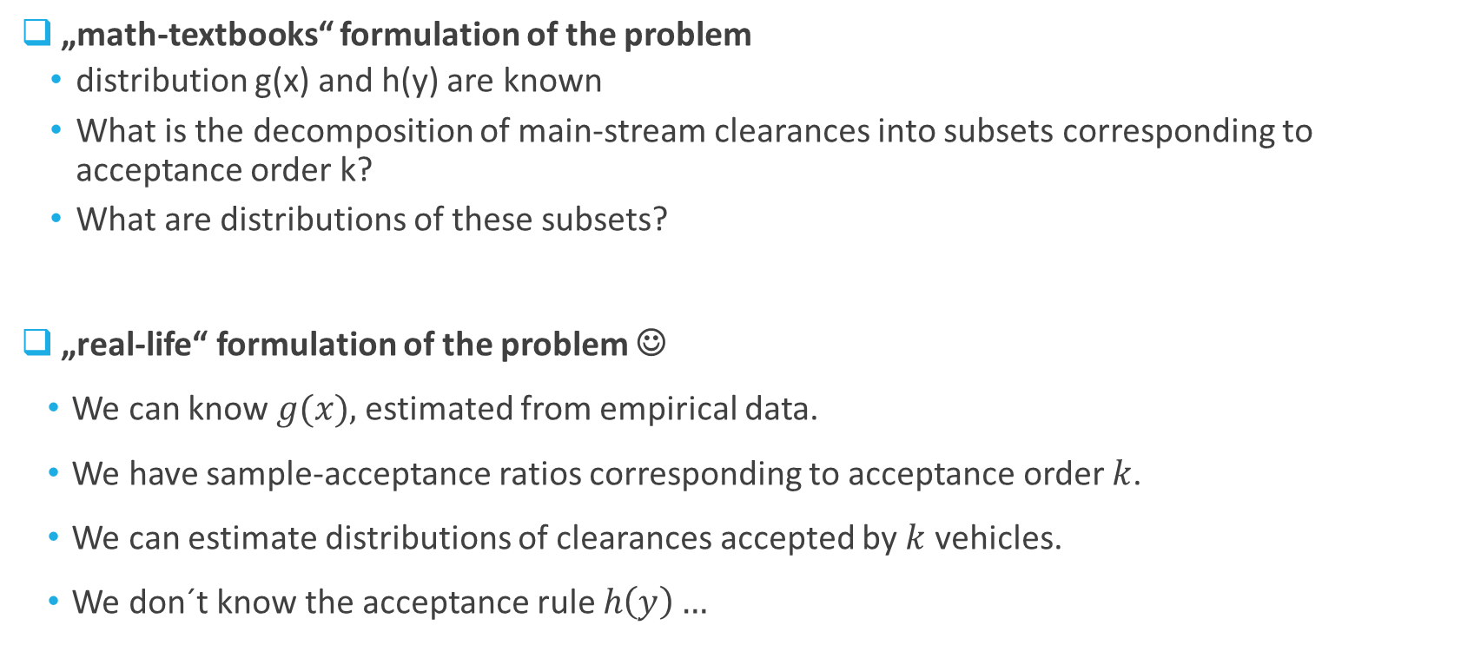
Classic problem vs. real problem
„math-textbooks“ formulation of the problem
  distribution g(x) and h(y) are known
  What is the decomposition of main-stream clearances into subsets corresponding to acceptance order k?
  What are distributions of these subsets?
  „real-life“ formulation of the problem ☺
    We can know $g(x),$estimated from empirical data.
    We have sample-acceptance ratios corresponding to acceptance order $k$.
    We can estimate distributions of clearances accepted by $k$ vehicles.
    We don´t know the acceptance rule $h\left(y\right)…$

Slide 22

Conclusion
    We can find $h(y)$by consistent reformulation of this problem into language of stochastic variables …
    … numerically so far …
    … but we hope also for deriving by theoretical (mathematical) approaches …
    … to go over with a bang!

