Slide 1
Spectral clusterin for directed graphs
Faculty of Nuclear Sciences a Physical Enginnering
Daniel Khol under the supervision of Jan Vybíral Ph. D.
29.6.2023

Slide 2
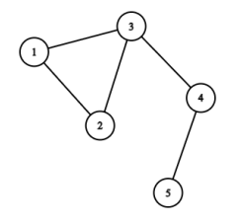
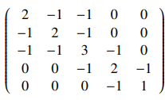
What is Laplacian matrix?
L=D-A
D is Degree matrix
A is Adjacency matrix

Slide 3
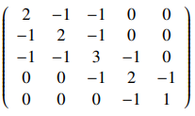
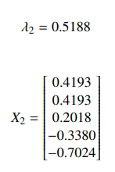
Spectral clustering
Laplacian matrix L.
Second smallest eigenvalue λ₂.
Eigenvector X_{2.}
Sort elements by:
-Positive/negative -Mean -K-mean

Slide 4
Traditional aproach to directed graphs. What are the problems?
Symetrization of a matrix of a directed graph.
Traditional problems of clustering.
Inability to distinguish between directed and undirected edges.

Slide 5
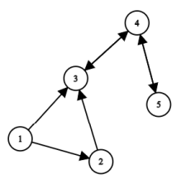
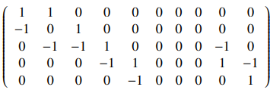
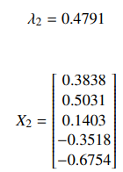
Aproach using LM for directed graphs
We find incidence matrix M of a graph.
We find L as $L=MM^{T}$
We proceed as before.

Slide 6
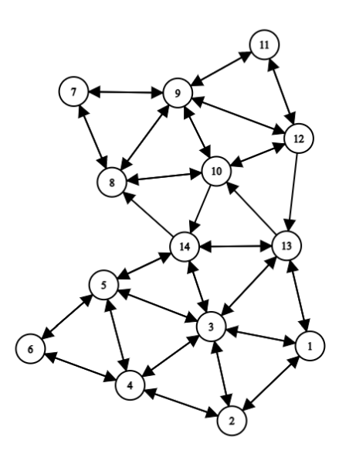
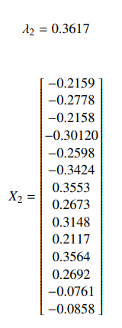
Example of a difference.

Slide 7
What we can prove about LM for directed graphs.
Every fundamental property of traditional LM.
Matrix is singular, symetric, weakly diagonally dominant.
Zero is a eigenvalue and vector of ones is a eigenvector.
Matrix is positive semi-definite.
Graph is continuos if and only if algebraic multiplicity of 0 is one.
Algebraic multiplicity of 0 is equal to a number of continuous components.

Slide 8
Thank you for you attention.

