Slide 1


Institute of General and Inorganic Chemistry
National Academy of Sciences of Belarus
Ca-Mg phosphates as an effective sorbents of ⁶⁰Co and ⁸⁵Sr radionuclides
Dr. Andrei Ivanets

Slide 2



The aim of this work was to study the efficiency of Ca-Mg phosphate sorbents based on dolomite for ⁶⁰Co and ⁸⁵Sr radionuclides removal from aqueous solutions depending on the electrolyte content in the wide range of pH.
OUTLINES
Preparation and characterization of Ca-Mg phosphate sorbents
Study of ⁶⁰Co radionuclide removal
Study of ⁸⁵Sr radionuclide removal
Efficiency of Ca-Mg phosphate sorbents towards ¹³⁷Cs, ⁸⁵Sr and ⁶⁰Co in multicomponent solution
RadChem 2018 – the 18th Radiochemical Conference
13 – 18 May 2018, Marianske Lazne, Czech Republic

Slide 3




THE SCHEME OF OBTAINING SORPTION MATERIALS BASED ON DOLOMITE
SYNTHESIS OF CA, MG-PHOSPHATE SORBENTS
700°C
D-700
800°C
D-800
900°C
D-900
CaCO3 - MgCO3
MgO - CaCO3
MgO - CaO
Na2HPO4
PD-3
PD-1
PD-2
RadChem 2018 – the 18th Radiochemical Conference
13 – 18 May 2018, Marianske Lazne, Czech Republic
Notes:
Полностью скопировать слово в слово из статьи в ворд формате

Slide 4
Fig. XRD patterns of sorbents PD-1 (1), PD-2 (2) and PD-3 (3)
RadChem 2018 – the 18th Radiochemical Conference
13 – 18 May 2018, Marianske Lazne, Czech Republic

Slide 5
Table. Chemical composition of Ca-Mg phosphate sorbents
Sorbent | Content, mmol g⁻¹ |  |  |  |  |  | Ca/Mg | (Ca+Mg)/P
 | Ca | Mg | NH₄ | CO₃ | PO₄ | H₂O
PD-1 | 3.91 | 1.99 | - | - | 4.93 | 17.39 | 1.96 | 1.20
PD-2 | 1.84 | 3.07 | 1.52 | - | 3.78 | 23.70 | 0.60 | 1.50
PD-3 | 5.27 | 5.09 | - | 4.65 | 1.56 | 7.78 | 1.04 | 6.65
Table. Adsorption and textural properties of Ca-Mg phosphate sorbents
Sample | Specific surface area, m²g⁻¹ |  | Pore volume, cm³g⁻¹ |  | Pore size, nm
 | A_{sp} | A_{BET} | V_{sp.ads} | V_{sp.des} | D_{ads} | D_{des}
PD-1 | 19 | 22 | 0.069 | 0.080 | 14 | 16
PD-2 | 49 | 54 | 0.182 | 0.238 | 15 | 19
PD-3 | 15 | 17 | 0.041 | 0.043 | 11 | 12
RadChem 2018 – the 18th Radiochemical Conference
13 – 18 May 2018, Marianske Lazne, Czech Republic

Slide 6
Table. Composition of modeling seawater solution
Component | Concentration, g L⁻¹
Na⁺ | 15.39 | 10.77
K⁺ | 0.57 | 0.40
Mg²⁺ | 1.82 | 1.28
Ca²⁺ | 0.60 | 0.42
Cl⁻ | 27.77 | 19.44
SO₄²⁻ | 3.85 | 2.69
Total salt content | 50.00 | 35.00
Fig. Effect of salt content (Cs) on the distribution coefficient (a) and the degree of sorption of ⁶⁰Co (b) at pH 8.0 ± 0.5
RadChem 2018 – the 18th Radiochemical Conference
13 – 18 May 2018, Marianske Lazne, Czech Republic

Slide 7
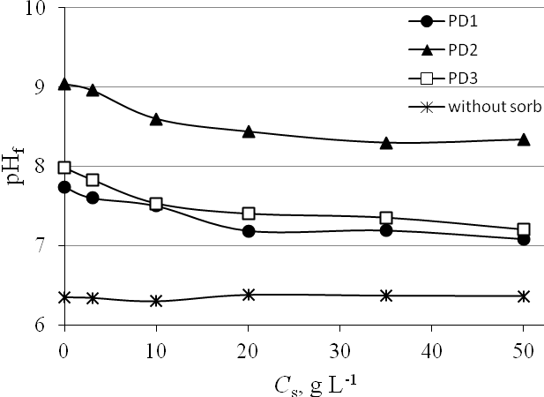
Fig. Effect of salt content (C_{s}) on the equilibrium рН of solutions after contact with sorbents
(with stable Co(II))
Fig. Effect of рН of initial solutions (pH_{s}) on the distribution coefficient (a)
and degree of ⁶⁰Co sorption (b) at the salt content of 35.0 g L⁻¹
RadChem 2018 – the 18th Radiochemical Conference
13 – 18 May 2018, Marianske Lazne, Czech Republic

Slide 8
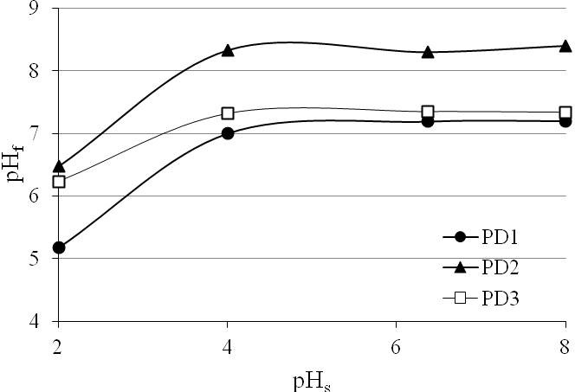
1 – Co²⁺; 2 – CoOH⁺; 3 – Co(OH)₂
Fig. Forms of Co²⁺in aqueous solutions, calculated from constants of hydrolysis
Fig. Effect of рН of initial solutions (pH_{s})
at the salt content of 35.0 g L⁻¹on the equilibrium рН of solutions without
⁶⁰Co after contact with sorbents
RadChem 2018 – the 18th Radiochemical Conference
13 – 18 May 2018, Marianske Lazne, Czech Republic

Slide 9
Fig. XRD patterns of PD-1 (1, 2), PD-2 (3, 4) and PD-3 (5, 6) after interaction with solution of Co(NO₃)₂(1.0 g L⁻¹) without (1, 3, 5) and with seawater modeling solution(50 g L⁻¹) (2, 4, 6)
RadChem 2018 – the 18th Radiochemical Conference
13 – 18 May 2018, Marianske Lazne, Czech Republic

Slide 10
Fig. Effect of salt content Cs on the degree of sorption of ⁸⁵Sr (a), distribution coefficient (b) and the рН changes of solutions after contact with sorbents (c).
RadChem 2018 – the 18th Radiochemical Conference
13 – 18 May 2018, Marianske Lazne, Czech Republic

Slide 11
Fig. Effect of рН of initial solutions (pHs) with salt content of 35.0 g L⁻¹ on the degree of sorption (a) and distribution coefficient (b) of ⁸⁵Sr and on the рН changes of solutions after contact with sorbents (c).
RadChem 2018 – the 18th Radiochemical Conference
13 – 18 May 2018, Marianske Lazne, Czech Republic

Slide 12
Table. Sorption properties of different materials towards strontium ions
Sorbents | m/V, g/mL | Competing ions / composition | Concentration, mol L⁻¹ | State of strontium / concentration (mol L⁻¹) | S, % | Sorption, mg∙g⁻¹ | Kd, mL g⁻¹ | References
HA (bioceramics) | 1/100 | Ca²⁺ / CaCl₂ | 1 × 10⁻⁵ ‒ 1 × 10⁻² | Sr²⁺ / 1 × 10⁻¹ | ‒ | ‒ | 516 ‒ 5 | [21]
HA (for liquid chromatography) | 1/100 | Ca²⁺ / CaCl₂ | 1 × 10⁻⁵ ‒ 1 × 10⁻² | Sr²⁺ / 1 × 10⁻¹ | ‒ | ‒ | 1885 ‒ 17 | [21]
HA (prepared by a wet chemical precipitation) | 1/100 | Ca²⁺ / CaCl₂ | 1 × 10⁻⁵ ‒ 1 × 10⁻² | Sr²⁺ / 1 × 10⁻¹ | ‒ | ‒ | 42 ‒ 1 | [21]
HA (biogenic, amorphous) | 1/150 | Na⁺ / NaCl | 2 × 10⁻⁴ ‒ 2 | Sr²⁺ / 1 × 10⁻³ | 66.2 ‒ 44.9* | 8.7 ‒ 5.9 | ‒ | [20]
 | 1/150 | Ca²⁺ / CaCl₂ | 2 × 10⁻⁴ ‒ 2 | Sr²⁺ / 1 × 10⁻³ | 76.1 ‒ 5.8* | 10 ‒ 0.76 | ‒ | [20]
HA (commercial nano-sized, crystalline) | 1/150 | Na⁺ / NaCl | 2 × 10⁻⁴ ‒ 2 | Sr²⁺ / 1 × 10⁻³ | 16.0 ‒ 9.9* | 2.1 ‒ 1.3 | ‒ | [20]
 | 1/150 | Ca²⁺ / CaCl₂ | 2 × 10⁻⁴ ‒ 2 | Sr²⁺ / 1 × 10⁻³ | 27.4 ‒ < 0.15* | 3.6 ‒ < 0.020 | ‒ | [20]
HA (biogenic, amorphous) | 1/150 | Seawater / Na⁺ (0.450 mol L⁻¹) Mg²⁺ (0.052 mol L⁻¹) Ca²⁺ (0.009 mol L⁻¹) | 90 % of salt content | Sr²⁺ / 1 × 10⁻³ | 17.5* | 2.3 | ‒ | [20]
HA (commercial nano-sized, crystalline) | 1/150 | The same | 90 % of salt content | Sr²⁺ / 1 × 10⁻³ | 1.6* | 0.21 | ‒ | [20]
Clinoptilolite | 1/150 | The same | 70 % of salt content | Sr²⁺ / 1 × 10⁻³ | 0 | 0 | ‒ | [20]
HA (low-crystalline) | 1/200 | Na⁺ / NaNO₃, | 5 × 10⁻⁴ ‒ 5 × 10⁻³ | Sr²⁺ / 2 × 10⁻³ | 42.5 ‒40.5 | ‒ | ‒ | [18]
 |  | Ca²⁺ / Ca(NO₃)₂ | 5 × 10⁻⁴ ‒ 5 × 10⁻³ | Sr²⁺ / 2 × 10⁻³ | 37.6 ‒ 24.0 | ‒ |  | [18]
RadChem 2018 – the 18th Radiochemical Conference
13 – 18 May 2018, Marianske Lazne, Czech Republic

Slide 13
Table. (continued)
Sorbents | m/V, g/mL | Competing ions / composition | Concentration, mol L⁻¹ | State of strontium / concentration (mol L⁻¹) | S, % | Sorption, mg∙g⁻¹ | Kd, mL g⁻¹ | References
HA | 1/250 | Ca²⁺ / CaCl₂ | 5 × 10⁻² | ⁸⁵Sr / ~ 10 kBq mL | 10 | ‒ | 30 | [35]
Ca-Mg phosphate based on dolomite:
PD-1 | 1/250 | Ca²⁺ / CaCl₂ | 5 × 10⁻² | ⁸⁵Sr / ~ 10 kBq mL | 12 | ‒ | 40 | [35]
PD-2 | 1/250 | Ca²⁺ / CaCl₂ | 5 × 10⁻² | ⁸⁵Sr / ~ 10 kBq mL | 31 | ‒ | 110 | [35]
PD-1 | 1/250 | Na⁺ / NaCl | 1.7 × 10⁻¹ | Sr²⁺ / 3 × 10⁻² | 99.2* | 217.6 | ‒ | [41]
PD-2 | 1/250 | Na⁺ / NaCl | 1.7 × 10⁻¹ | Sr²⁺ / 3 × 10⁻² | 99.2* | 196.5 | ‒ | [41]
PD-1 | 1/500 | Modelling seawater: Na⁺ (0.468 mol L⁻¹) Mg²⁺ (0.053 mol L⁻¹) Ca²⁺ (0.011 mol L⁻¹) | 14 ‒ 100 % | ⁸⁵Sr / ~10 kBq mL⁻¹ | 11.5 ‒ 7.0 | ‒ | 66 ‒ 13 | This work
PD-2 | 1/500 | The same | 14 ‒ 100 % | ⁸⁵Sr / ~10 kBq mL⁻¹ | 42.2 ‒ 26.4 | ‒ | 365 ‒ 179 | This work
RadChem 2018 – the 18th Radiochemical Conference
13 – 18 May 2018, Marianske Lazne, Czech Republic

Slide 14
Fig. XRD patterns of PD-1 (a), PD-2 (b) and PD-3 (c) after aging in water without salt (1) and in solution modeling seawater with salt content 10.0 g L⁻¹ _{(2), 35.0 g L}⁻¹ (3‒5) at pH 2 (4), 6 (1−3) and 8 (5).
RadChem 2018 – the 18th Radiochemical Conference
13 – 18 May 2018, Marianske Lazne, Czech Republic

Slide 15
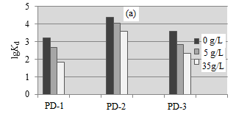
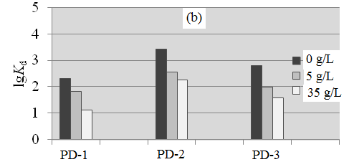
Fig. Effect of salinity on the lg K_{d} of ⁶⁰Co (a) and ⁸⁵Sr (b) radionuclides on Ca-Mg phosphate
sorbents (V/m=500 cm³/g)
RadChem 2018 – the 18th Radiochemical Conference
13 – 18 May 2018, Marianske Lazne, Czech Republic

Slide 16
CONCLUSION
High effective Ca-Mg phosphates sorbents towards 60Со and 85Sr were synthesized.
Effect of sorbents phase and chemical composition, salinity and pH of solution were studied.
The highest sorption efficiency and selectivity was obtained for PD-2 sorbent.
The simplicity of Ca-Mg phosphates preparation and use of widely occurring natural raw material dolomite for their production give the scientific basis for industrial implementation of novel sorbents for treatment facilities.
The produced materials are promising for application in seawater and liquid radioactive waste treatment from 60Со and 85Sr radionuclides.
RadChem 2018 – the 18th Radiochemical Conference
13 – 18 May 2018, Marianske Lazne, Czech Republic

Slide 17
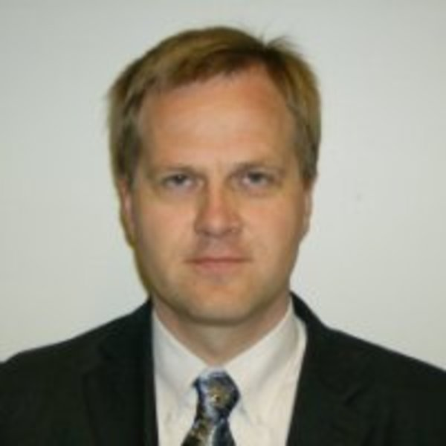
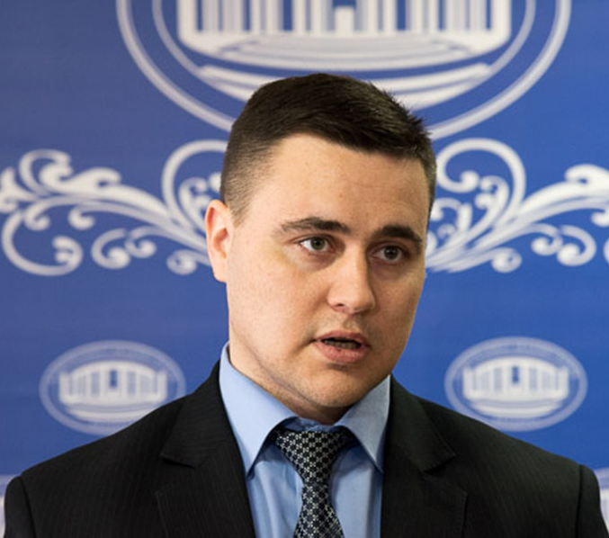
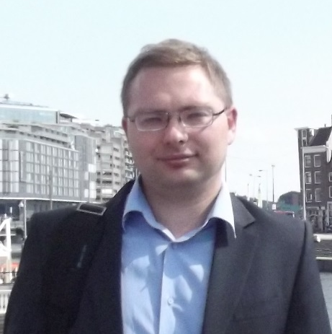
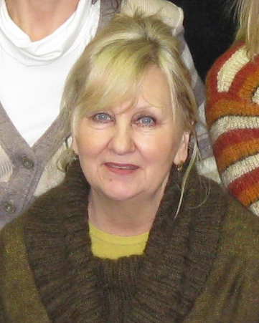
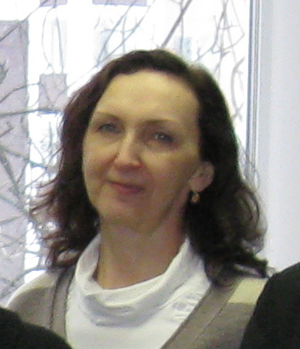
OUR SCIENTIFIC TEAM
Prof. Sillanpää Mika
Dr. Andrei Ivanets
Dr. Radkevich Artem
Dr. Shashkova Irina
Dr. Kitikova Natalia
RadChem 2018 – the 18th Radiochemical Conference
13 – 18 May 2018, Marianske Lazne, Czech Republic

Slide 18

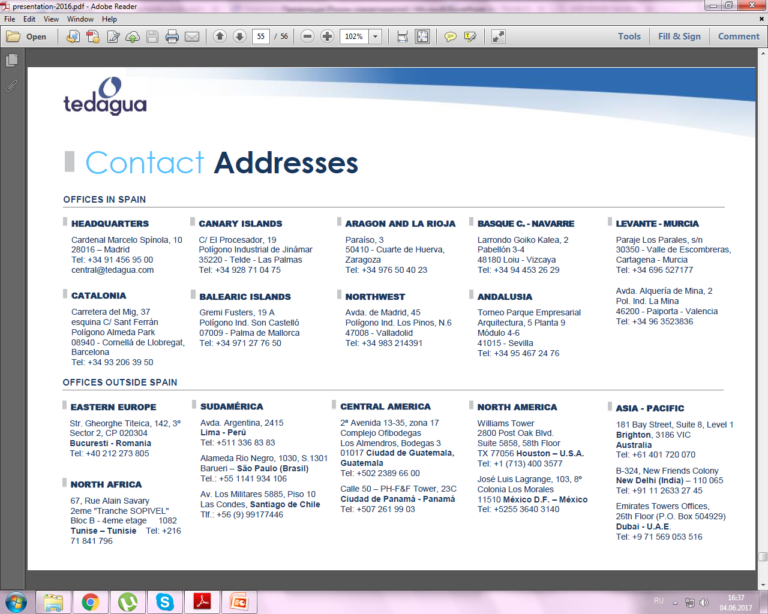
Thank you for your attention!
www.igic.bas-net.by
Andreiivanets@yandex.ru
Tel./Fax: +375 17 2842712

