Slide 1
Radiochemical characterization for a decommissioning purpose at NRg:
The case of Ion Exchange Resins
Radiochemical Conference,
13-18 of May 2018
Mariánské Lázně, Czech Republic
Patrick Haaß
Gaël Ménard
Tanja Tomasberger
18th of May 2018

Slide 2
Content
RadChem, 13th -18th of May 2018, Mariánské Lázně, Czech Republic
Overview and strategy of NRG in radiochemical characterization
Approach and methodology for radiochemical analysis applied on the Ion Exchange Resins
Results and status of the project

Slide 3
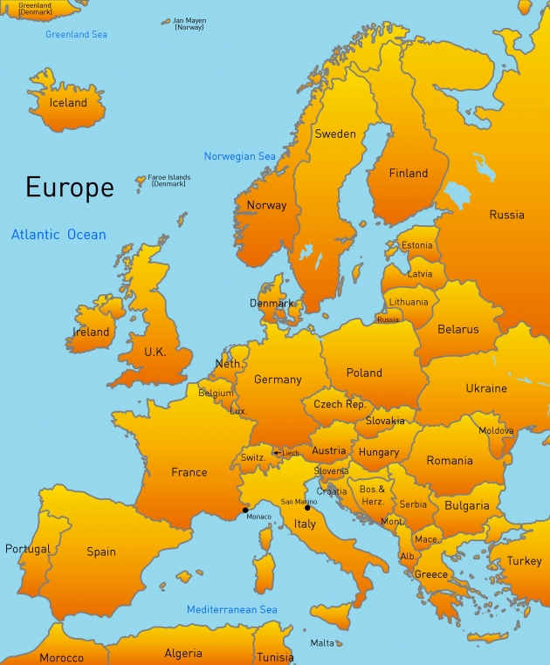
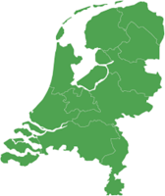

The Netherlands, Petten
intro

Slide 4
WASTE Characterisation
RadChem, 13th -18th of May 2018, Mariánské Lázně, Czech Republic
Context:
  Higher demand for nuclear waste characterization from regulator/public
  Waste Acceptance Criteria (WAC) not globally standardized
  Definition of needs not fully clarified
Requirements for waste characterization
  Fit storage facilities acceptance criteria (if established)
  Representative of the radionuclide content
  Nuclide selections for characterization
Example given of common waste
  Internal of NPP
  Ions exchange resins (IER)

Slide 5
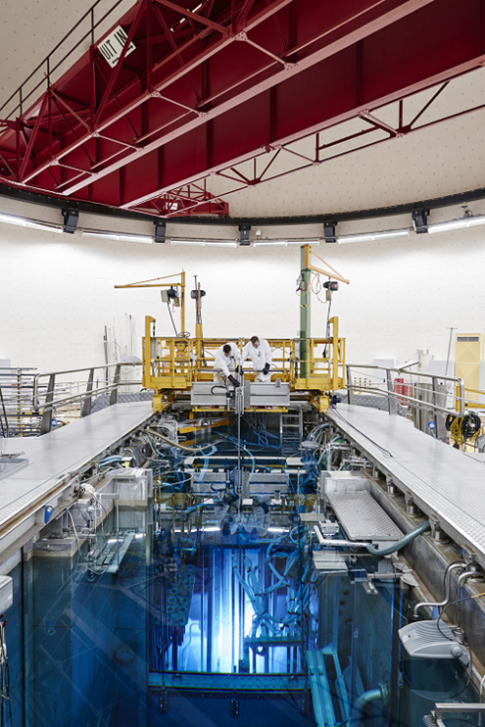
ION EXCHANGE RESINS
RadChem, 13th -18th of May 2018, Mariánské Lázně, Czech Republic
Continuous clean-up of the primary circuit and of the water basin

Slide 6
Ion exchange resins
RadChem, 13th -18th of May 2018, Mariánské Lázně, Czech Republic
Existing storage/treatment solution
  Direct storage in containers
  Direct cementation
  Steam reforming (THOR process)
  Incineration ➔ Ashes + Cementation
Requirement in all cases:
  Activities and dose
  Nuclide content
    Short-lived RN (Transport related): H-3; (S-35); Co-60; Ni-63; Sr-90; Cs-137
    Long-lived RN (Storage related): C-14; Cl-36; Fe-55; Tc-99; I-129; U; Pu

Slide 7
Characterization in a nutshell
RadChem, 13th -18th of May 2018, Mariánské Lázně, Czech Republic
Cost:
Minimalize
the amount of analysis
Time and/or
public pressure
Comprehensive information for:
-Transport
-Safe long-term storage
CHARACTERIZATION
ALARA
Representative:
(As much “data” as possible)

Slide 8
Constraint on Homogeneity
RadChem, 13th -18th of May 2018, Mariánské Lázně, Czech Republic
Inside one container (Presence of hot spots?)
In the different containers of a same batch
IAEA recommendation on homogeneity of a waste stream
(IAEA-TECDOC-1573)
“For stable waste streams, measuring one or more key nuclides and non-radioactive elements may be sufficient to check the homogeneity. For example, a simple and stable waste stream could be declared homogeneous if NDA measurements of 137 Cs and/or 60 Co made at different locations are within a 30% relative interval”

Slide 9
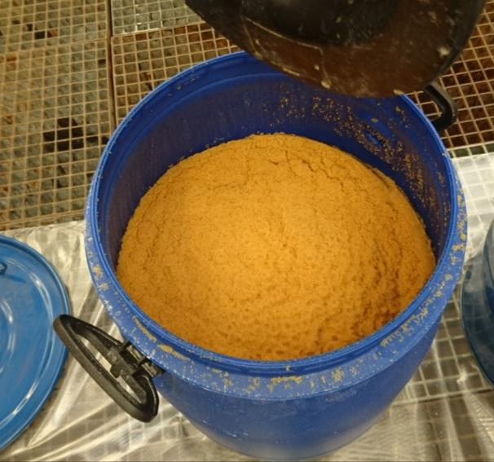
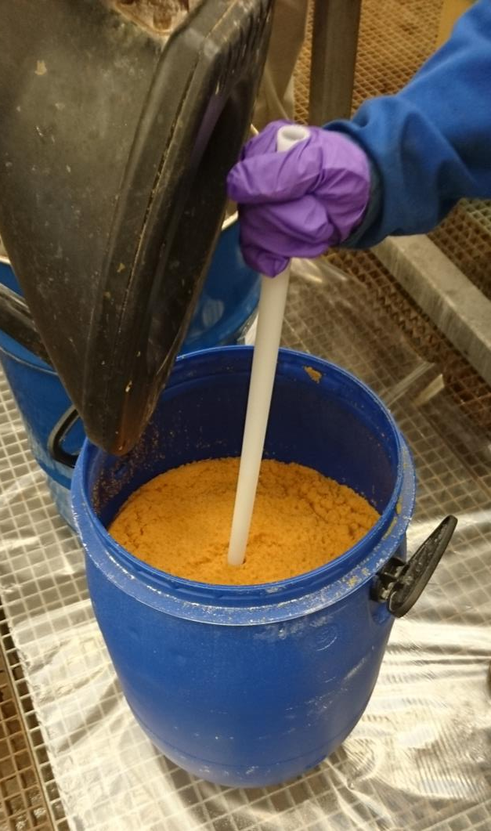
SAMPLING
RadChem, 13th -18th of May 2018, Mariánské Lázně, Czech Republic

Slide 10
OVERVIEW of the contingent
RadChem, 13th -18th of May 2018, Mariánské Lázně, Czech Republic
Batch | Total containers | Containers sampled | Container internal homogeneity check
2004 | 16 | 6 | Yes, on 2 containers
2009 | 19 | 5 | No
2010 | 9 | 4 | No
2011 | 10 | 8 | Yes, on 1 container
2012 | 19 | 9 | Yes, on 4 containers
2014 | 22 | 7 | No
2017 | 24 | 4 | No

Slide 11
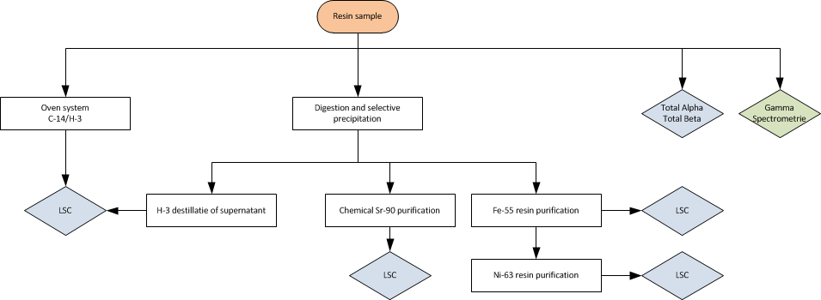
Preparation: IER Application
RadChem, 13th -18th of May 2018, Mariánské Lázně, Czech Republic

Slide 12
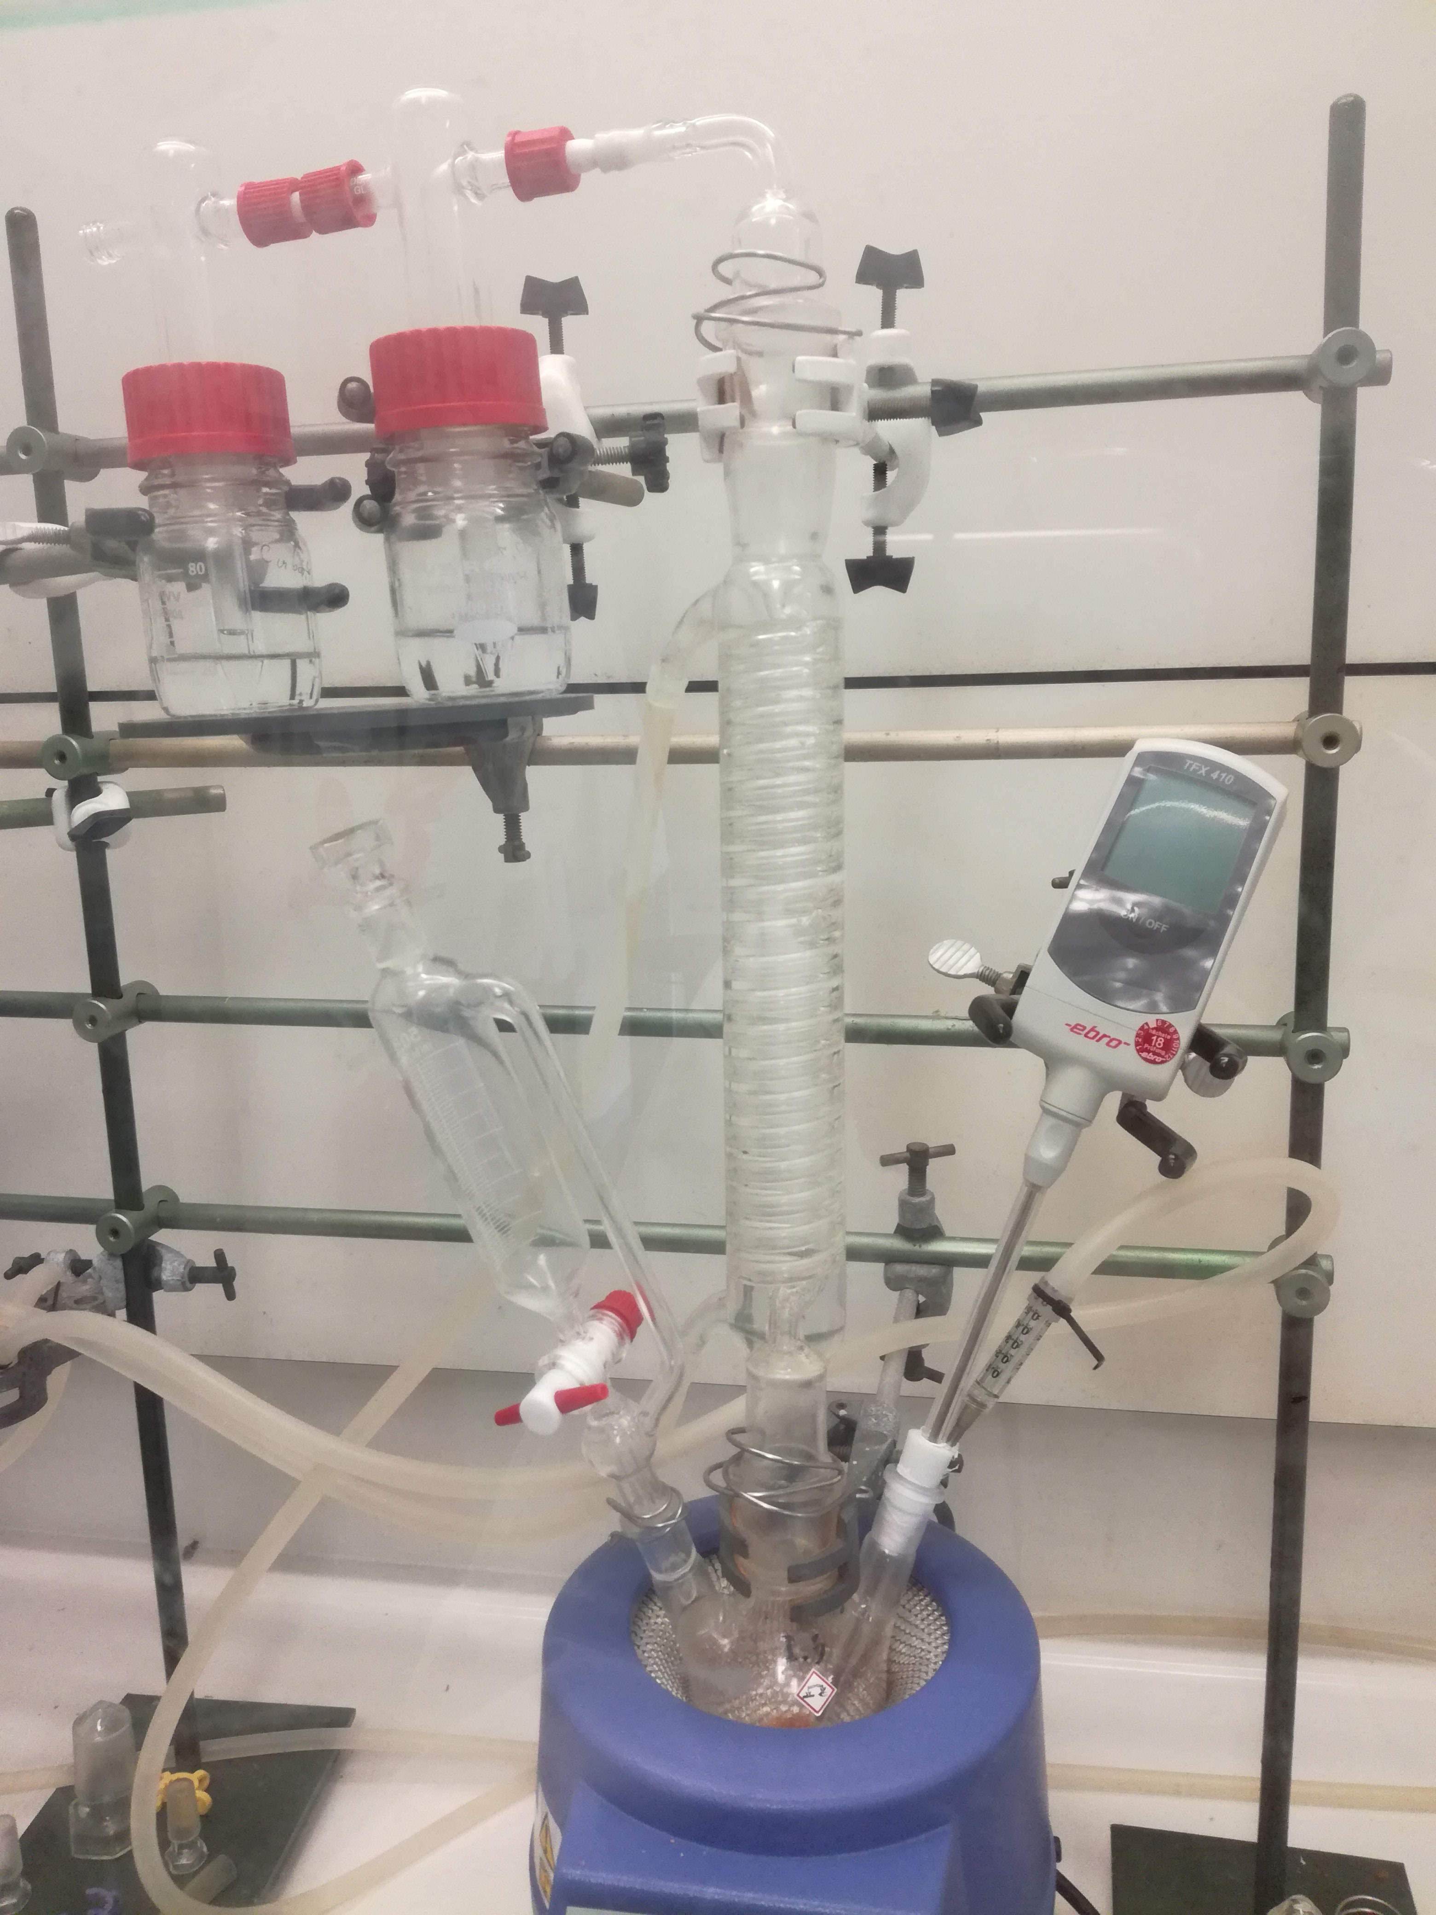
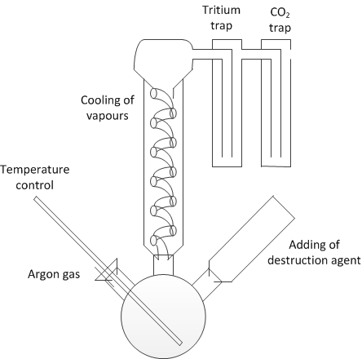
Preparation - Digestion
RadChem, 13th -18th of May 2018, Mariánské Lázně, Czech Republic

Slide 13
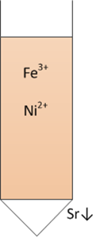
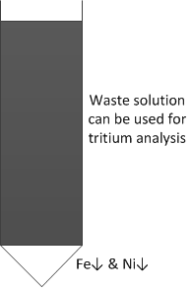
Preparation - precipitation
RadChem, 13th -18th of May 2018, Mariánské Lázně, Czech Republic
Separation in two steps
Selective precipitation of Sr
Co-precipitation of Ni and Fe
➔ Purification
➔ Separation

Slide 14
Results: Homogeneity
RadChem, 13th -18th of May 2018, Mariánské Lázně, Czech Republic

Slide 15
Results : Recovery and selectivity
RadChem, 13th -18th of May 2018, Mariánské Lázně, Czech Republic

Slide 16
Results : Recovery and selectivity
RadChem, 13th -18th of May 2018, Mariánské Lázně, Czech Republic
Nuclides | Recovery range
Fe-55 | 45%-75%
Ni-63 | 75%-95%
Sr-90 | 65%-96%

Slide 17
OVERVIEW OF THE RESULTS
RadChem, 13th -18th of May 2018, Mariánské Lázně, Czech Republic
Batches analyzed: 7 different production
Amount of samples taken: 36 for homogeneity
15 for full analysis
Homogeneity proven: Yes, on 6 production
Anomalies detected: Yes, on 1 production
Analysis performed : Gamma
Beta (in-house):H-3; Fe-55; Ni-63; Sr-90
Beta (other labs): C-14; Cl-36; Tc-99

Slide 18
New challenges:
RadChem, 13th -18th of May 2018, Mariánské Lázně, Czech Republic
Pyrolyser for analyses of C-14 and H-3
Development of Cl-36 and I-129 methods
Development of Tc-99
Analysis of Cationic Resins

Slide 19
Conclusion
RadChem, 13th -18th of May 2018, Mariánské Lázně, Czech Republic
Developed analysis for IER
Result in agreement with other labs
Norm ISO-17025 accredited
Large applications of the characterization work:
  Internal of nuclear power plants (Low flux reactor in Petten)
  Historical waste (Legacy waste project at NRG)
  Third party waste/decommissioning projects

Slide 20
RadChem, 13th -18th of May 2018, Mariánské Lázně, Czech Republic
Thank you for your attention!
Any question?
Contact:
Patrick Haaβ; haass@nrg.eu
Gaël Ménard; menard@nrg.eu
Tanja Tomasberger; tomasberger@nrg.eu

Slide 21
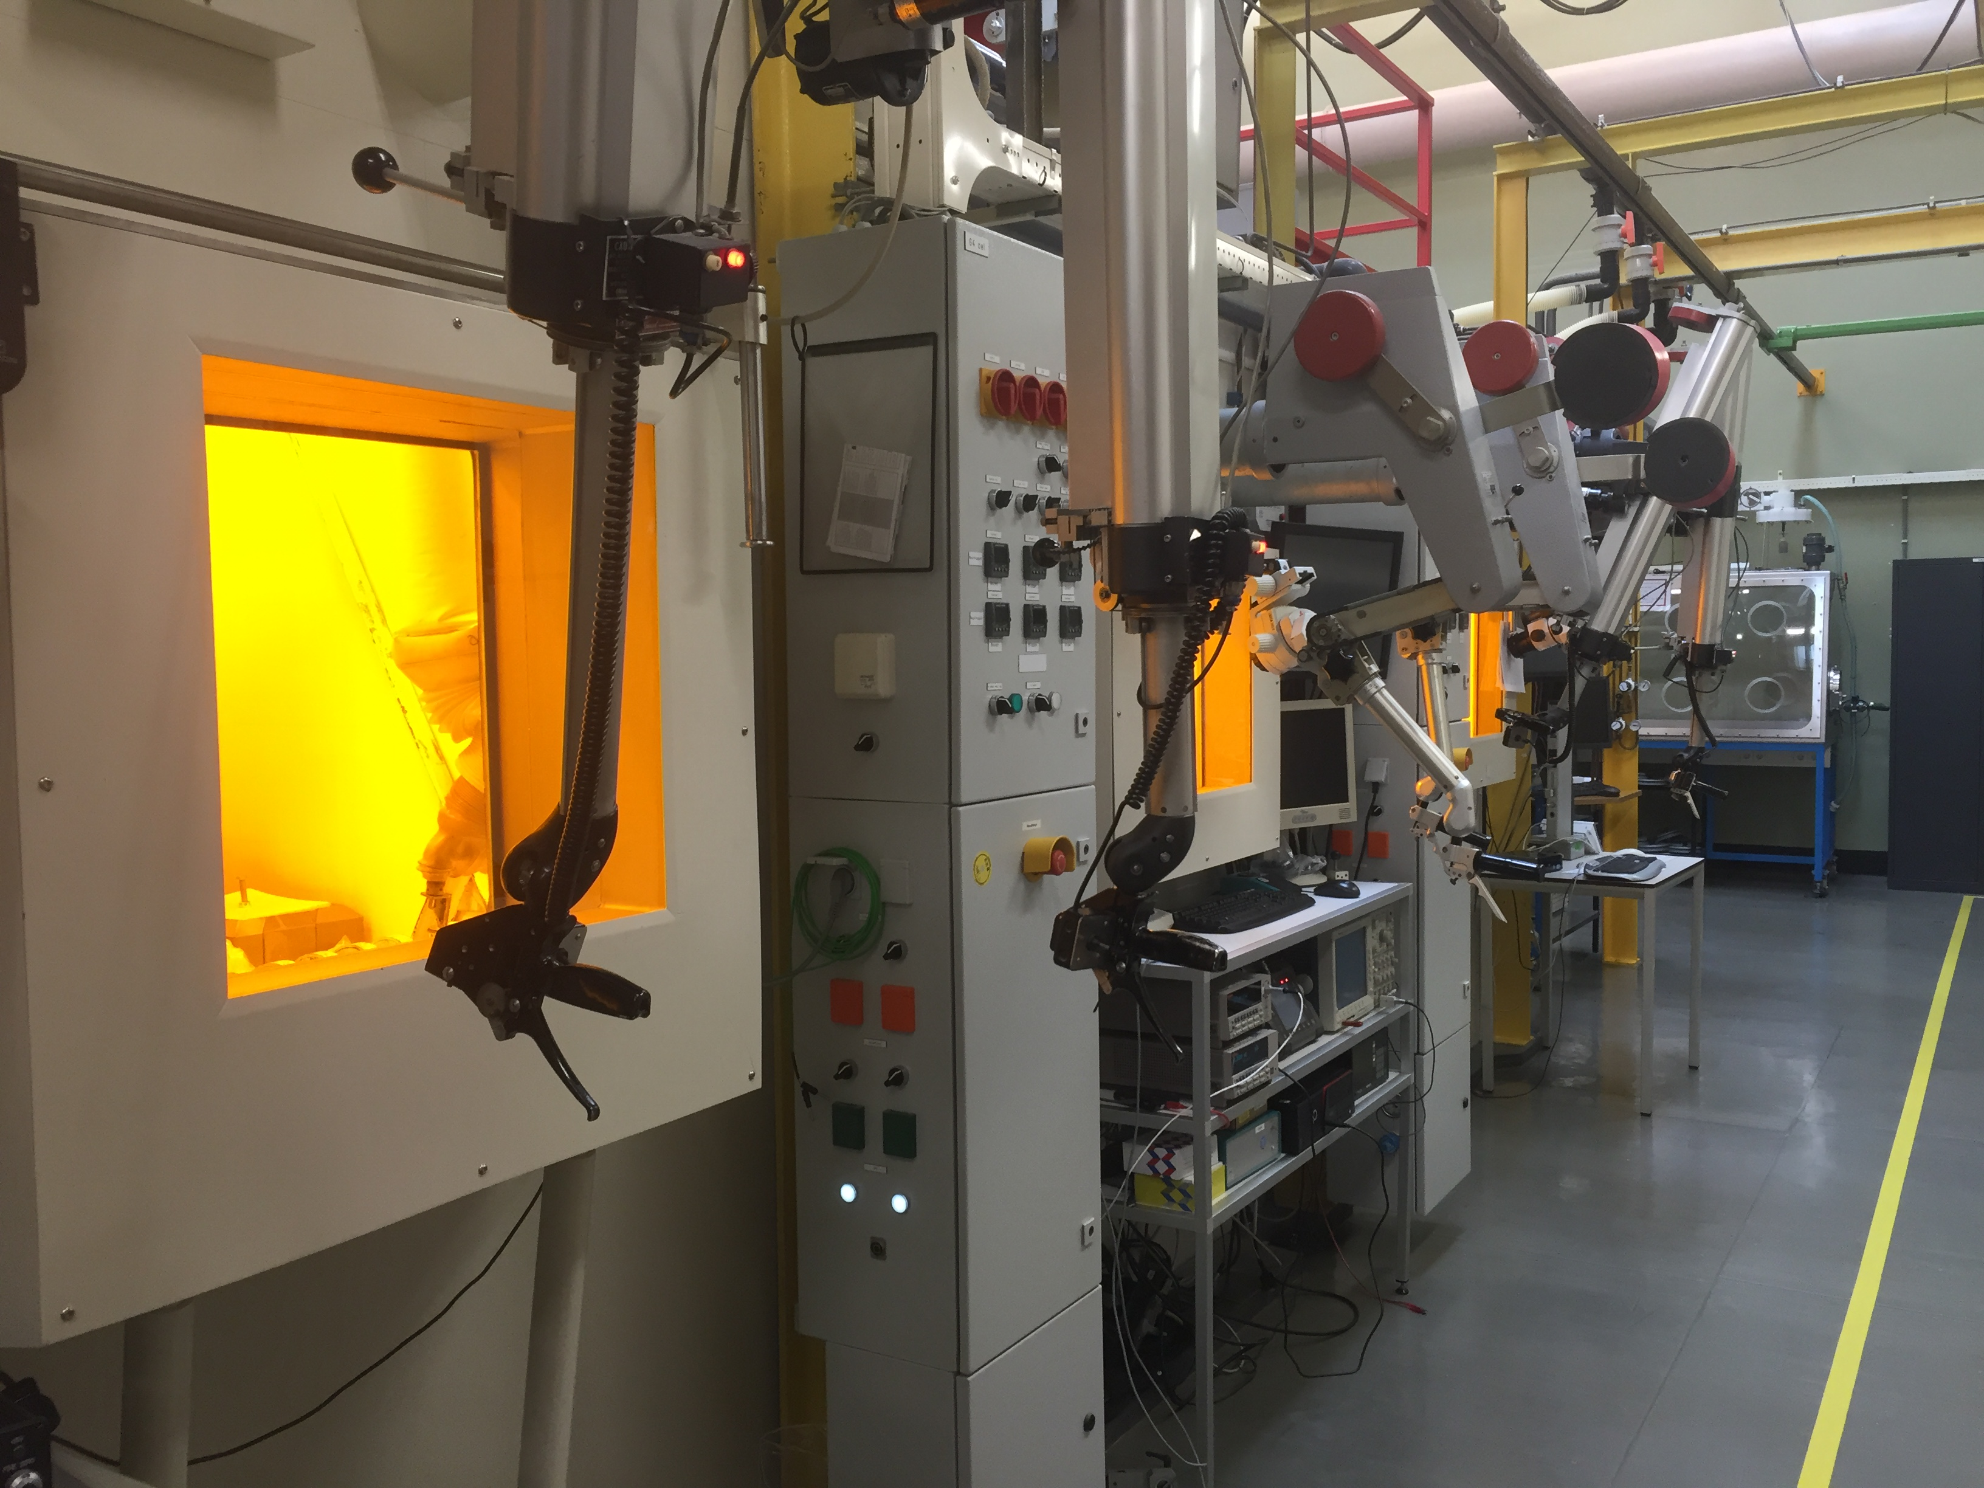
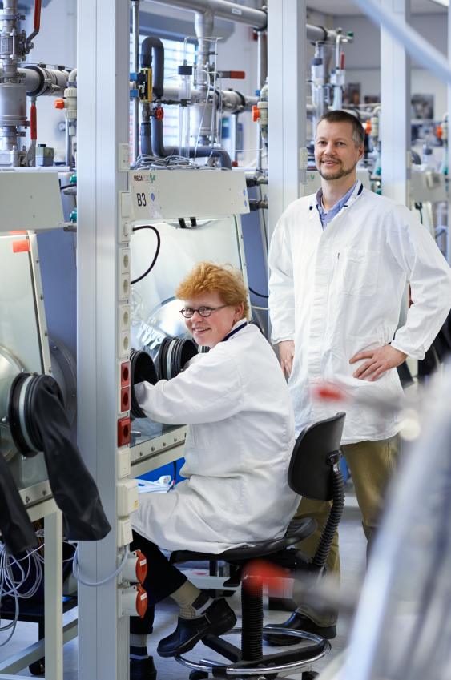
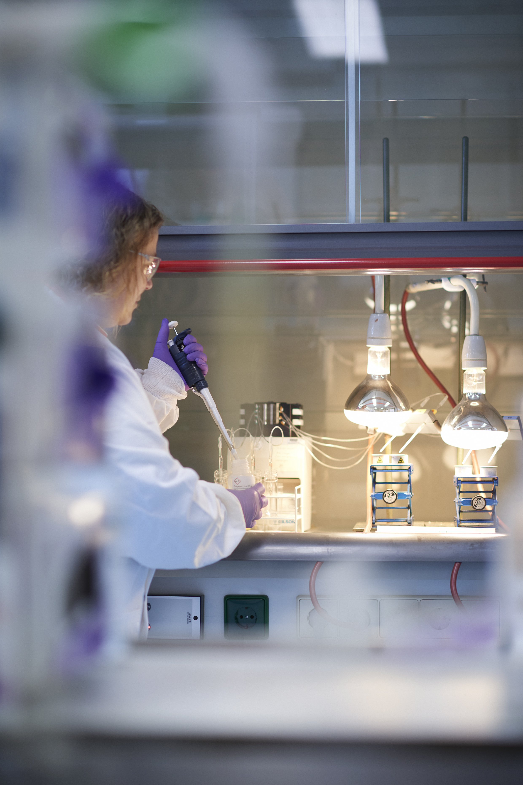
NRG CAPACITIES
RadChem, 13th -18th of May 2018, Mariánské Lázně, Czech Republic
Unique structure at NRG:
Hot samples:
  5 concrete, 12 lead shielded hot cells for high active samples
  20 glove boxes for intermediate samples
  Radiochemistry laboratories

Slide 22
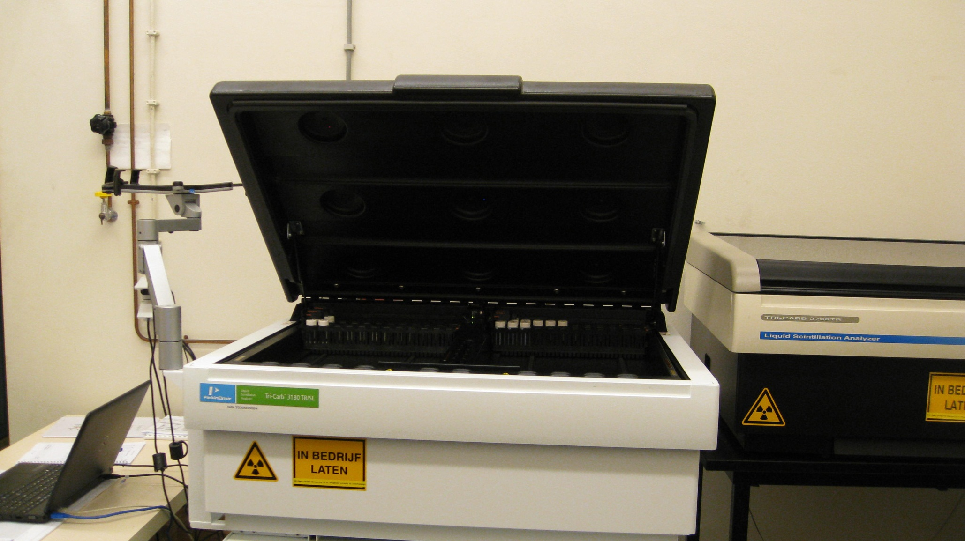
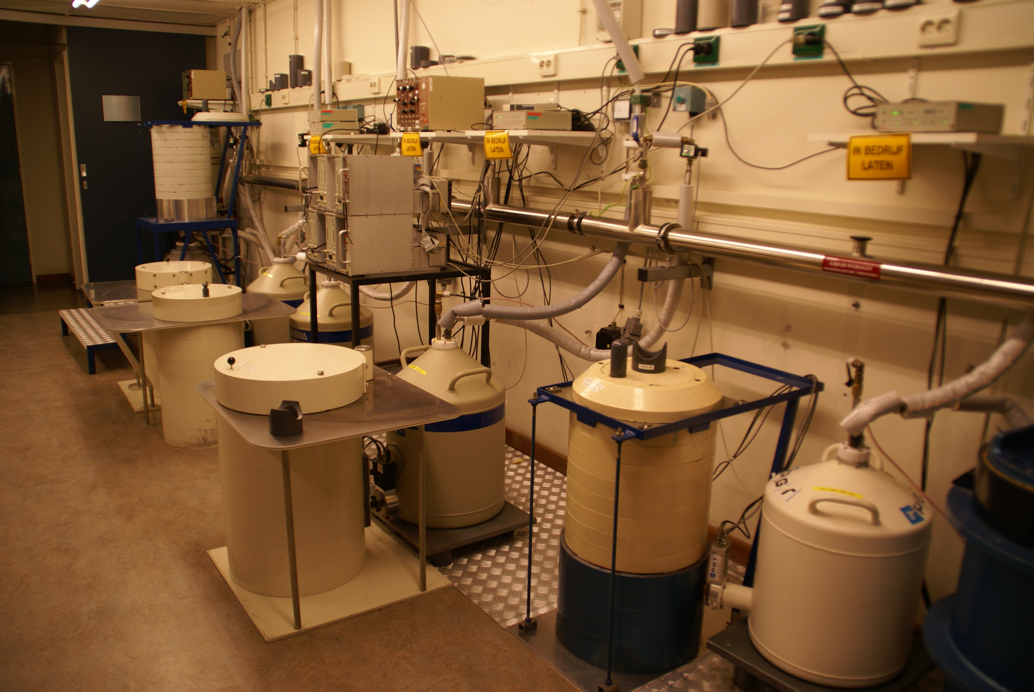
NRG CAPACITIES
RadChem, 13th -18th of May 2018, Mariánské Lázně, Czech Republic
Several Gamma detectors and LSC capable of handling range from high to low active samples
  Advanced separation methods allow full characterisation of higher active nuclides along with low active nuclides
TriCarb 3180 TR/SL LSC
Low level HPGe gamma spectrometry system

Slide 23
Measurement
RadChem, 13th -18th of May 2018, Mariánské Lázně, Czech Republic
Direct measurements:
  Total Alpha / Total Beta ➔LSC Calibrated to a specific amount of resin
  Gamma spectrometry
Indirect measurements:
  C-14 and Tritium by LSC
After oxidative combustion and absorption of gas
  Fe-55, Ni-63 and Sr-90 by LSC
After precipitation and purification of sample

Slide 24
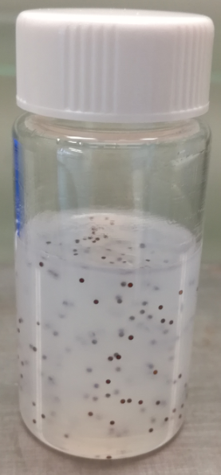

Preparation: Overall Approach
RadChem, 13th -18th of May 2018, Mariánské Lázně, Czech Republic
Gamma spectrometry : Direct measurement
Total Alpha and total Beta: Simple preparation
  RN: Adsorption on resins surface
  ➔ Gel media as scintillation cocktail
  ➔ Homogeneity for LSC
Gel
Immobilized resin beads

Slide 25
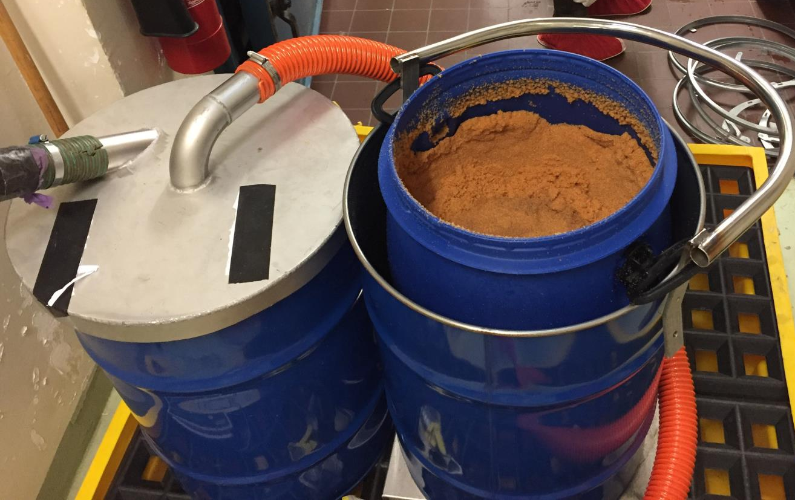
SAMPLING: Background
RadChem, 13th -18th of May 2018, Mariánské Lázně, Czech Republic
IER Beds are emptied after regeneration: Still consider a potential inhomogeneity in the activity

Slide 26
CHARACTERISATION DECOMPOSED
RadChem, 13th -18th of May 2018, Mariánské Lázně, Czech Republic
Analyte
Matrix
Sampling
Preparation
Measurement
Repeatability
Analysis

Slide 27
Example: Matrix issue
RadChem, 13th -18th of May 2018, Mariánské Lázně, Czech Republic
General approach:
C-14: absorption in Carbosorb / sodium hydroxide
H-3: absorption in nitric acid
Issue:
Absorption of gases produced during destruction
colouring of Carbosorb / capacity reduction of sodium hydroxide
H-3 forms no volatile species
➔ no absorption possible

Slide 28
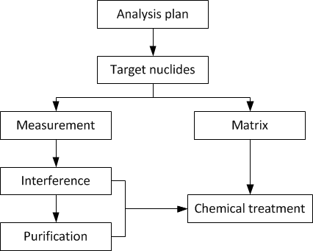
Preparation(1/2): General plan
RadChem, 13th -18th of May 2018, Mariánské Lázně, Czech Republic

Slide 29
Preparation (1/3):
RN specific approach
RadChem, 13th -18th of May 2018, Mariánské Lázně, Czech Republic
Goal: Transfer of RN from IER into solution
Two approaches:
Leaching:
  Pro: Lighter process
  Con: Uncomplete recovery of radionuclides content
Destruction:
  Pro: No loss of content
  Con: More complex matrix
  ➔ Preferred approach for full inventory

