Slide 1
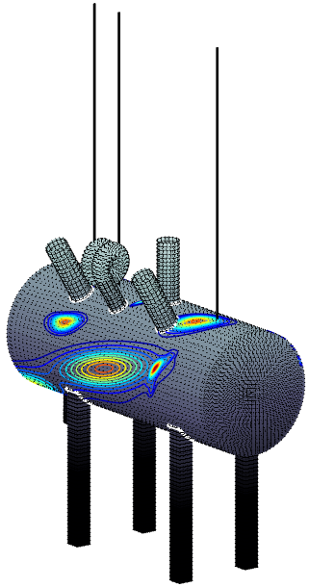
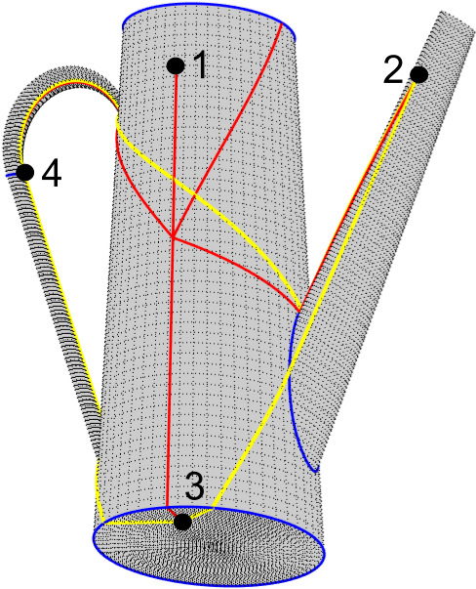
Geodesic optimization and acoustic emission localization maps processing
1
Author: Petr Gális
Supervisor: Ing. Václav Kůs, Ph.D.
Advisor: Ing. Milan Chlada, Ph.D.
1
2
1: CTU– Faculty of nucelar sciences and physical engineering
2: AS – Institute of Thermomechanics

Slide 2
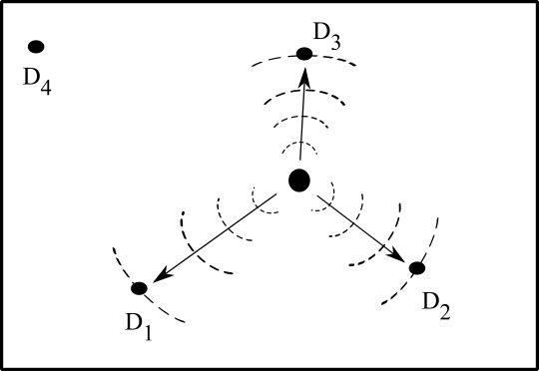
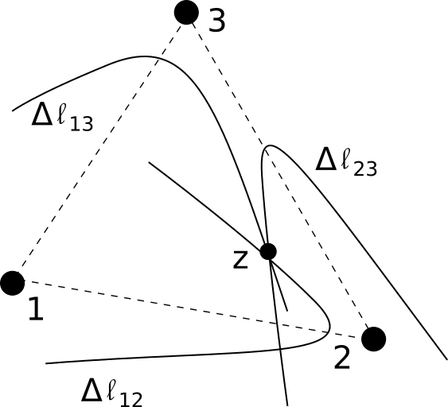
$\text{∆}\text{t}$ - localization
Denoting ${\text{∆}\text{t}}_{ij}=t_{i}−t_{j}$ time differences of signal arrivals to sensors $D_{1},D_{2},D_{3}$
$${\text{∆}\text{t}}_{12}=t_{1}−t_{2}$$
$${\text{∆}\text{t}}_{23}=t_{2}−t_{3}$$
$${\text{∆}\text{t}}_{31}=t_{3}−t_{1}$$
Let c be velocity of acoustic signals
$$c{\text{∆}\text{t}}_{12}=ct_{1}−ct_{2}=l_{1}−l_{2}$$
$$c{\text{∆}\text{t}}_{23}=ct_{2}−{ct}_{3}=l_{2}−l_{3}$$
$$c{\text{∆}\text{t}}_{31}=ct_{3}−ct_{1}=l_{3}−l_{1}$$
$l_{1},l_{2},l_{3}$ are distances between source and sensors
Key Task is to find shortest path between two points on the surface – potential source and sensor

Slide 3
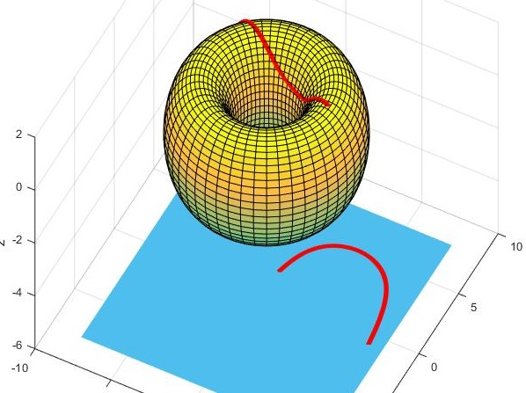
Finding shortest path Geodesic curve
Generalization of straight
Geodesic curve is such a curve, which has shortest length among all curves connecting two points
Let x : U → S be parametrization of the surface S and $p_{1}∊S,{ p}_{2}∊S.$
Let α = ( u(t) ,v(t) ) $∈U$ , $t∈I$ be plane curve in the domain of the parametrization x.
Then $γ=x∘$α $=$x (u(t), v(t)) is a geodesic, if
functions u(t), v(t) meets GEODESIC EQUATIONS
$$\ddot{u}+{Γ }_{11}^{1}{\dot{u}}^{2}+2{Γ }_{12}^{1}\dot{u}\dot{v}+{Γ }_{22}^{1}{\dot{v}}^{2}=0$$
$$\ddot{v}+{Γ }_{11}^{2}{\dot{u}}^{2}+2{Γ }_{12}^{2}\dot{u}\dot{v}+{Γ }_{22}^{2}{\dot{v}}^{2}=0$$

Slide 4
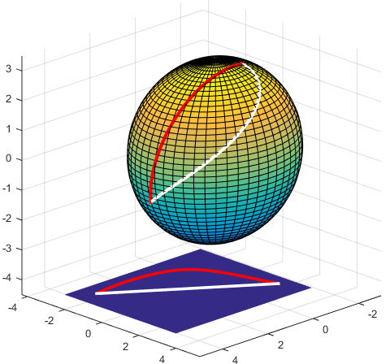
Numerical solution of geodesic equations
$$\ddot{u}+{Γ }_{11}^{1}{\dot{u}}^{2}+2{Γ }_{12}^{1}\dot{u}\dot{v}+{Γ }_{22}^{1}{\dot{v}}^{2}=0$$
$$\ddot{v}+{Γ }_{11}^{2}{\dot{u}}^{2}+2{Γ }_{12}^{2}\dot{u}\dot{v}+{Γ }_{22}^{2}{\dot{v}}^{2}=0$$
Finite difference method
$$u_{k}=\frac{1}{2}\left(u_{k+1}+u_{k−1}\right)+\frac{1}{8}\sum_{i,j=1}^{2}{Γ_{ij}^{1}(u_{k},v_{k})}△ω_{i}^{k}△ω_{j}^{k}$$
$$v_{k}=\frac{1}{2}\left(v_{k+1}+v_{k−1}\right)+\frac{1}{8}\sum_{i,j=1}^{2}{Γ_{ij}^{2}(u_{k},v_{k})}△ω_{i}^{k}△ω_{j}^{k}$$
$$△ω_{1}^{k}=\left(u_{k+1}+u_{k−1}\right),$$
$$△ω_{2}^{k}=\left(v_{k+1}+v_{k−1}\right)$$
Fixed point iteration
$x^{k+1}=φ(x^{k})$
Newton-Raphson method
d$F\left(x^{k}\right)∙△x^{k}=−F(x^{k})$
$x^{k+1}=x^{k}+△x^{k}$

Slide 5
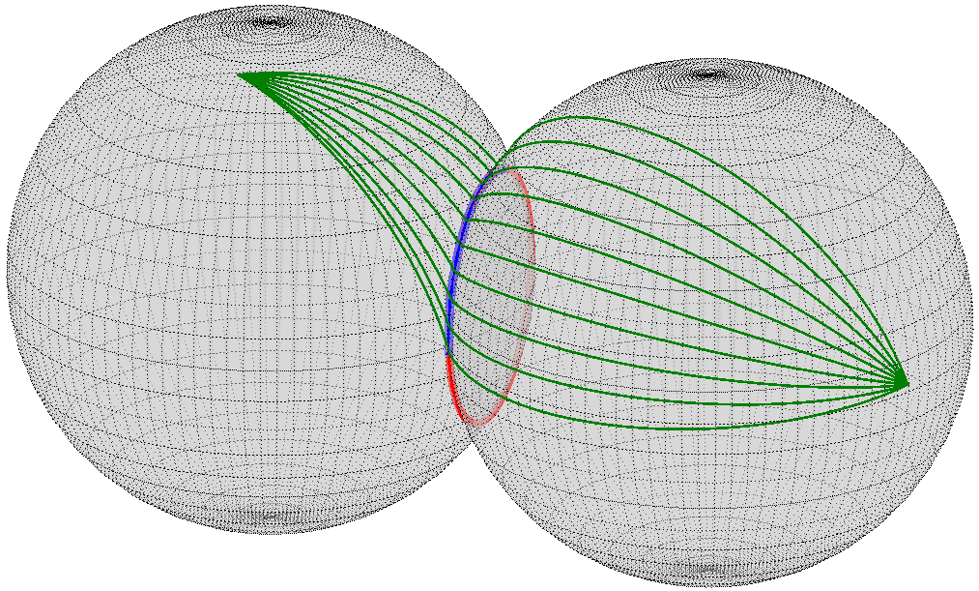
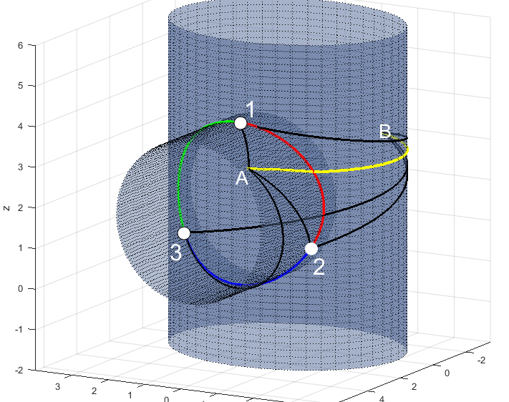
Computing geodesics on compound surface
Iterative algorithm:
Let $γ∈(a_{0},b_{0})$ be parameter of the intersection of two surfaces
Let $γ_{0}=\frac{{a_{0}+b}_{0}}{2}$ and step ${{σ_{0}=|a}_{0}+b}_{0}|$
For $k=0,1,2,…$
$$σ_{k+1}=σ_{k}/2$$
$$a_{k+1}=γ_{k}+σ_{k+1}$$
$$b_{k+1}=γ_{k}+σ_{k+1}$$
$$γ_{k+1}=\underset{L_{a_{k+1}},L_{b_{k+1}},L_{γ_{k}} }{argmin}{\{a_{k+1},b_{k+1},γ_{k+1}\}}$$
Exhaustive method:
Minimization of sum of lengths through
fixed points on the intersection

Slide 6
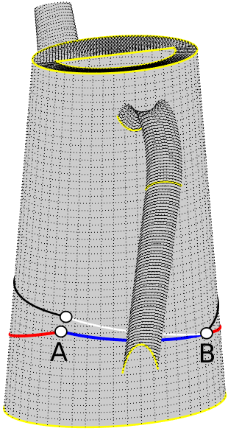
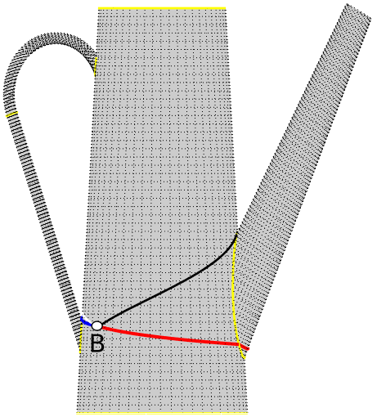
Conditioned reparametrization of geodesic curve
To obtain shortest geodesic it is necessary to
interchange ranges for angular coordinate
Criteria for change:
$$u∈(−π,π)$$
$$u∈(0,2π)$$
If $\left|u_{B}−u_{A}\right|>π$
perform reparametrization

Slide 7
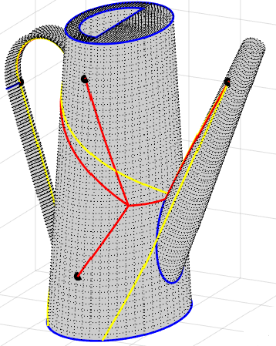
Localization
${\text{∆}\text{t}}_{ij}=t_{i}−t_{j}$ be measured length differences from the experiment
${\text{∆}\text{s}}_{ij}=s_{i}−s_{j}$ be computed length differences from the computer model
Let
Two approaches are possible
Minimization of length differences: $F=\sum_{i,j}{\left|{\text{C}\text{∆}\text{t}}_{ij}−{\text{∆}\text{s}}_{ij}\right|}$, or
Minimization of time differences: $F=\sum_{i,j}{\left|{\text{∆}\text{t}}_{ij}−\frac{{\text{∆}\text{s}}_{ij}}{C}\right|}$.
Each point of the body is tested to localize minimum of the functional $F$
Point $Z$, where $F\left(Z\right)= \min_{p}{F\left(p\right)}$ is the source of AE

Slide 8
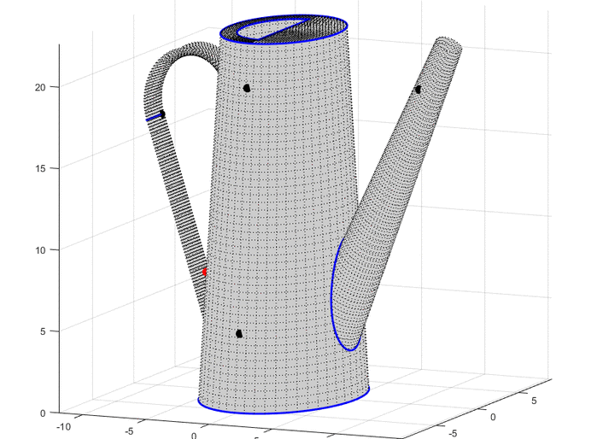
Compass algorithm
Let $(u_{0},v_{0})$ be inital base point
L$et$ $h_{u},h_{v}>0$ be intial step and choose number of „directions“ (e.g. 9)
For i=1,2,…
$\left(u_{i},v_{i}\right)←$ $\left(u_{i−1},v_{i−1}\right)$
C$ompute F(u_{i},v_{i})$, $F\left(u_{i}±h,v_{i}±h\right)$
Find $\left(u,v\right)=argmin F(u_{l},v_{m})$
If $\left|F(u,v) \right|<ε$ or i=max END
If $\left(u,v\right)=$ $\left(u_{i},v_{i}\right)$ : $h←h/2$ CONTINUE
Else $h←h\frac{F(u,v)}{F(u_{i},v_{i})}$
$\left(u_{i},v_{i}\right)←(u,v)$ CONTINUE

Slide 9
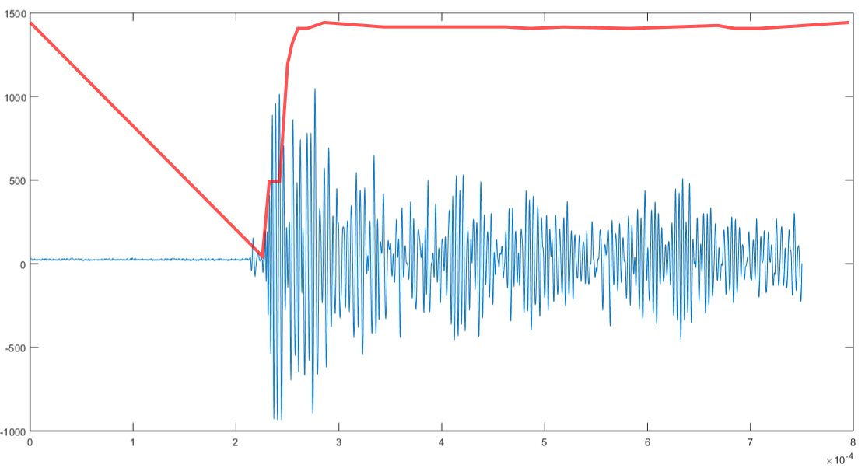
Detecting time of arrival of signal
Schwarz information criteria (SIC)
Finds point of change p in the measured data
$SIC\left(k\right)=n\ln{2π }+k\ln{S21}+n$
+ $2\ln{n}+\left(n−k\right)\ln{S22 }$
p = argmin $SIC(k)$
$S21=\frac{1}{k}\sum_{i=1}^{k}{{(x_{i}−μ)}^{2}}$
$S22=\frac{1}{n−k}\sum_{i=k+1}^{n}{{(x_{i}−μ)}^{2} }$
$$n=number of points in the sample$$
Other methods: treshold method, CUSUM, ${\text{χ}}^{2}$

Slide 10
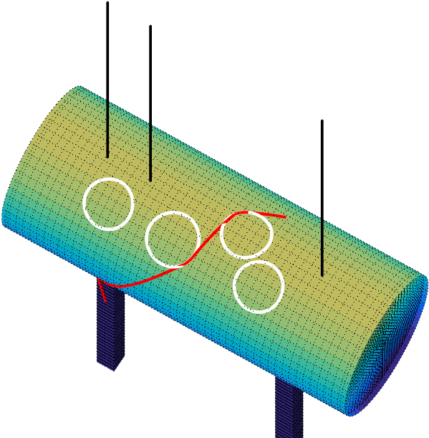
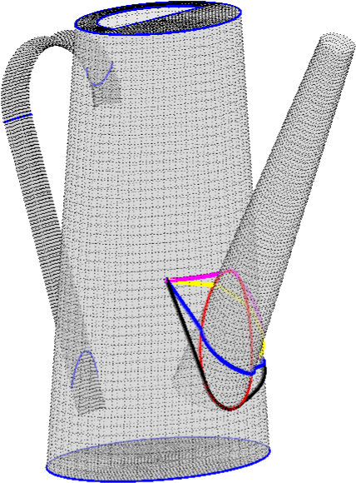
Computing geodesics around obstacles

Slide 11
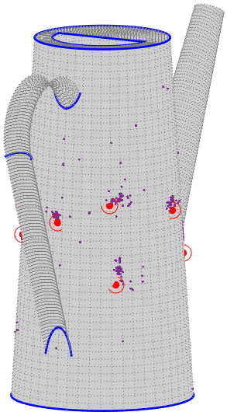
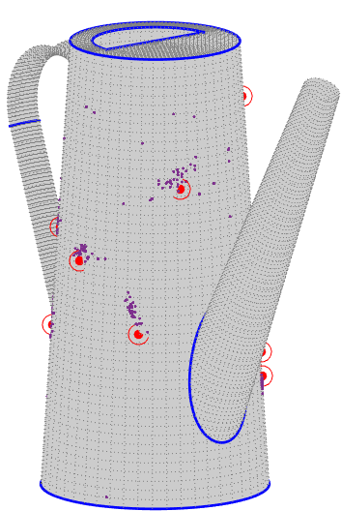
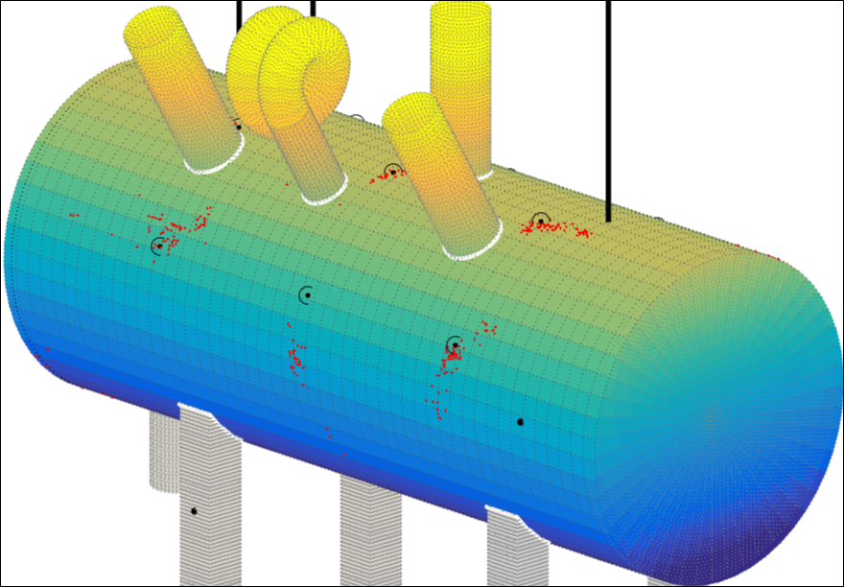
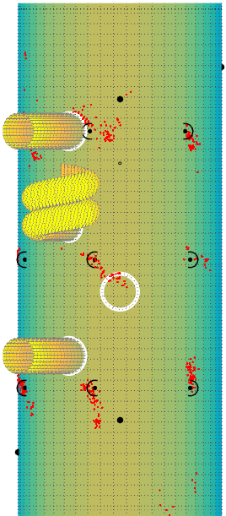
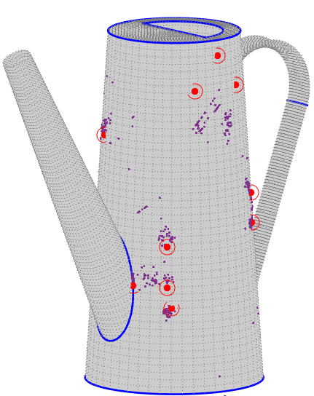
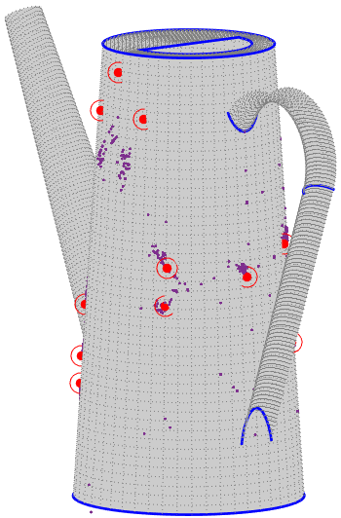
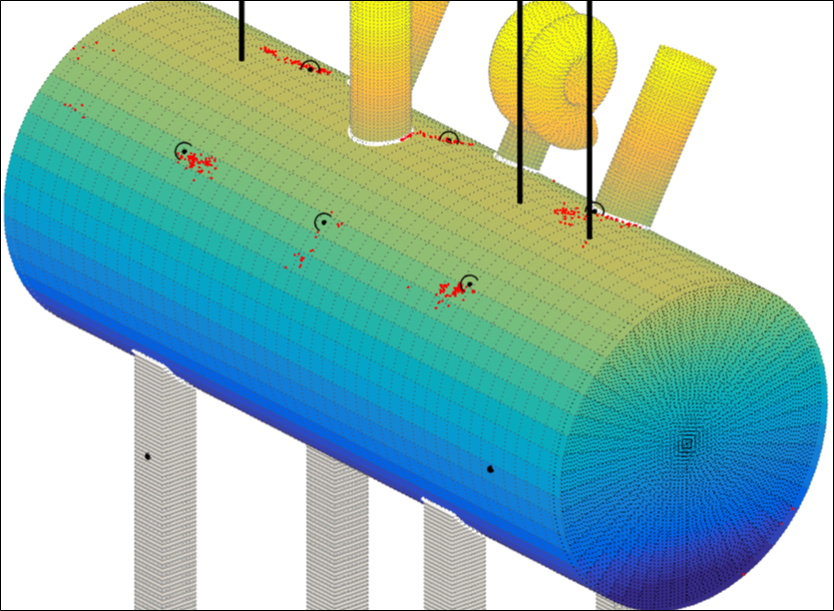
Results of the model

Slide 12
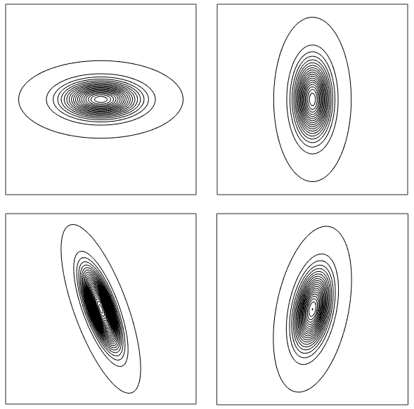
Kernel probability density estimates in$ℝ^{2}$
Let $X_{1},…,X_{n}$ be independent and identically distributed random variables with density $f$, where $X_{i}=(u_{i},v_{i})$
Kernel density estimate of $f$ is defined as
where
Is two-dimensional kernel satisfying
and $H∈ℝ^{2,2}$ is symmetric and positive definite smoothing matrix
$$\hat{f}\left(x\right)=\frac{1}{n}\sum_{i=1}^{n}{K_{H}\left(x−X_{i}\right)}$$
$$K_{H}\left(u\right)={|H| }^{−1/2}K\left({H }^{−1/2}u\right)$$
$$\int_{ℝ^{2}}{K\left(x\right)d}x=1$$
$$H=\left(\begin{matrix}h_{11} & h_{12} \\ h_{12} & h_{22}\end{matrix}\right)$$
How to choose matrix $H$ ?

Slide 13
Computation of the smoothing matrix $H$
Reference density method (RD)
where $\hat{∑}=\left(\begin{matrix}s_{11} & s_{12} \\ s_{12} & s_{22}\end{matrix}\right)$ is estimate of covariance matrix of measured data $X_{1},…,X_{n}$
Iterative method (IT)
$$H_{RD}=n^{−1/3} \hat{∑}$$
$$2h_{11}\sqrt{S\left(s_{ij}\right)}\sum_{i,j=1,i≠j}^{n}{Λ_{H}\left(x−X_{i}\right)}=nV(K)$$
$V\left(K\right)=\int{K^{2}\left(x\right)}dx$
$S\left(s_{ij}\right)=(s_{11}s_{22}−s_{12}^{2})/s_{11}^{2}$
$Λ\left(u\right)=(K∗K∗K∗K−2K∗K∗K+K∗K)(u)$
Other methods: maximal smoothing method, Least Squares Cross Validation method

Slide 14
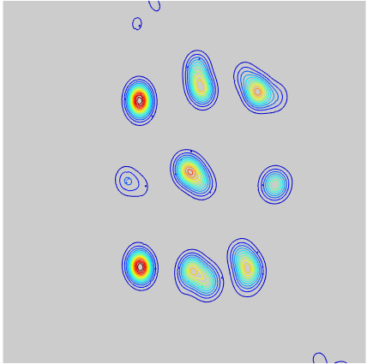
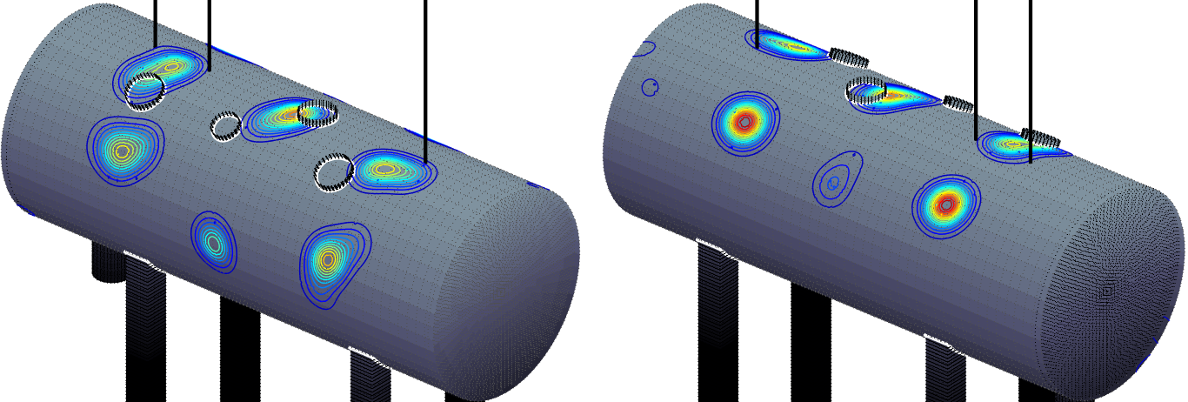
Kernel estimate in the parametric space

Slide 15
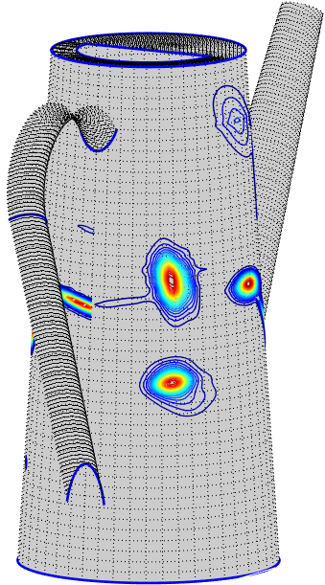
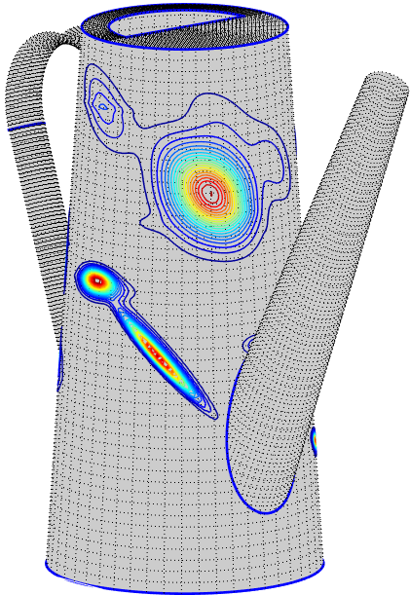
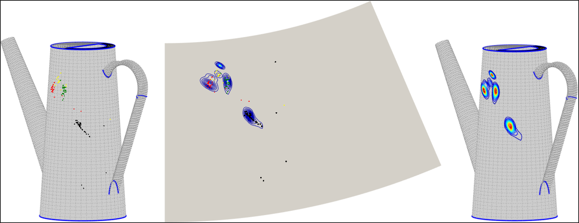
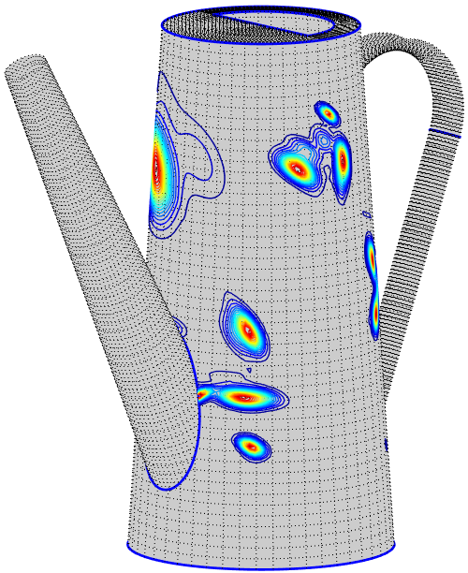
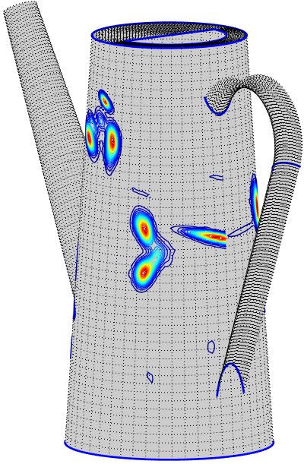
Kernel estimate on the unrolled surface

Slide 16
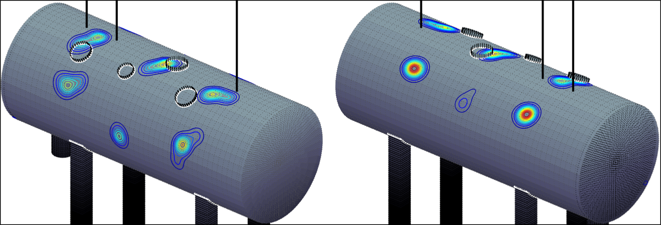
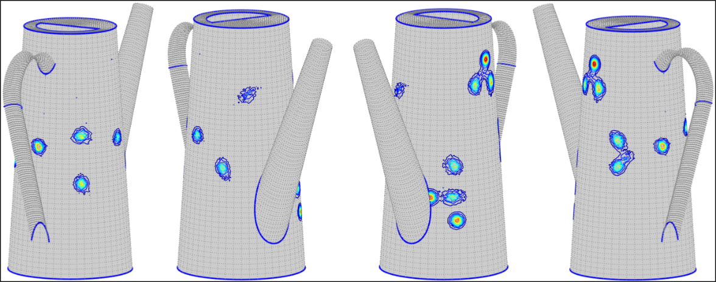
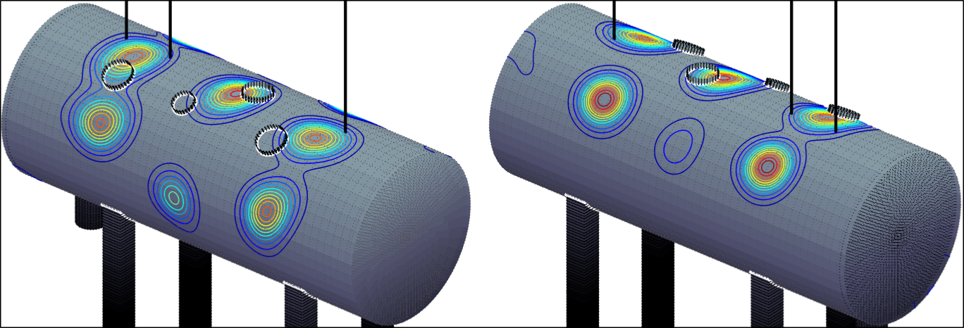
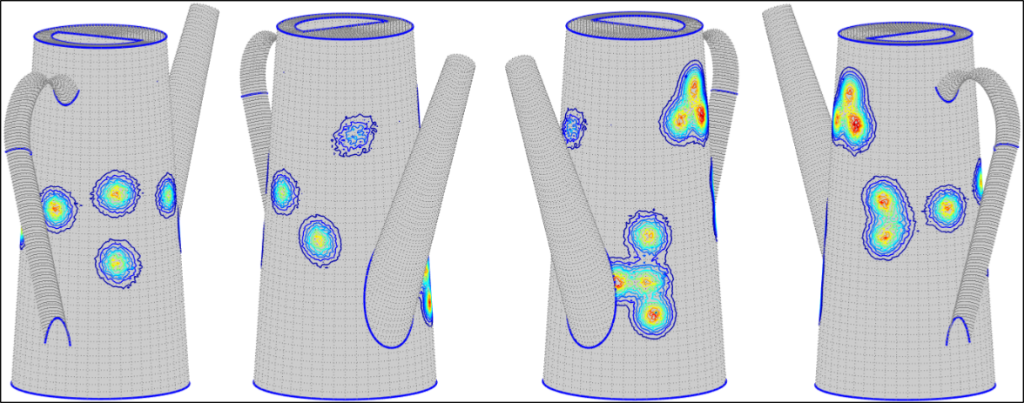
Kernel estimate on the curved surface
$h=0.75 cm$
$h=0.5 cm$
$h=1.5 cm$
$h=1.0 cm$

